Slide 1
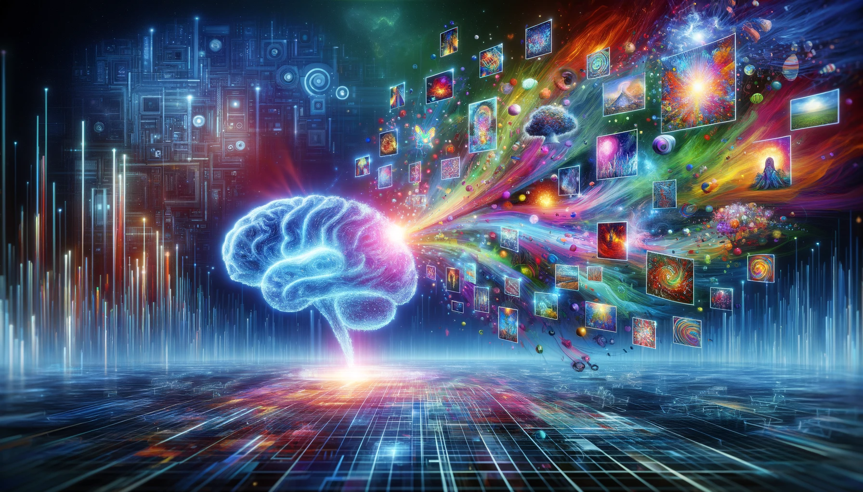
A glimpse of the possibilities with text-to-image generative AI

Slide 2
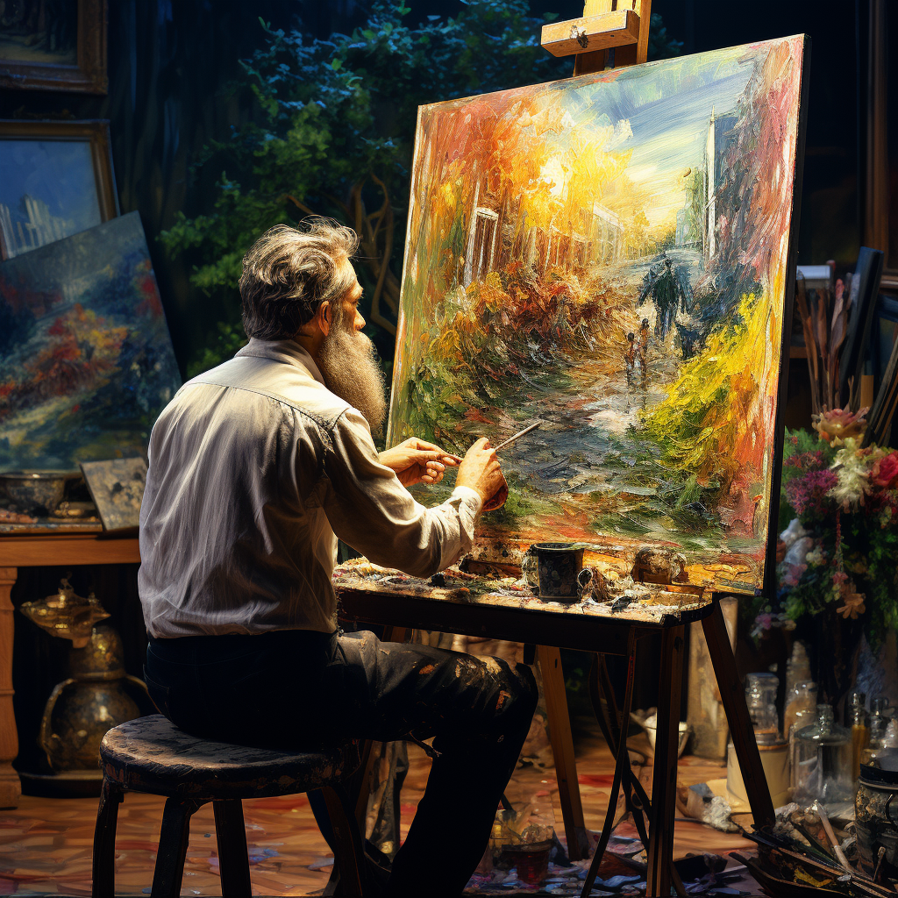
What is text-to-image generative AI?
Prompt:
artist, painting, easel, post impressionism
Prompt for opening picture:
Can you make a cool illustration for the opening slide in a presentation on the possibilities with text-to-image generative AI?

Slide 3
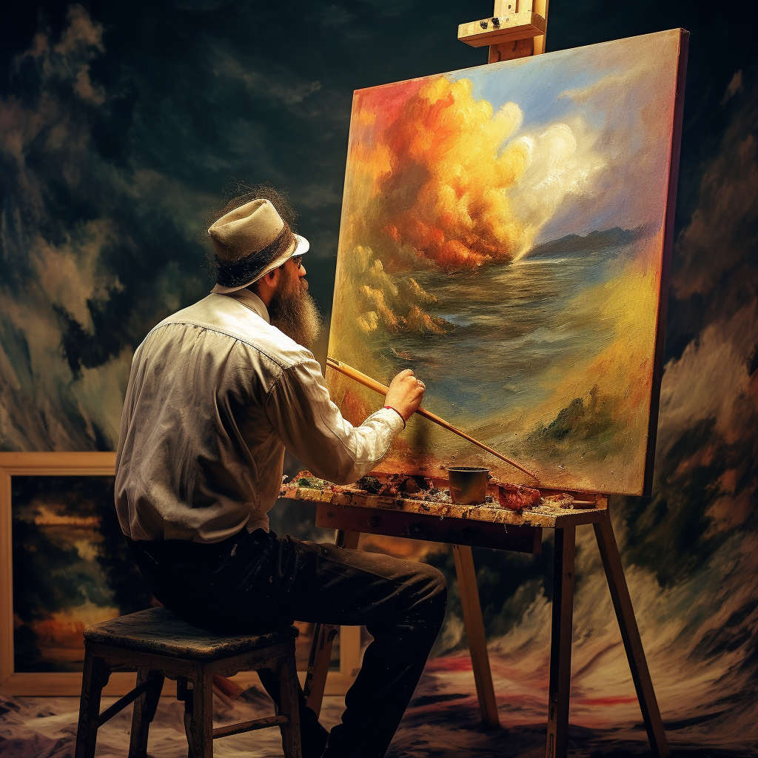
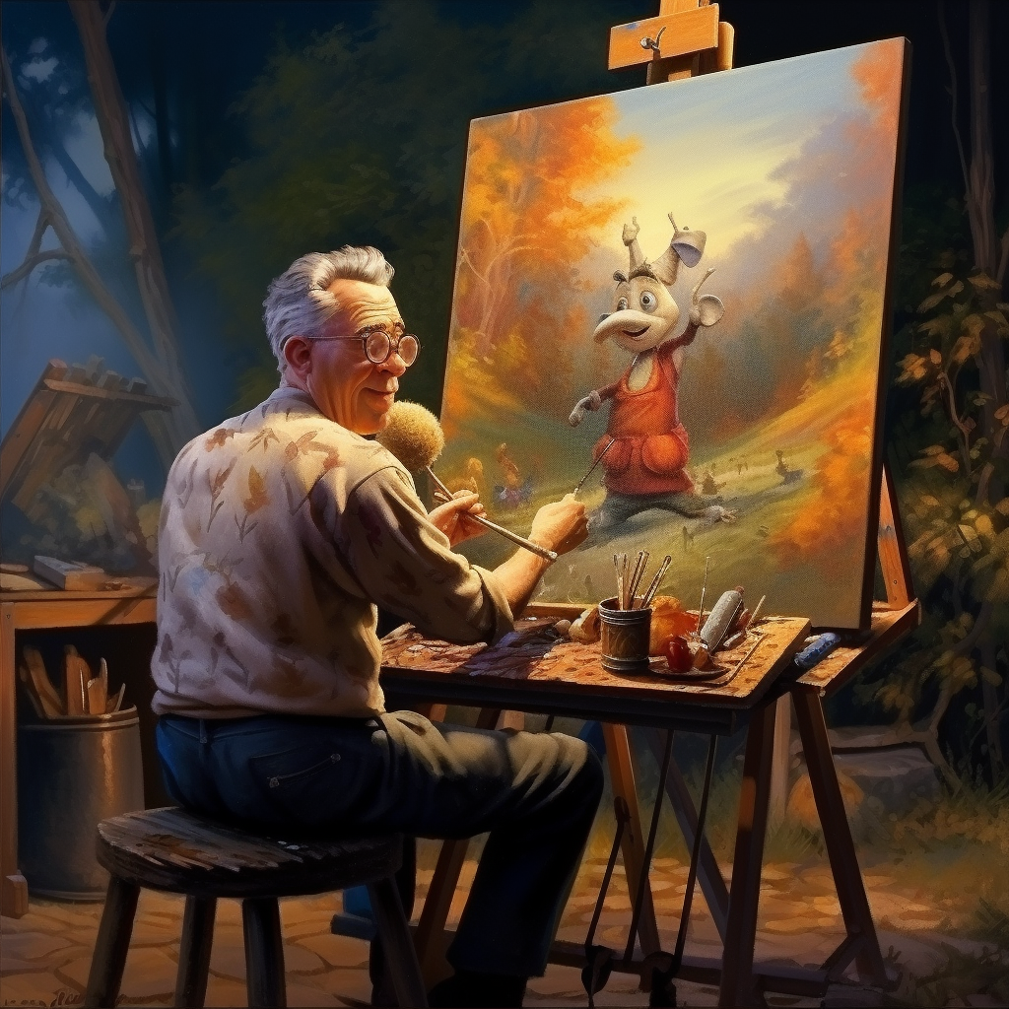
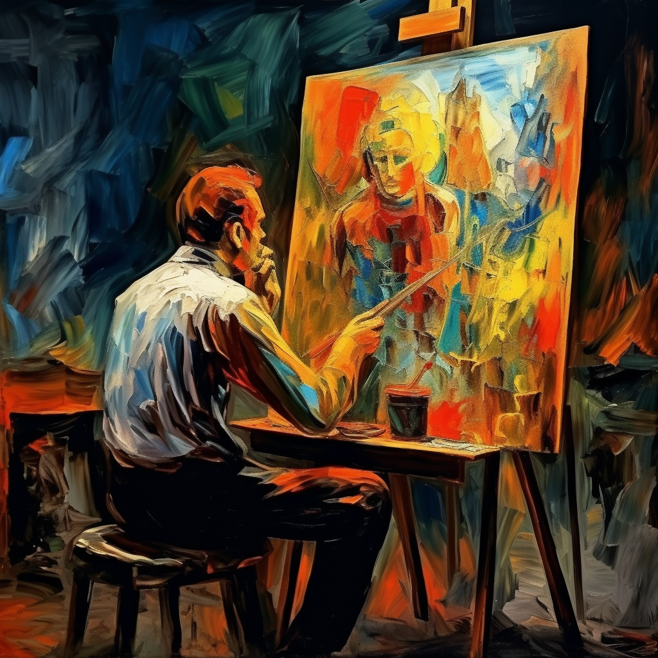
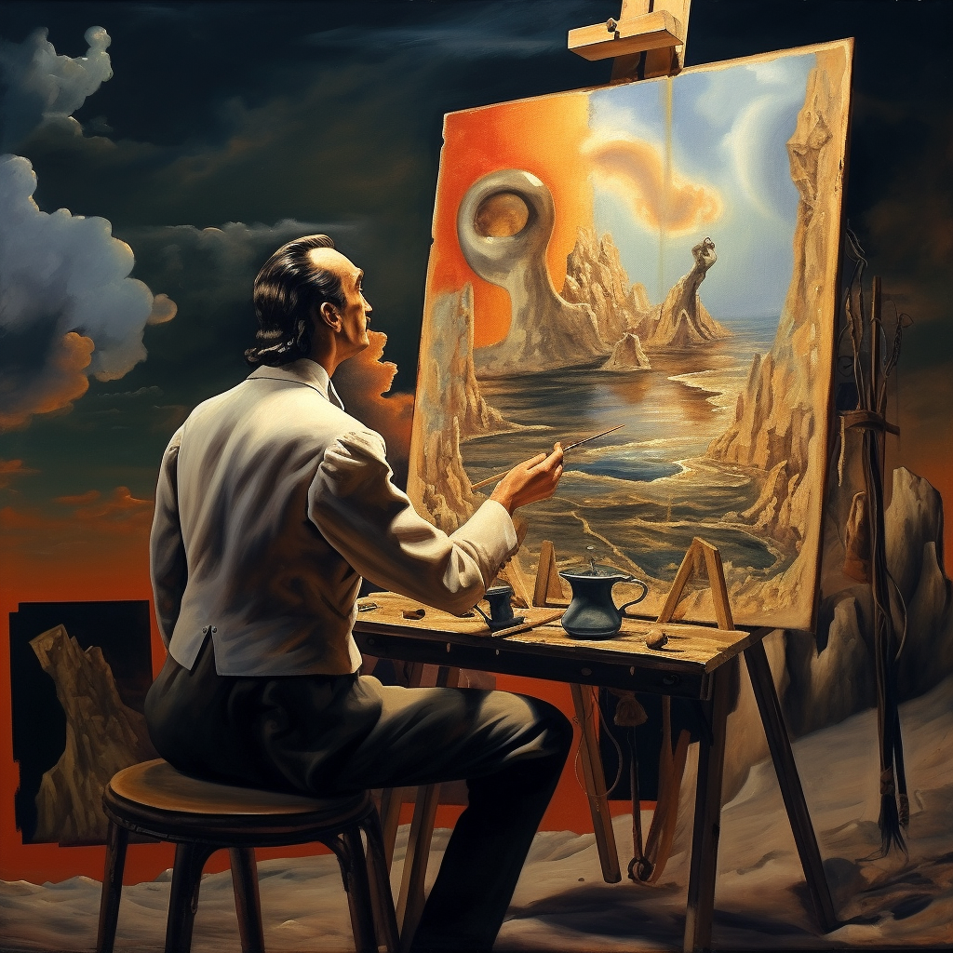
The AIs can generate pictures in any style you like
Photography
Pixar
Broad brushes
Salvador Dali

Slide 4
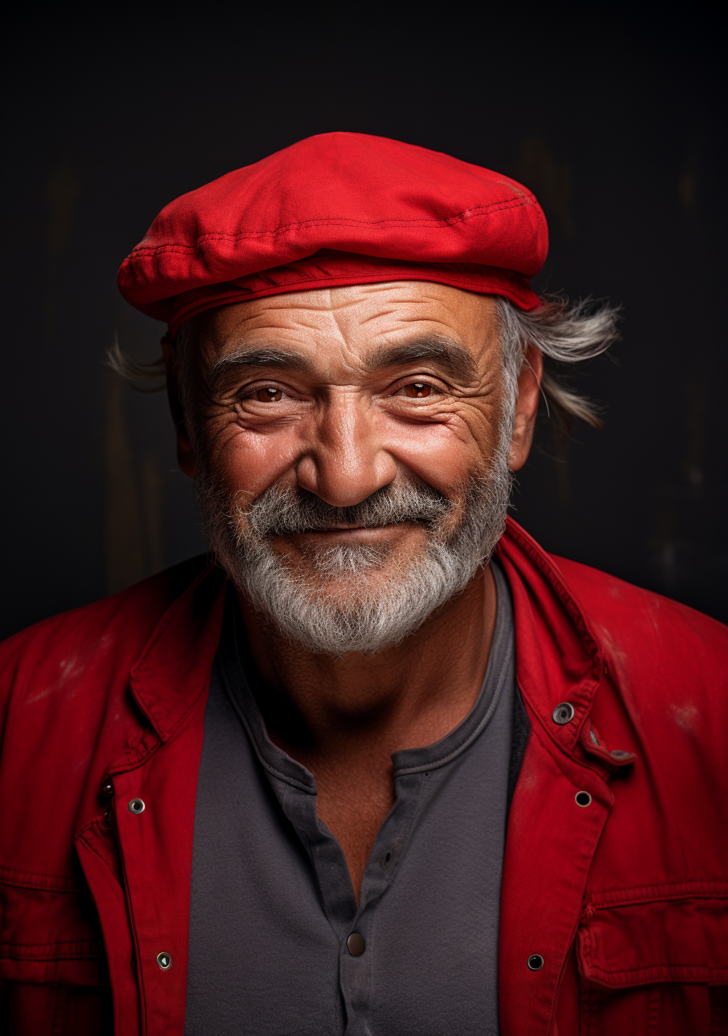
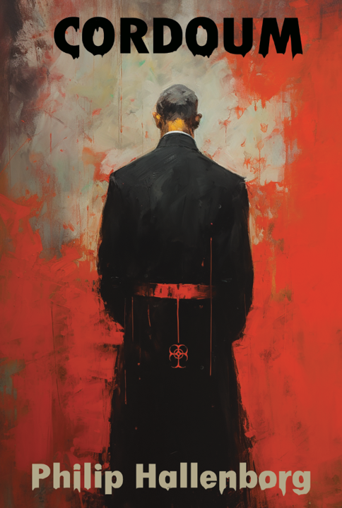
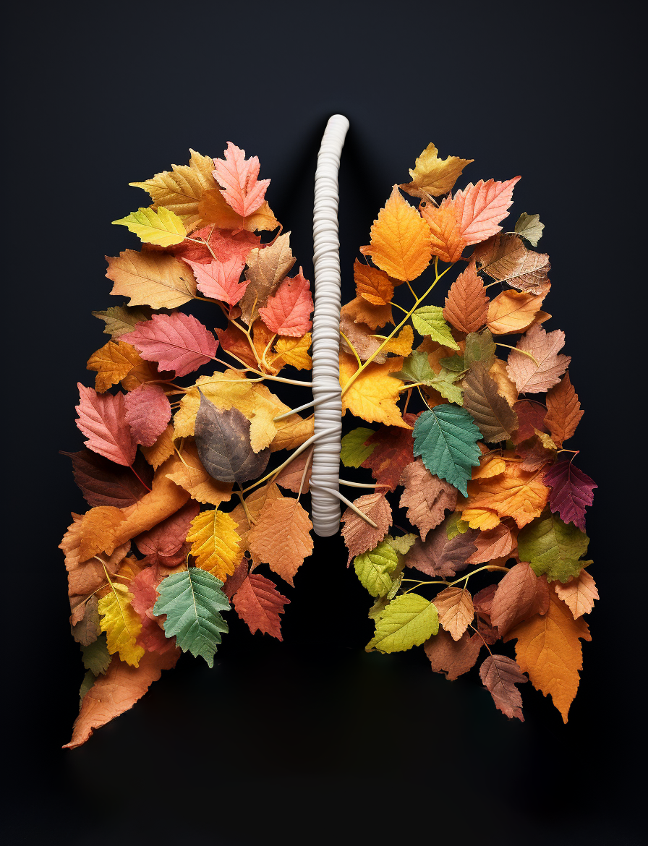
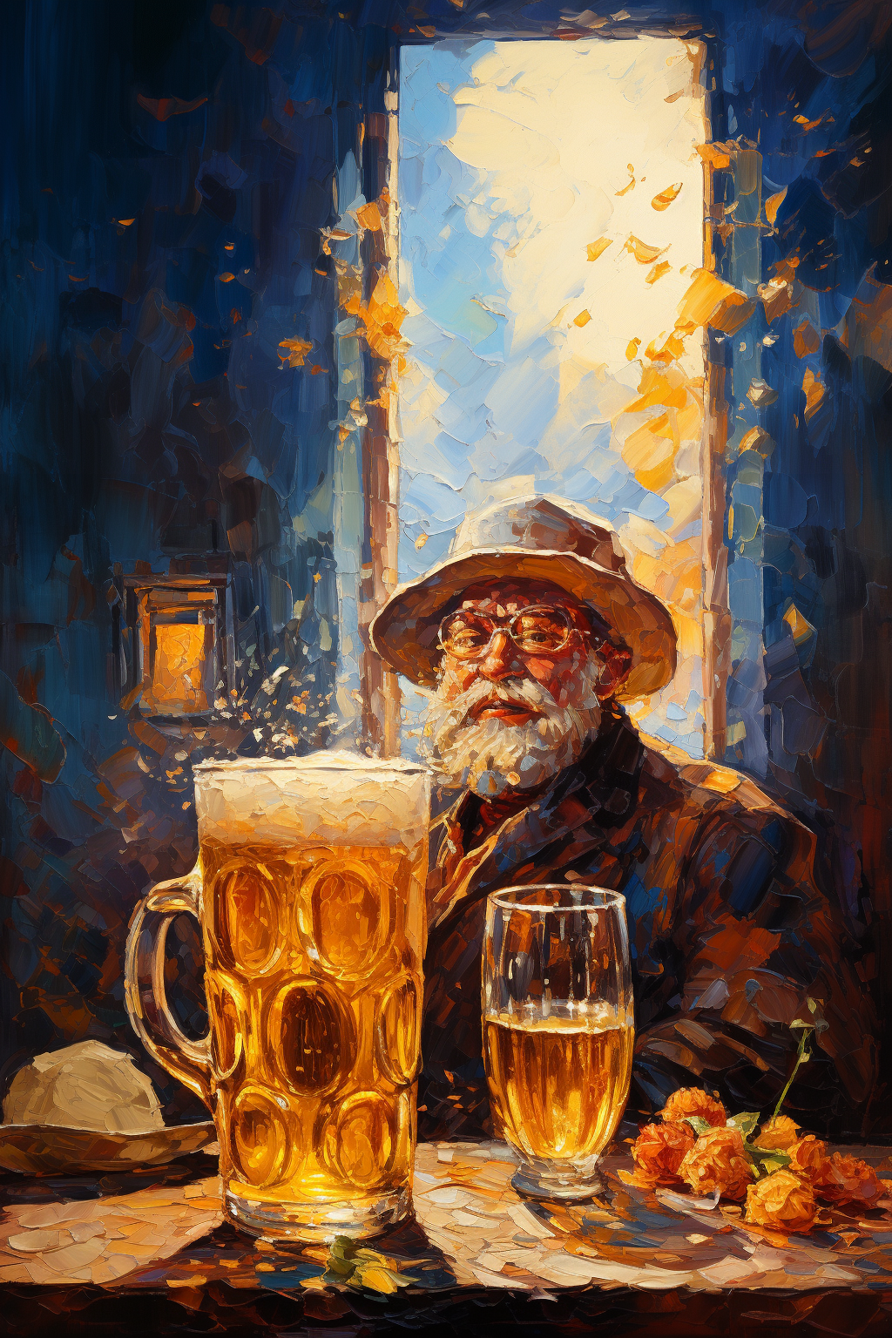
My experiences with text-to-image AI
Treasure hunt
Logos
Book cover
Cover art

Slide 5
What you can use text-to-image AI for
Cover art for publications
Logos for research consortia
Artistic elements for presentations
…

Slide 6
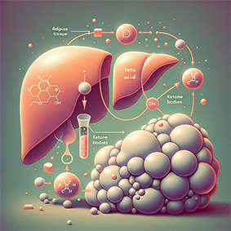
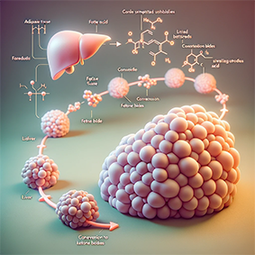
What you can use text-to-image AI for – if you have patience
Graphical abstracts

Slide 7
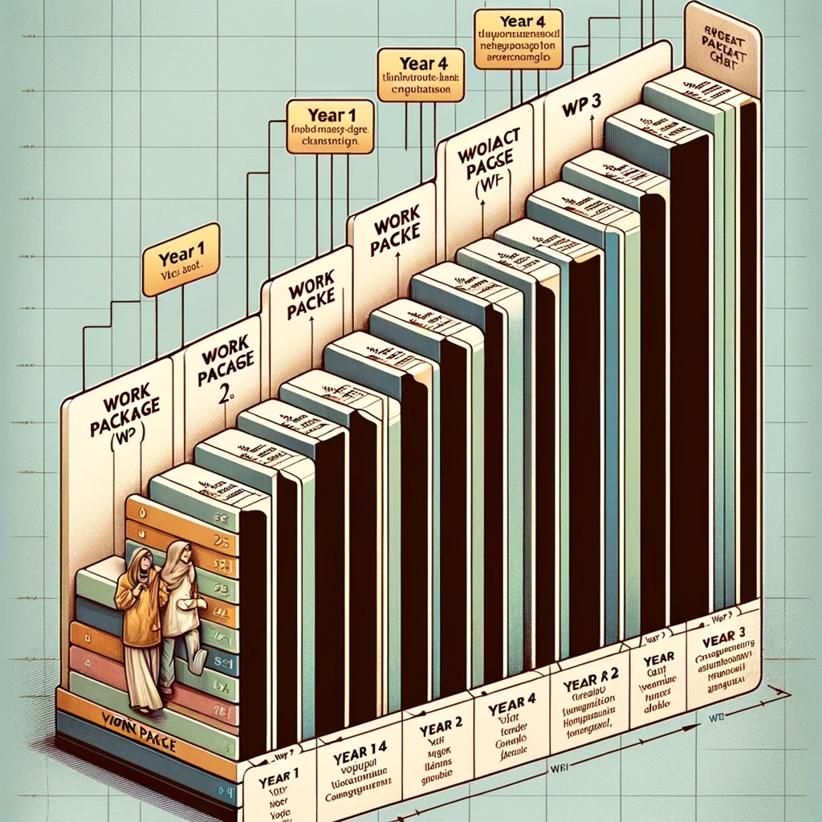
What you cannot use it for - yet
Gantt charts
Can you render a Gantt chart for a 4-year research project, with WP1 spanning year 1, WP2 spanning year 2-3, and WP3 spanning year 4?

Slide 8
What you cannot use it for - yet
Graphical representations of pathways

Slide 9
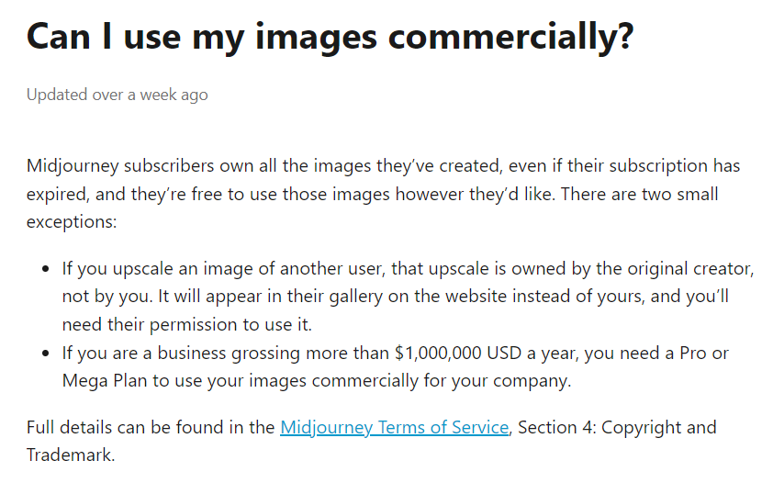
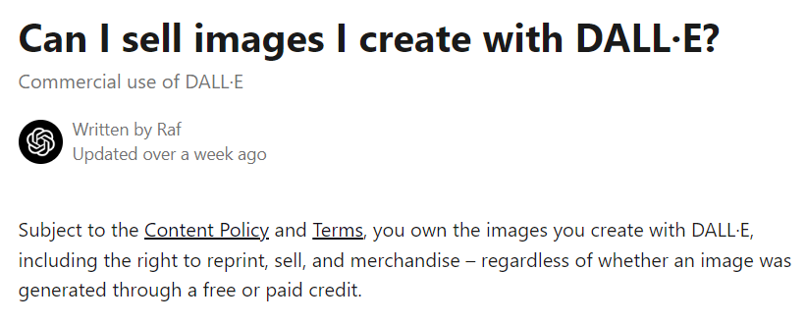
The AIs we are having a look at today
Midjourney
DallE 3
Photoshop

Slide 10
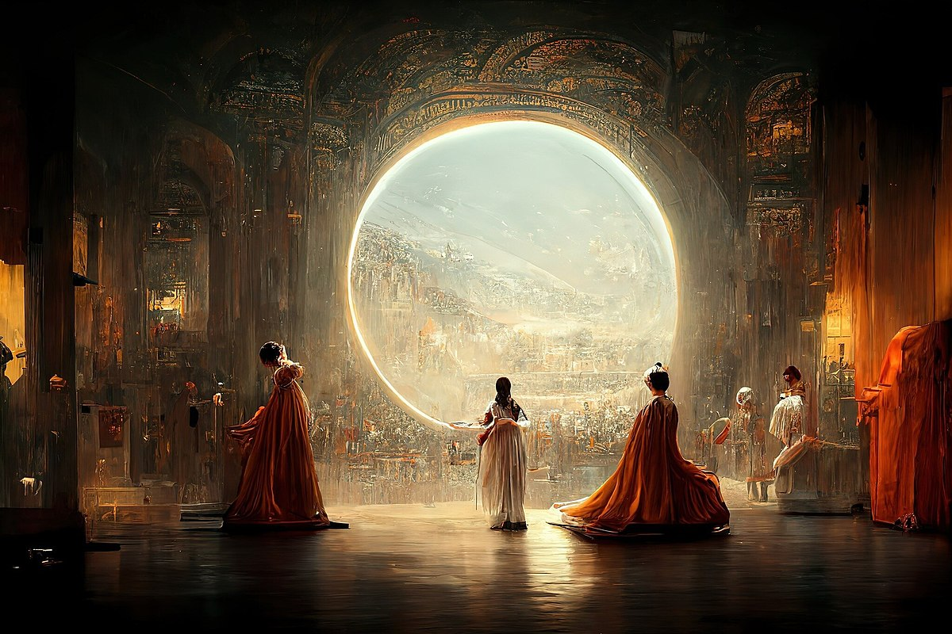
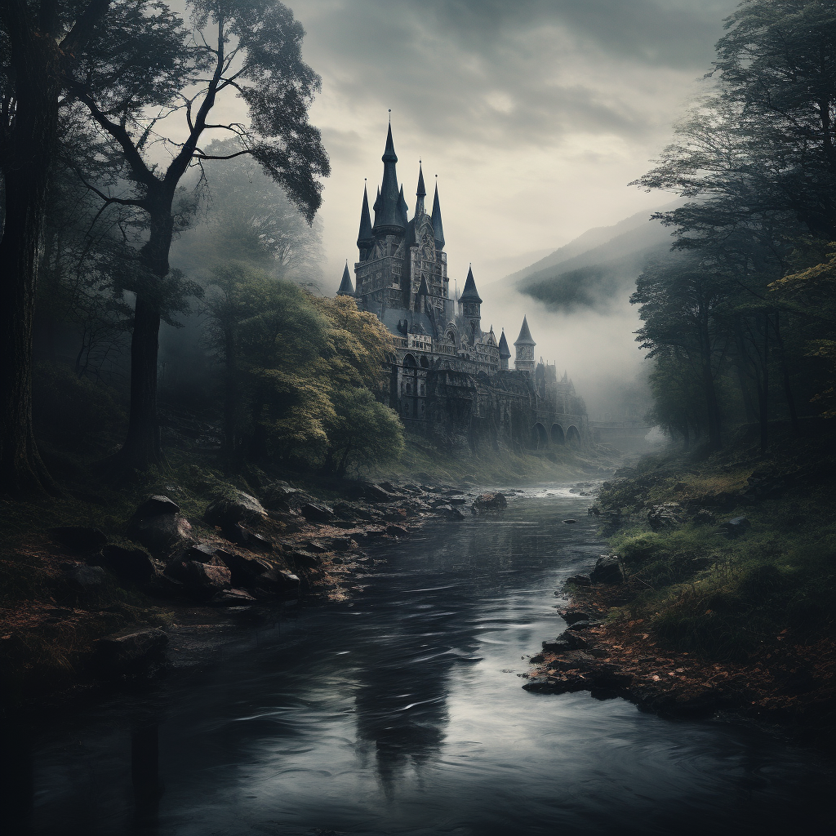
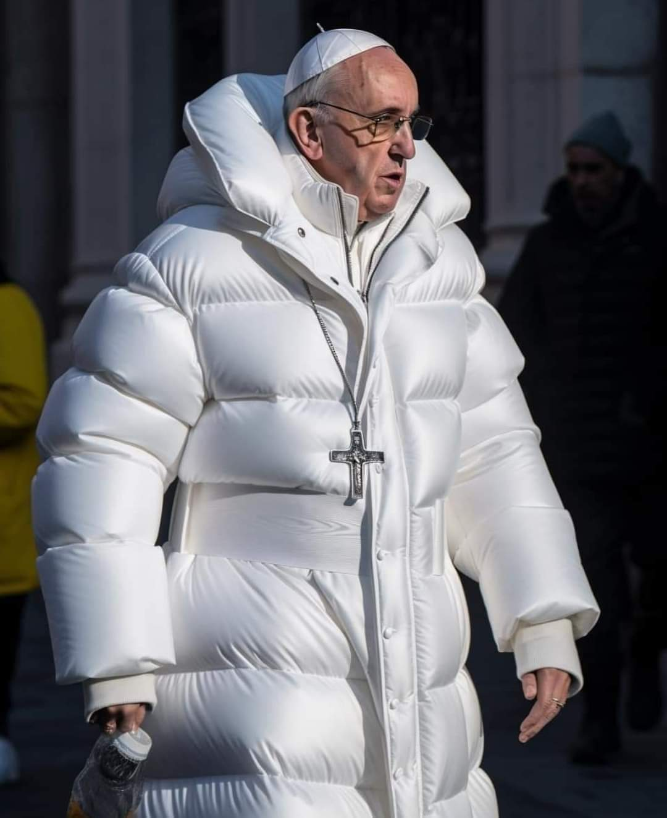
Midjourney - general
Prompt:
river, elven castle, forest, gloomy, in the style of lord of the rings, hyper-realistic photography
Jason M. Allen / Midjourney

Slide 11
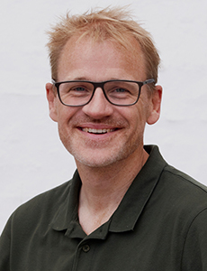
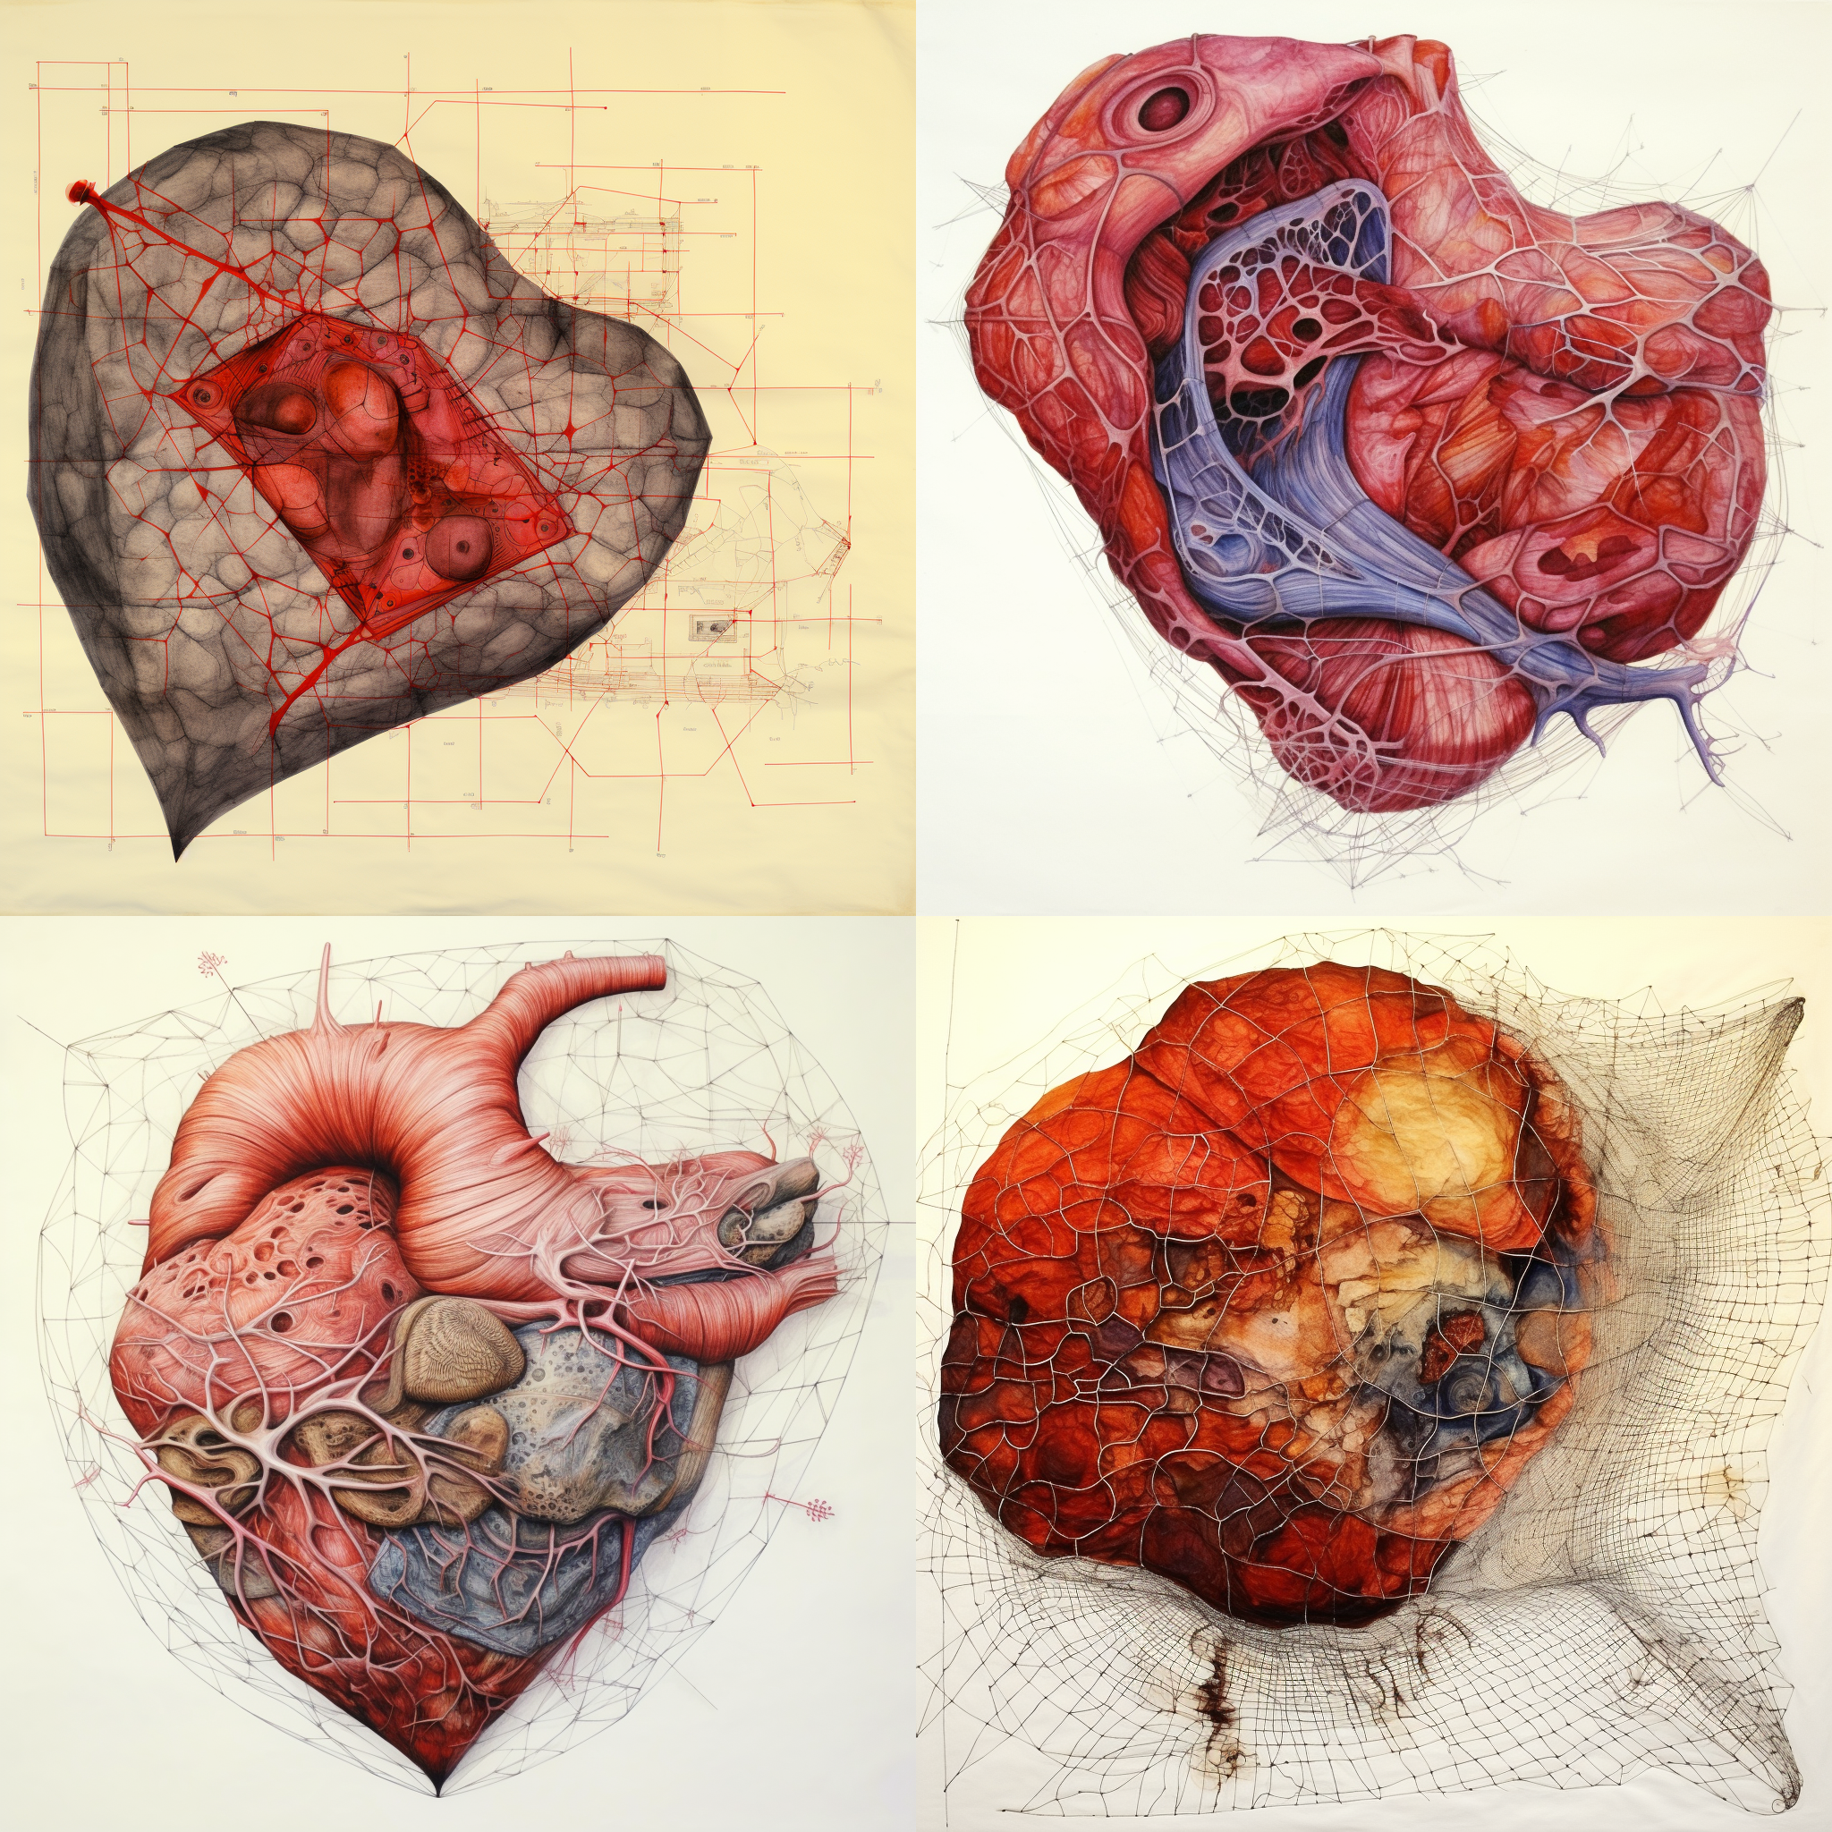
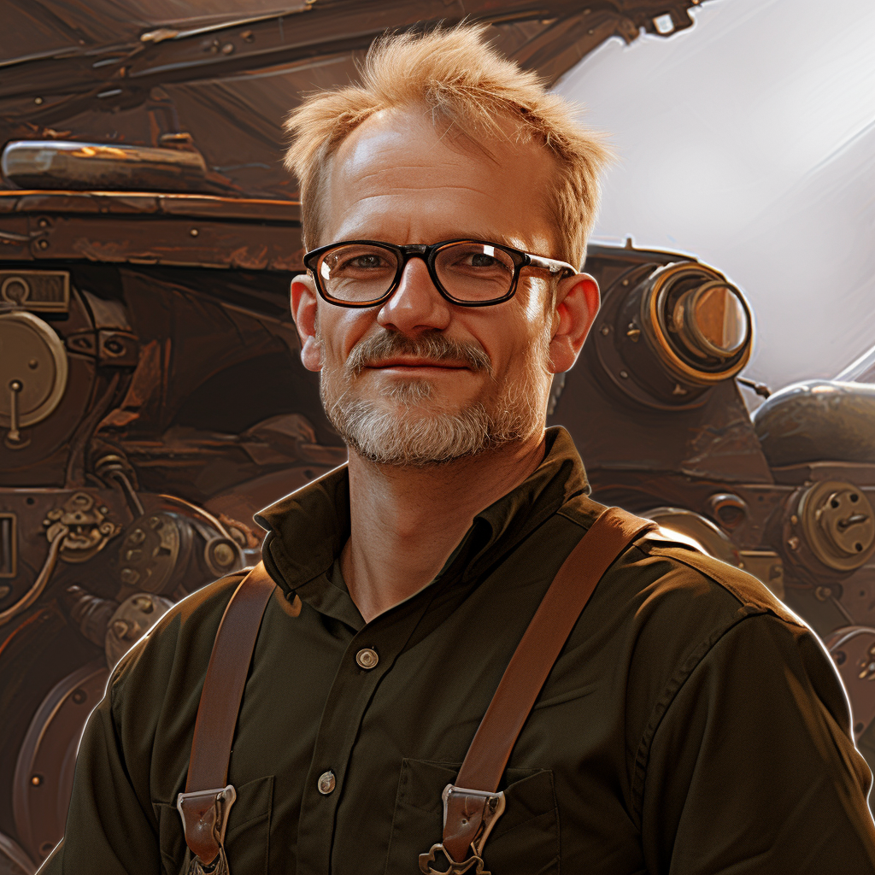
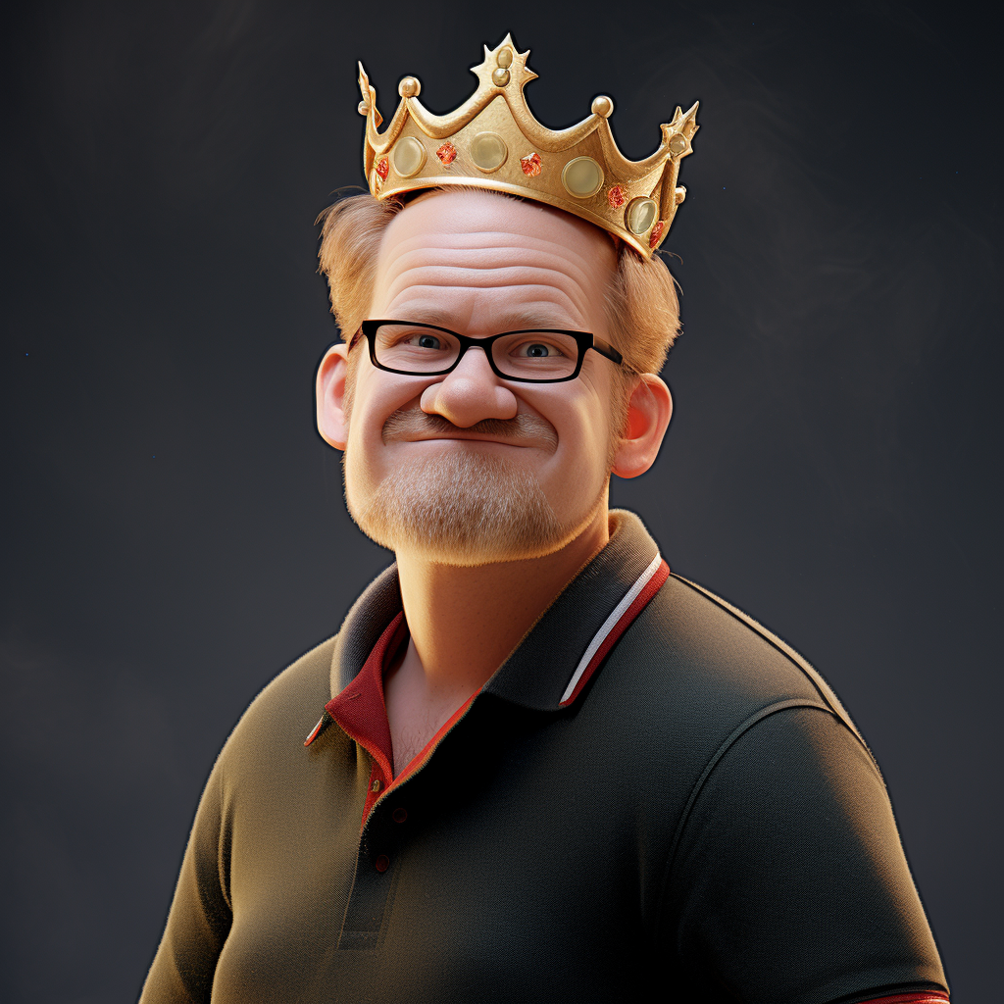
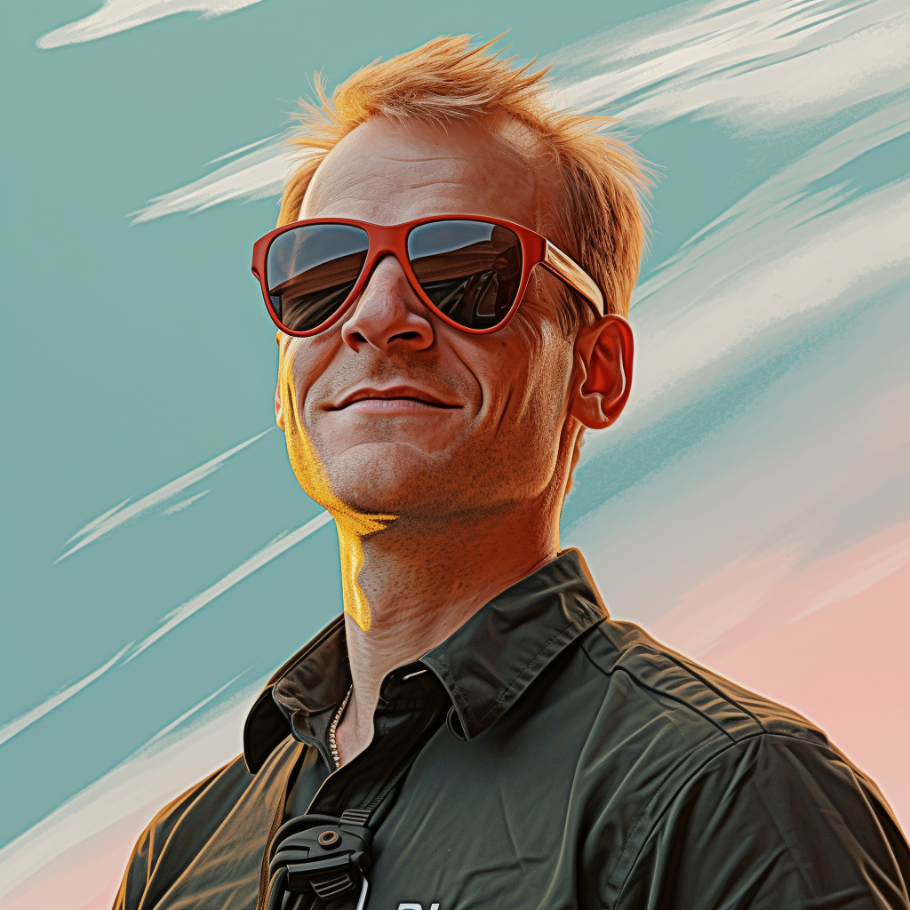
Midjourney – general #2
Prompt:
fat tissue, liver, circulation, graphical sketch

Slide 12
Midjourney - overview
Strengths
Weaknesses
Great for creating images with a high level of atmosphere/mood
Excellent for idea creation
Can generate high-resolution images
Can produce images in any aspect-ratio
Specific parts of images generated can be edited
Unsurpassed in generating portraits and realistic photos
Cannot handle letters AT ALL
Awful in making flow diagrams
Cannot understand a context or concepts
Only for paying subscribers

Slide 13
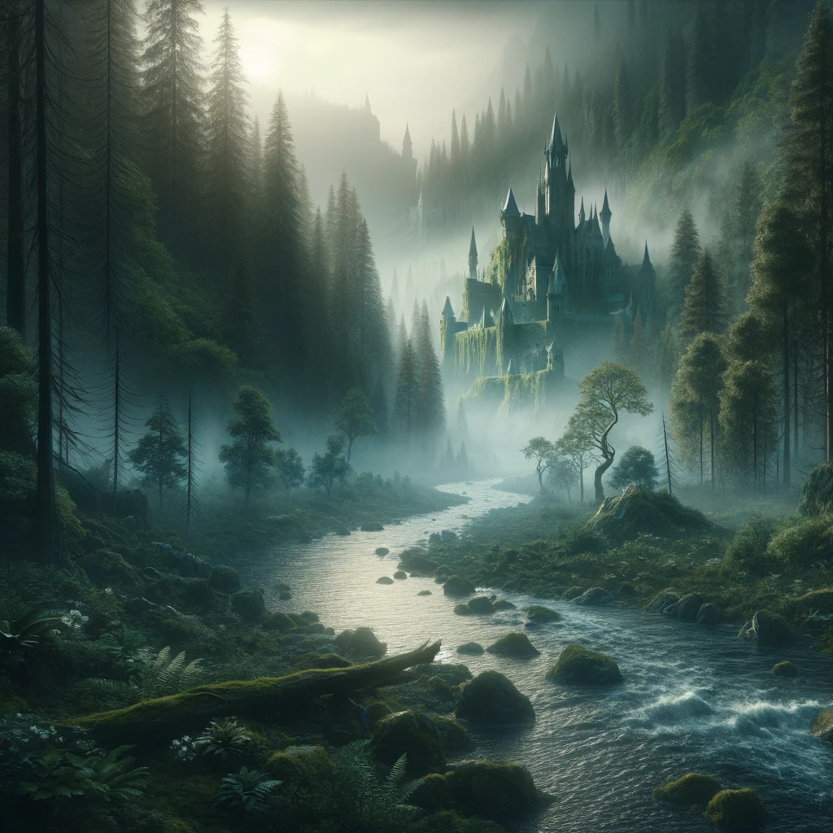
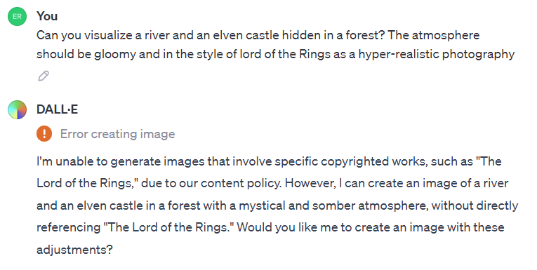
DallE3 - general
Prompt:
Can you visualize a river and an elven castle hidden in a forest? The atmosphere should be gloomy and in the style of lord of the Rings as a hyper-realistic photography

Slide 14
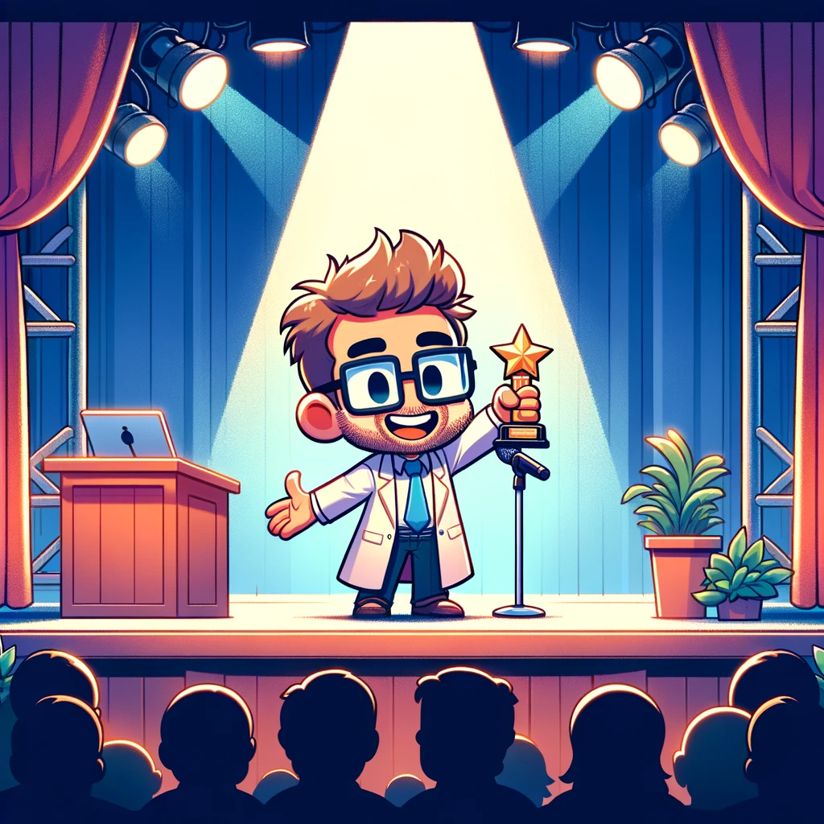
DallE3 – logos and consistency

Slide 15
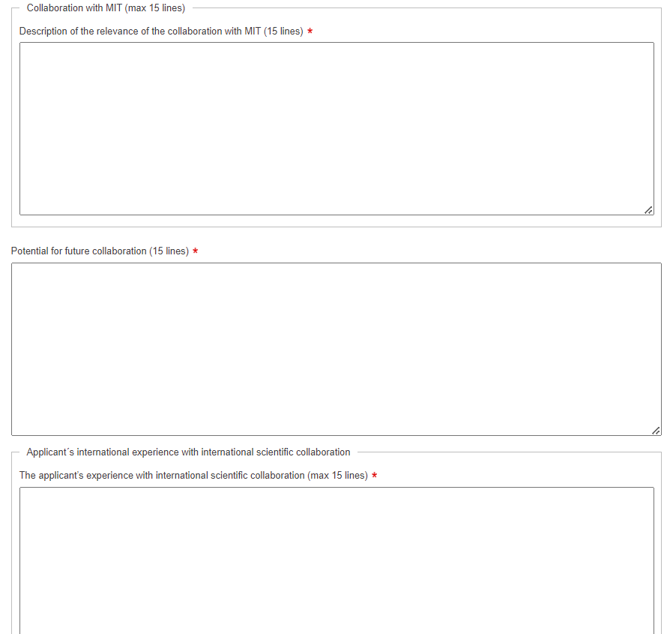
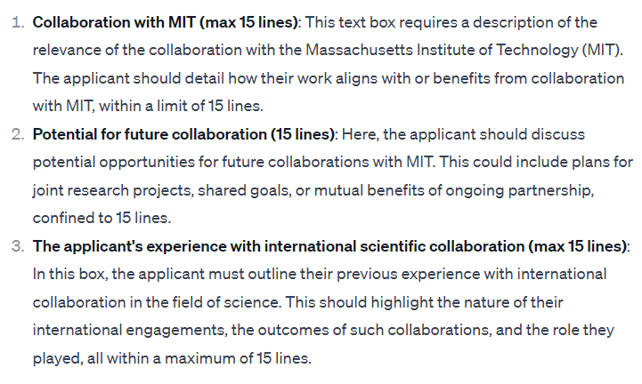
DallE3 – analyzing pictures

Slide 16
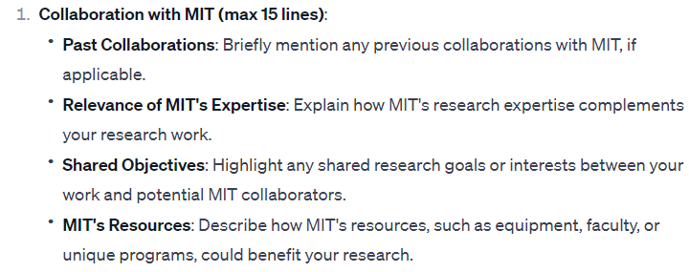
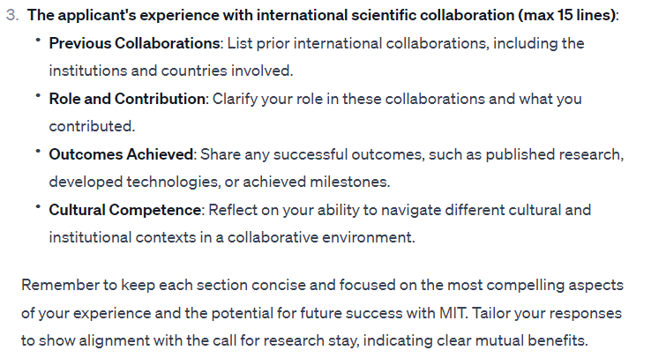
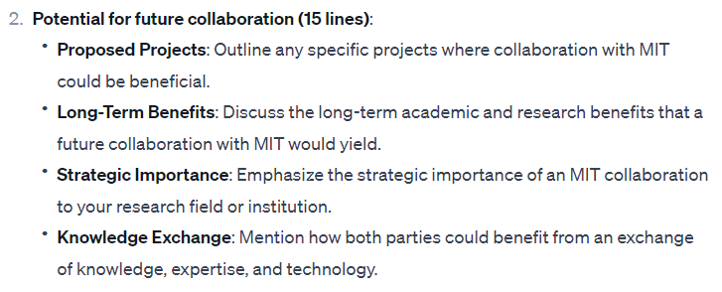
DallE3 – analyzing pictures #2

Slide 17
DallE3 - overview
Strengths
Weaknesses
”Excellent” in handling letters
Highly interactive
Understands concepts and contexts
Produces elegant logos
Freely available in Bing
Should be able to name things in images and reproduce them in new ones
Cannot edit already generated imags
Low resolution images

Slide 18
DallE3 and Microsoft Copilot
DallE3
Copilot

Slide 19
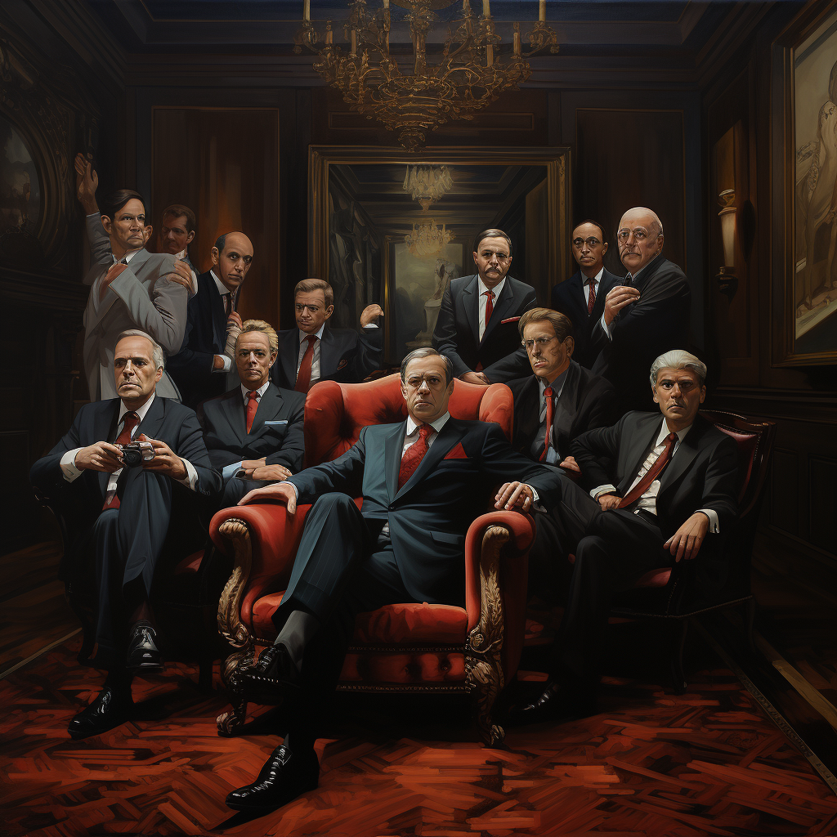
Stereotypes in Midjourney vs. DallE3
Prompt:
Group of CEOs
Midjourney
DallE3

Slide 20
Photoshop – expand photos

Slide 21
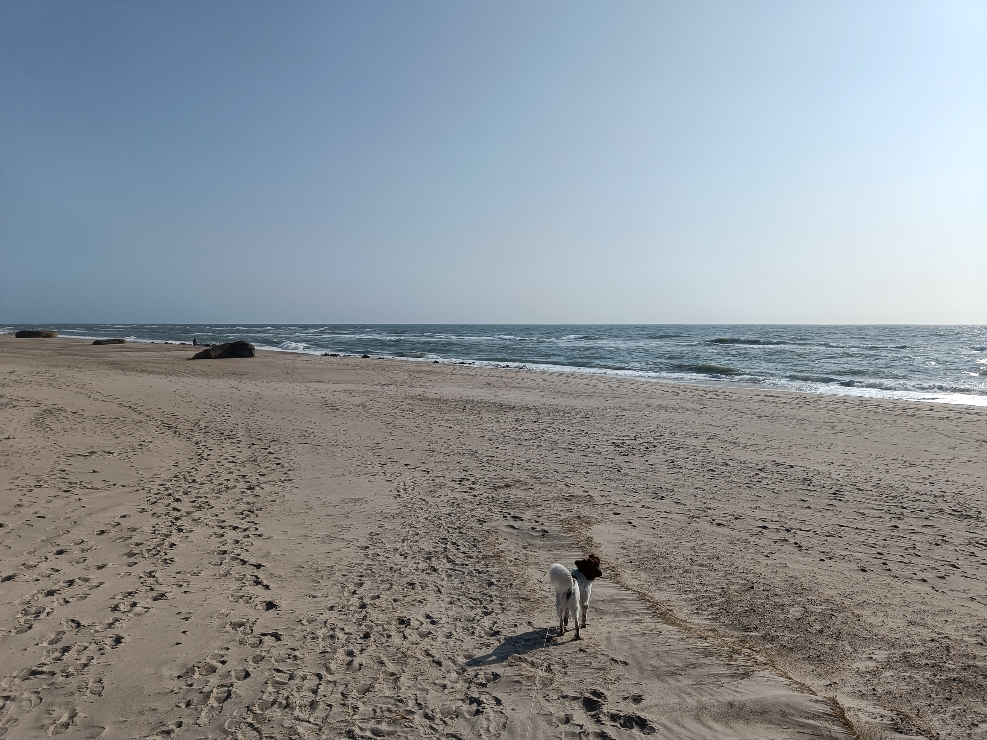
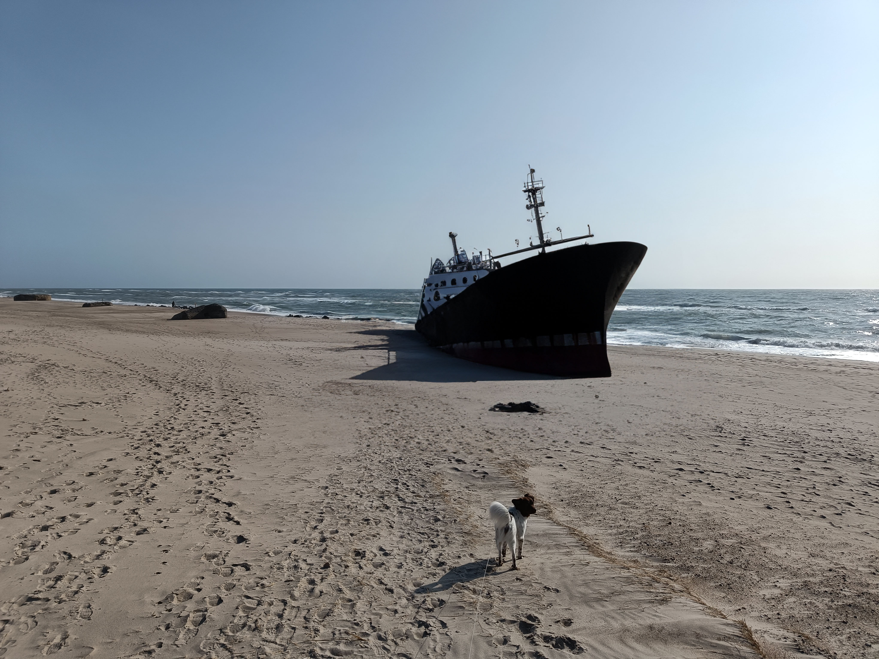
Photoshop – add elements to images

Slide 22
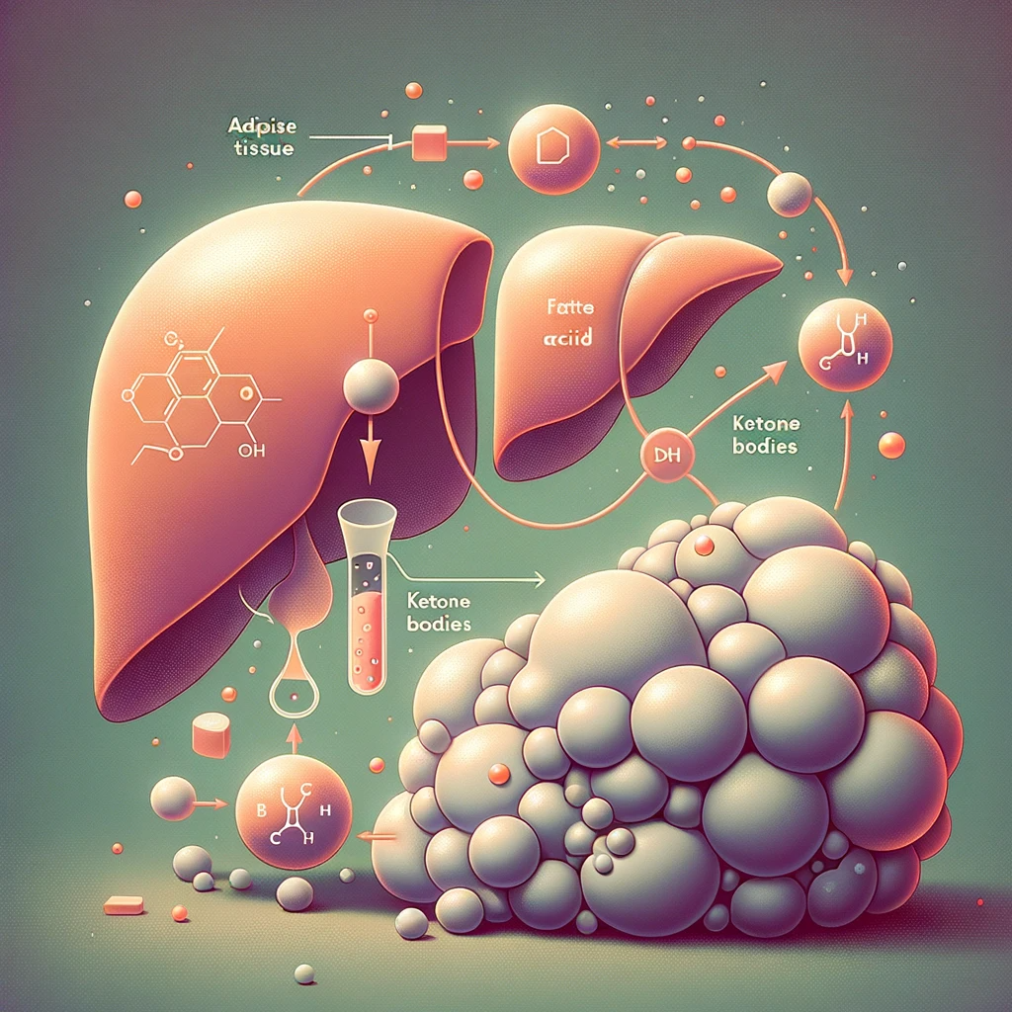
Photoshop – remove elements

Slide 23
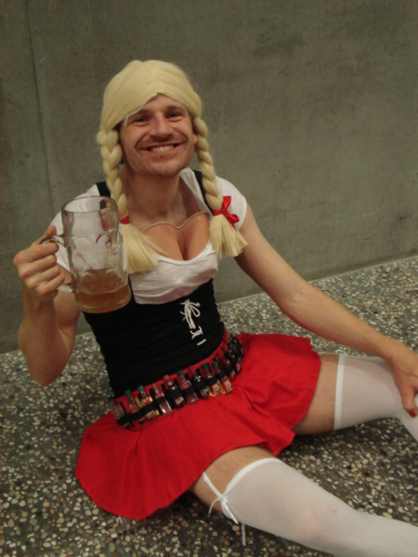
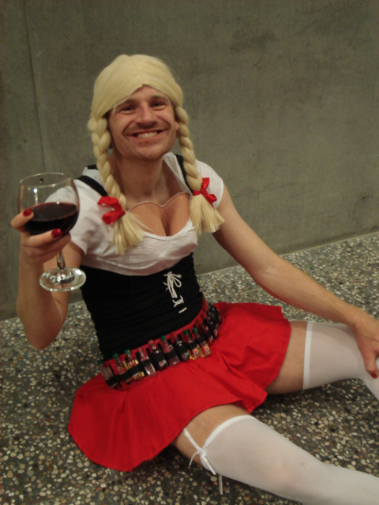
Photoshop – edit images

Slide 24
Photoshop - overview
Strengths
Weaknesses
Great for expanding images in certain directions
Perfect for editing existing images – adding, removing or changing objects
Not ideal for generating an image from scratch
Cannot understand a context or concepts
Requires Adope license

Slide 25
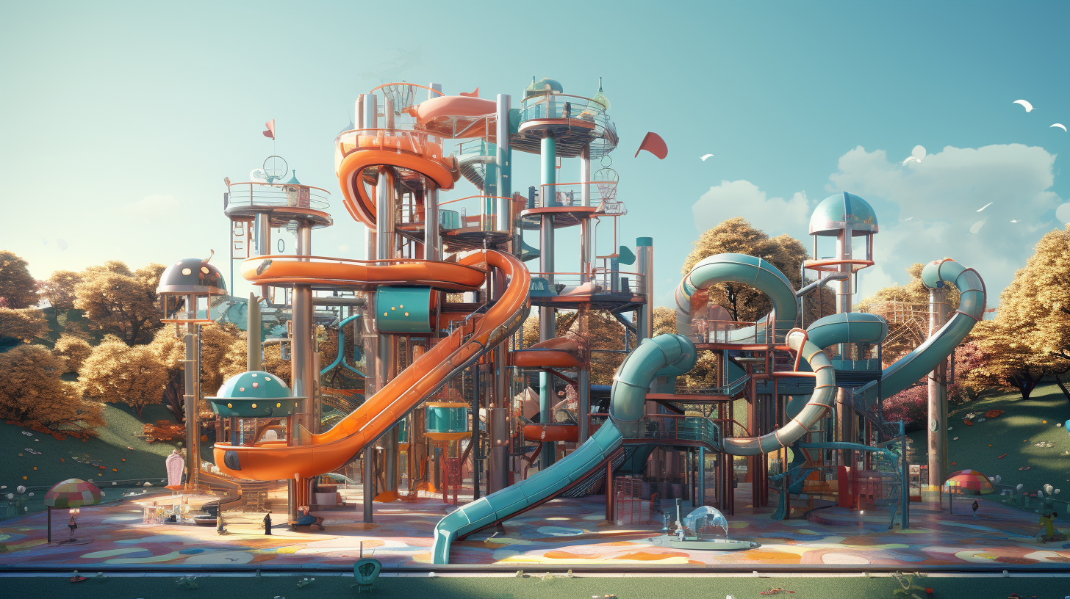
The playground is now open!

