Slide 1
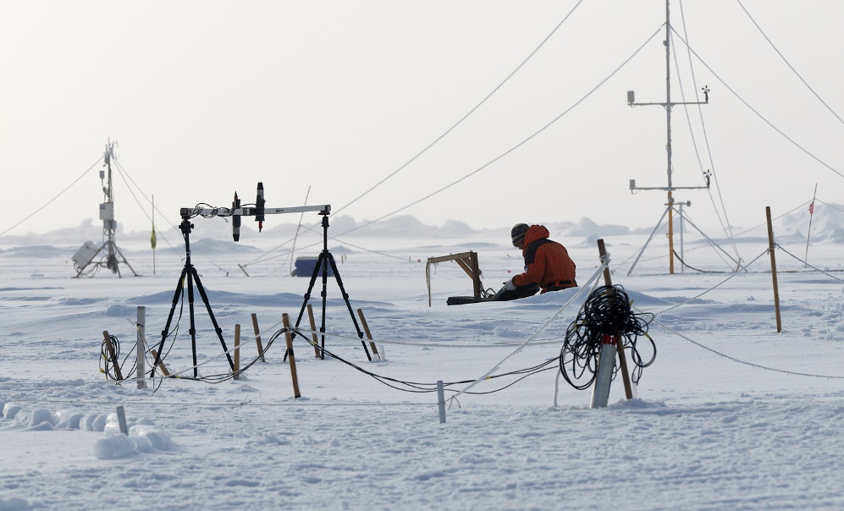
12th Call for new Centers of Excellence
Professor Søren-Peter Olesen, CEO

Slide 2
Overview 12th application round
Timeline
Submission of outline proposals | December 4, 2023
Decision on outline proposals | Feb 28 - March 1, 2024
Submission of full application | May 6, 2024
Interview + decision | September 2-4, 2024
New centers may start operating | From spring 2025
Notes:
Calls for new centers are announced approximately every two and a half years
A two-stage application process.
In the first stage, prospective center leaders are invited to submit short outline proposals.
In the second stage, applicants are invited to submit full proposals that are reviewed by three international experts in the field. Prior to the final selection, the board interviews each applicant.

Slide 3
Life Cycle of a Center of Excellence
Call
Expression of Interest
Center start Midterm evaluation Final evaluation
Full proposal
Continuation at host institution
1st period
2nd period
0 1 2 3 4 5 6 7 8 9 10
Year
Annual follow-up meetings

Slide 4
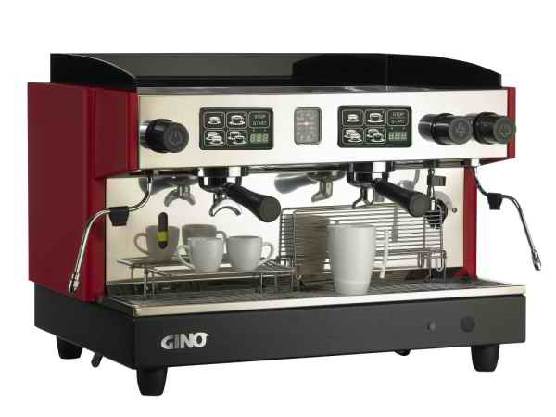
What is a Center of Excellence?
Group of researchers who jointly pursue a set of intriguing, overarching and ambitious research questions
A strong and coherent research environment forming a physical community
Clear center identity
Headed by a researcher with high international standing
Attractive research training sites
Spillover to education/host institution

Slide 5
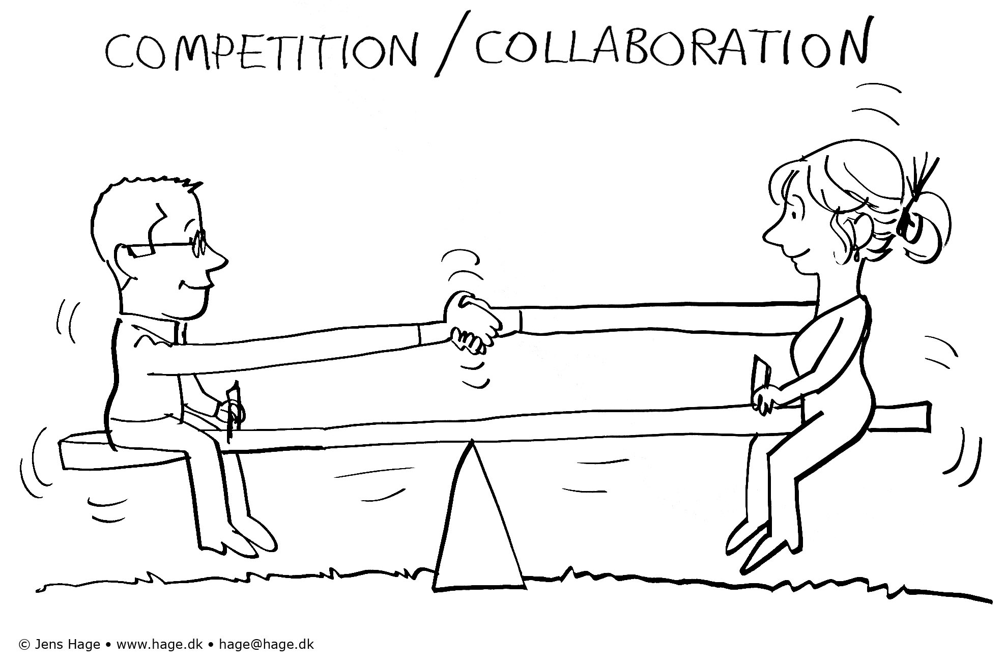
No fixed formula
The size of centers varies from 15 to +60 persons
Many centers are interdisciplinary
The centers are based at Danish research institutions. International institutions can be included
The size of grants: up to 36 or 60 million DKK for a 6-year period (incl. 44 % OH for universities) plus extraordinary expenses

Slide 6
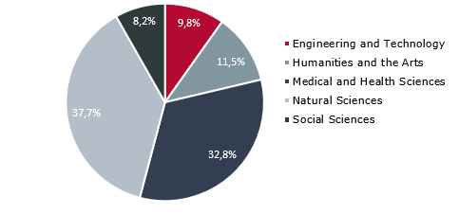
122 centers distributed among main scientific fields
122 centers established since 1993
At present 40 active centers
Notes:
The foundation welcomes proposals from all fields of research.
Centers can be established within and/or across all research areas: Humanities, Life Sciences, Natural Sciences, Social Sciences and Technical Sciences.
A majority of the centers can be described as interdisciplinary and, therefore, do not readily fit into one category.
The figure shows how the 122 centers established so far, categorize by main research field.

Slide 7
Centers of Excellences Examples

Slide 8
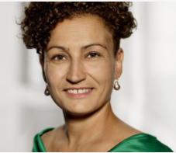
Centre for Urban Network Evolutions
The center explores the archaeology and history of urban societies and their networks from the Ancient Mediterranean to medieval Northern Europe and to the Indian Ocean World
An interdisciplinary research initiative, which integrates contextual cultural studies rooted in the humanities with the natural sciences
Located at Moesgaard Museum and AU
Rubina Raja
Notes:
Centerleder: Professor Rubina Raja
Periode: 2015 – 2025
Ansøgningsrunde: 8. ansøgningsrunde

Slide 9
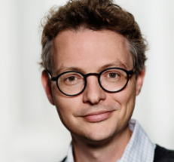
Center for Evolutionary Hologenomics
The center investigates how interaction between genes and microbes determine biological evolution
The vision is to re-tel the story of life, evolution and the big transitions such as the cambrian explosion, plant digestion, and domestification of animals
Located at Globe Center, KU
Marcus Thomas Pius Gilbert
Notes:
Center leader: Professor Marcus Thomas Pius Gilbert
Period: Jan. 2020 - Dec. 2025
Application round: 10th Round
Host institution: University of Copenhagen

Slide 10
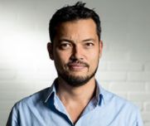
Center for Silicon Photonics for Optical Communications
SPOC addresses the optical communication infrastructures of the future
The center aims to find solutions to the major challenges of communication systems - the energy consumption and potential capacity
An interdisciplinary approach, relying on physics, nonlinear optics, photonic communication technologies, information theory and advanced coding
Located at Technical University of Denmark
Leif Katsue Oxenløwe
Notes:
Center leader: Professor Leif Katsuo Oxenløwe
Period: 2015 – 2025
Application round: 8th Round
Host institution: Technical University of Denmark

Slide 11
Selection and Assessment of New Centers of Excellence

Slide 12
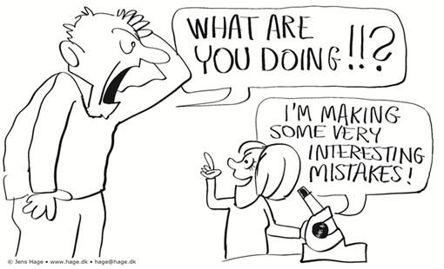
Criteria
Excellence remains the overall criteria. The following dimensions are emphasized when assessing the applications:
The idea
The center leader
The team
The structure/organization
Notes:
Excellence remains the overall criteria. As stated in the Guide for Applicants, the foundation will emphasize the following dimensions when assessing the applications:
The research idea is ambitious and original and has the potential for real scientific breakthroughs in the relevant research field(s).
The proposed center leader has a high standing in the international research community as well as managerial skills.
The center includes high-quality personnel in order to establish a creative and dynamic international research environment that will provide an inspirational training ground for young researchers.
The focus, structure, and size of the proposed center are such that they set the stage for scientific ventures that would not be feasible within conventional funding from other sources.

Slide 13
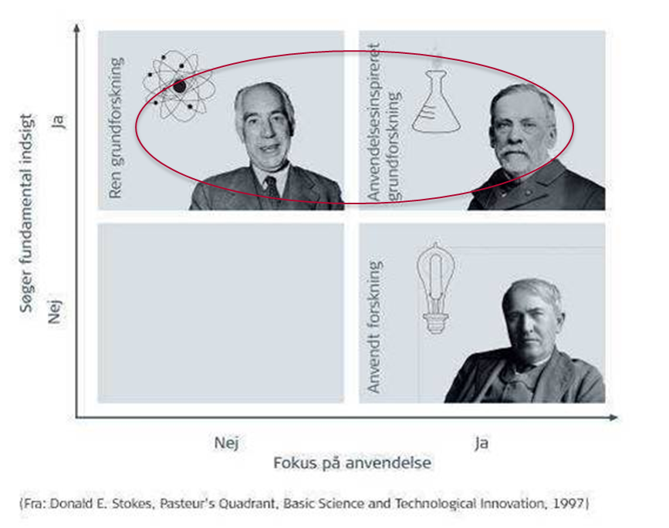
The idea
The research
must have high scientific quality
must be ambitious, visionary
must be original and novel
potentially ground-breaking research within all fields
DNRF wants to support
bottom-up driven ‘dream projects’

Slide 14
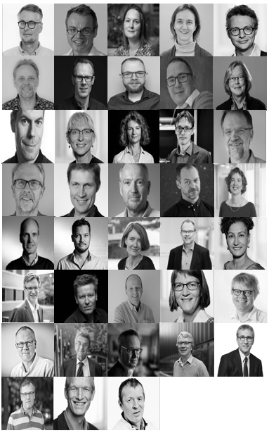
The center leader
An excellent and outstanding scientist with high international standing
A visionary leader capable of fostering a creative and dynamic research environment
Someone who can build the right team and inspire others to deliver their best performance
Leadership is essential !
Notes:
First and foremost an excellent and outstanding researcher with high international standing
A research leader that can create a dynamic risk-taking research groups
A research leader that can create team spirit and common ambitions
A mentor, motivator and catalyst for the next generation
But also
Personnel manager with flair
for administrative and
organizational conditions
Last BUT not least
He/she has flexible means
Administrative help close at hand

Slide 15
Co-applicants
Co-applicants are to be considered senior/key personnel:
Must contribute substantially to the science
Play an active and critical role in the success of the proposed endeavor
Devote a specified percentage of her/his time to the center throughout the funding period

Slide 16
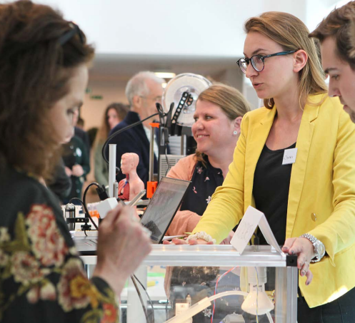
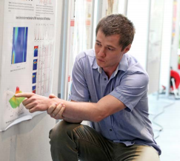
A fruitful environment for training of young scientists

Slide 17
Host institution
Centers should demonstrate a clear center identity in harmony with the host institution
The foundation expects research and new results from the center to spill over to the host environment
educational activities
interactions with other research groups
Commitment from the host institution in terms of
salaries for tenured staff, equipment, in kind and financial commitment
office and laboratory space

Slide 18
Outline proposals - 5 pages only
An argument (1,500 characters)
How will the proposed endeavor redefine the research field?
Which new insights and results may it produce?
Why this proposed team?
A short description (1,500 characters)
To be used to identify peer reviewers
Presentation of the research idea compared with “state of the art” and a strategy for how to reach the goals (10,000 characters)
Organization
Competences/capacities incl. roles of co-applicants
Methodologies and approaches
How to establish a creative and dynamic research environment
Notes:
Consider to address gender issues

Slide 19
Full proposals – 15 pages – peer review
The outline proposal is developed into full proposal – 15 pages
In-depth peer review
3 written peer reviews are collected.
The peers are chosen based on recommendations from external or internal sources.
The applicant is heard on the list of proposed reviewers’ professional complementarity and again on the reviews.
Notes:
The external reviewers
The DNRF will send full proposals for external review to three international experts within the relevant research area(s), two of whom are leading experts and one of whom is a generalist within the broader field.
Each applicant may submit the names of three high-level experts, one of whom will be chosen by the foundation to serve on the panel of reviewers who will assess the proposal. The foundation will choose the other two reviewers based on recommendations from external and/or internal sources.

Slide 20
Peer review - basic principles
Fairness
’Equal treatment’ of all proposals
No overlap in peer reviewers
Quality
True peers
Well argued reviews (not reduced to numbers, ranking/grading)
Transparency
‘Double open’
Extensive consultation procedure

Slide 21
Interview with applicants
25 minutes
Center leader gives a presentation (~10 min)
Discussion with the board –
…

Slide 22
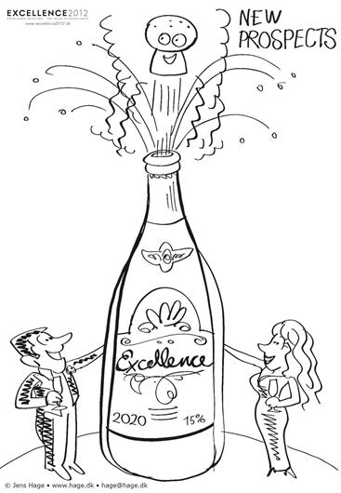
Contract negotiation - inauguration
The DNRF and the center leader negotiate with the host institution.
New centers may be operating starting in the spring of 2025

Slide 23
Tips
The DNRF board is your target group at first
Explain how the project will redefine science and why exactly your outline proposal/application should get funded
Be ambitious, daring and original
Be concrete – envision daily life in the center
Ask advice from present and former center leaders
Do not hesitate to contact the DNRF secretariat for advice

Slide 24
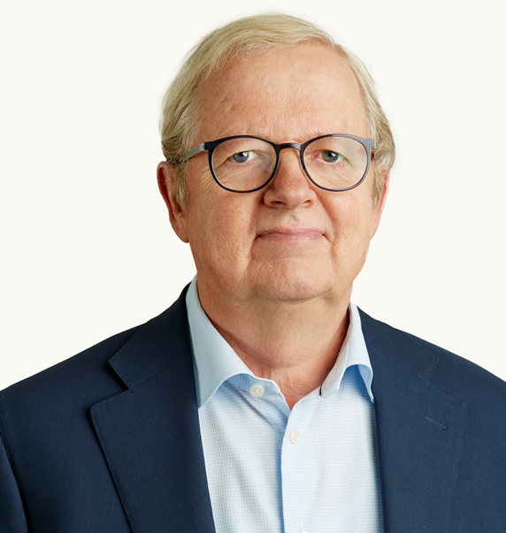
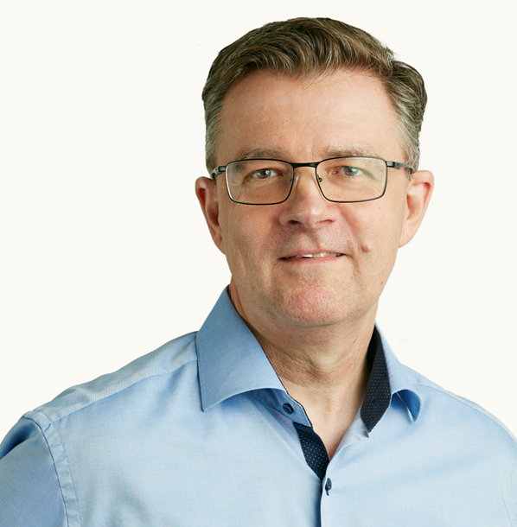
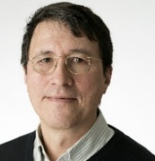
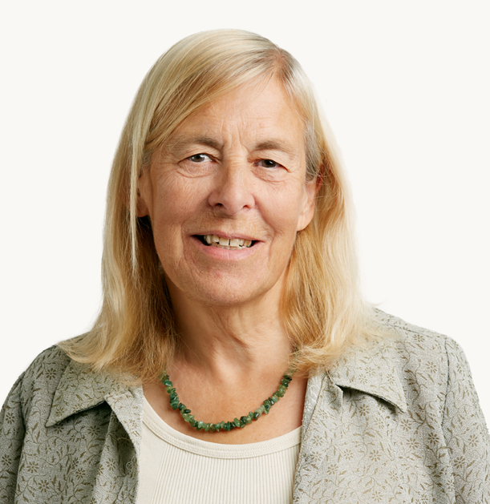
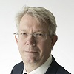
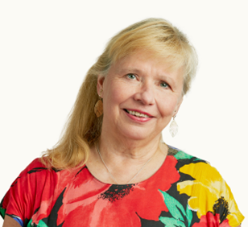
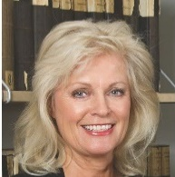
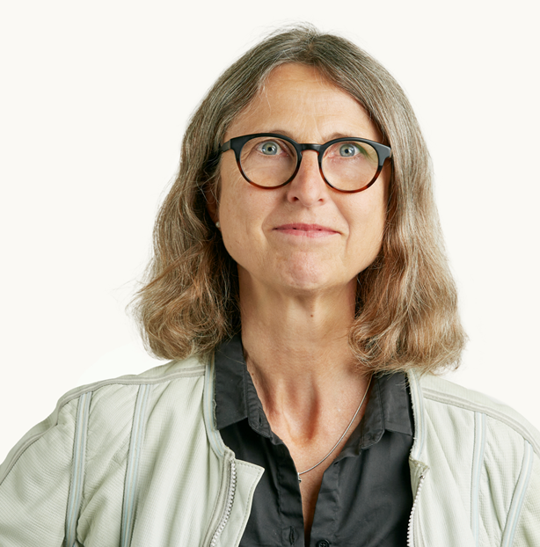
An board of international scientists
Chair
Jens Kehlet Nørskov
Denmark
Vice Chair
Christian S. Jensen
Denmark
Minik Thorleif Rosing
Denmark
Janet Thornton
United Kingdom
Morten Overgaard Ravn
United Kingdom
Sirpa Jalkanen
Finland
Vigdis Broch-Due
Norway
Tine Brink Henriksen
Denmark
Anne Scott Sørensen
Denmark

Slide 25
Contact Information
Please contact the DNRF secretariat if you have any questions about the application process.
Questions may be directed to:
CEO Søren-Peter Olesen, e-mail: spo@dg.dk, tel.:3318 1950
Senior Adviser Johanne Juhl Ryø, e-mail: jj@dg.dk, tel.:3318 1951
Senior Adviser Mette Müller, e-mail: mm@dg.dk, tel.:3318 1957

