Slide 1

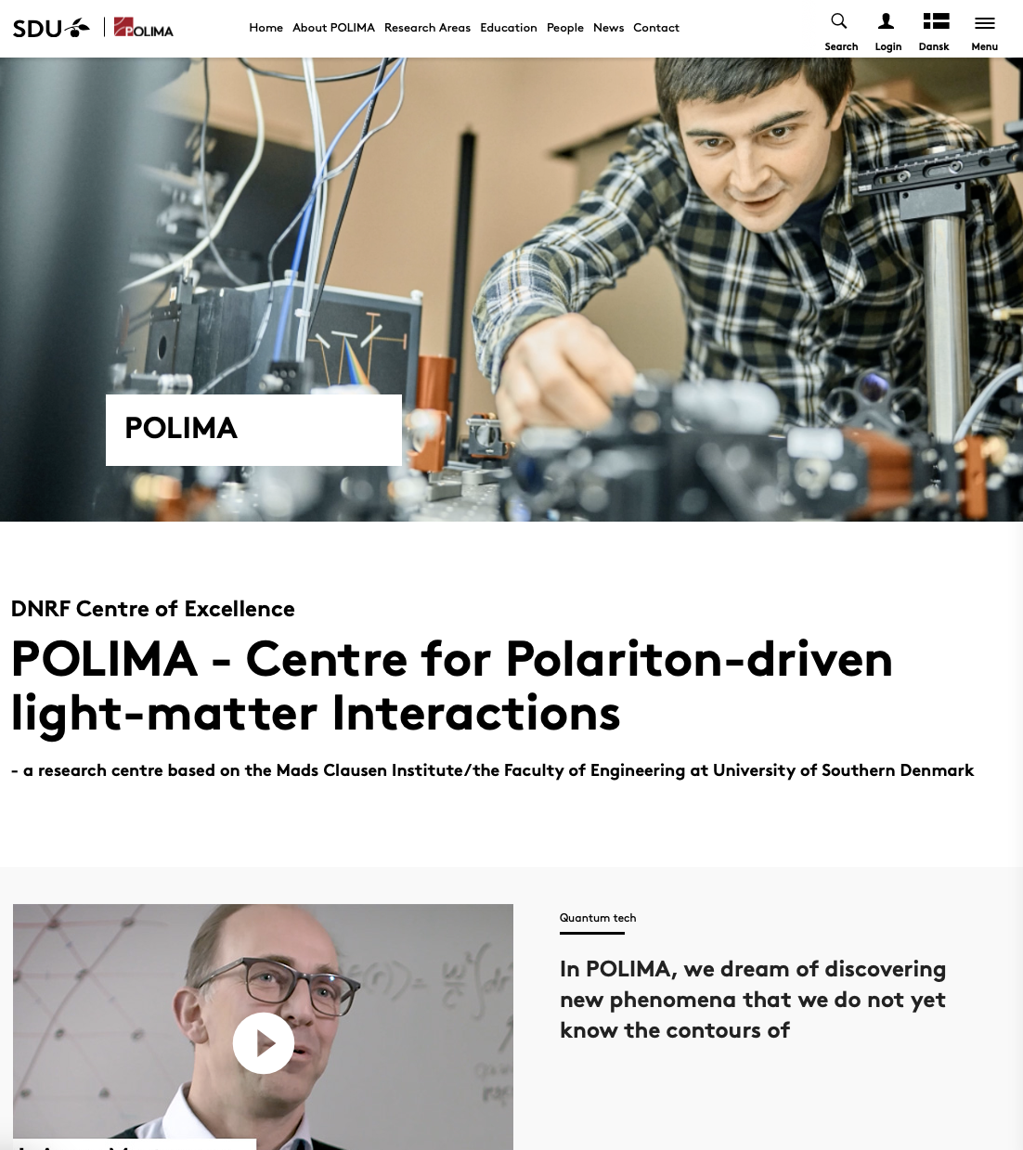
POLIMA
– DNRF Center of Excellence
N. Asger Mortensen^{1,2}
¹ Center for Polariton–Driven Light–Matter Interactions, University of Southern Denmark, Odense
² Danish Institute for Advanced Study, University of Southern Denmark, Odense

Slide 2

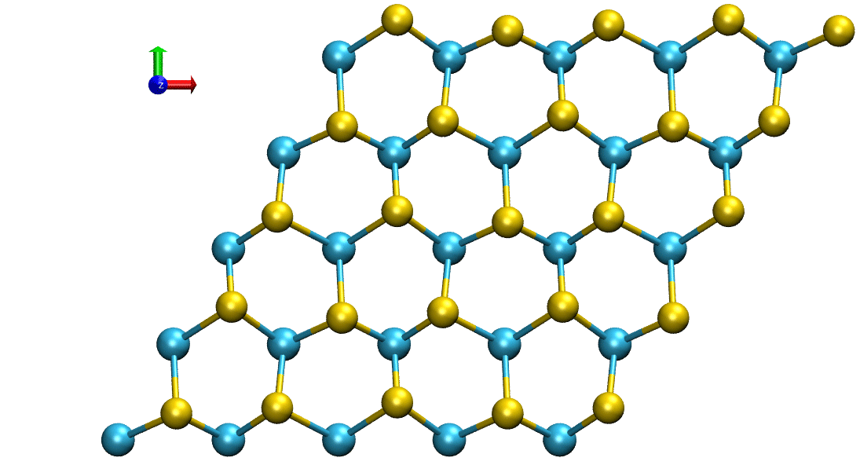
Center of Excellence grant from the
Danish National Research Foundation (DNRF)
nano
technol.
8 M€ for curiosity-driven research and fundamental explorations of electrodynamics and quantum physics in 2D polaritonic systems
Polaritons — quasiparticles originating from coupling of light with matter excitations … colloquially, part-light part-matter excitations
Foundational to emerging light-based quantum technologies
condensed matter & quantum physics
optical science & photonics
materials science
Example of matter excitation: Lattice vibrations of atoms

Slide 3
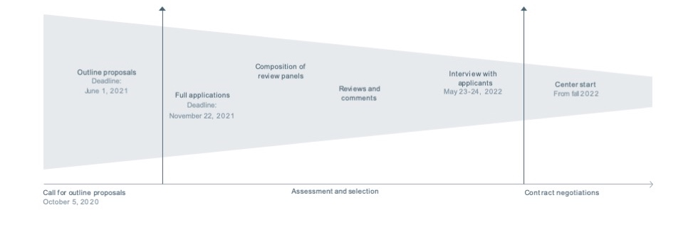
Coping with rejections …
9th DNRF round (2016): Immediate rejection ☹
10th DNRF round (2018): 133 letters-of-interest
→ 23 full proposals/peer review/interviews
→ 10 CoE grants
[rejection following interview ☹]
11th DNRF round (2021): 149 letters-of-interest
→ 25 full proposals/peer review/interviews
→ 11 CoE grants
[finally granted ☺]

Slide 4


Consolidating the proposal …
Actions following the DNRF-9 rejection:
  Rejected proposal → perspective in high-impact journal (quickly became WoS ‘highly cited’)
Preparations for the DNRF-10 proposal:
  Strategic revisions targeting the main criticism of ‘lack of cohesion’ (call of Mortensen to SDU and change of PI)
  Formal PI management training (INSEAD)
  Chairing of international conference (bringing the entire elite to Copenhagen)
  Chairing workshop (bonding with international leaders, catalyzing ideas for the proposal)
  Guest-editing special issues in high-impact journals (adding to our international visibility)
  Publishing invited perspective papers in high-impact journals (seeding the proposal)
  Effort to address gender imbalance and strengthen the group of applicants
Actions following the DNRF-10 rejection:
  Dr. scient. thesis submitted to UCPH
  Approaching high-impact journals to publish thesis as an invited comprehensive review
  Accepting editorial position with the interdisciplinary top-journal Science Advances (AAAS)
Preparations for the DNRF-11 proposal
  New group of co-applicants: strategic investments in 5 emerging research leaders (assist. profs.)
  Strategic revisions targeting call for ‘more coherence among research themes‘
2 M€

Slide 5
Prepare in due time for your proposal
Work on the proposal idea/topic, but invest also in the positioning of the CoE and the exposure of the PI …
DNRF focus on PI qualifications; consolidate documentation of international research leadership
Analyze which points to improve actively, and which points are beyond influence …
Citation metrics is difficult to improve with short notice, while other potential directions include high-impact journals, ’invited’ reviews, perspective papers, editorial materials (news & views) etc.
International visibility, conference organization, international workshops catalyzing the proposal idea
Use and expand international network actively. Identify strategic co-authors, advisory-board members, and opinion makers (potential reviewers). Work actively on a strategy how to prime them on the ideas prior to the submission of the proposal. This is the group of international leaders that will endorse your research leadership.
Consider formal training that documents research-management expertise. It might even be useful …
Document your efforts in young-researcher training at the highest international level by pushing your alumnae for international young-researcher awards and further international training in elite-research environments

