Slide 1
Novo Nordisk Foundation presents
Information Meeting on
Funding Opportunities 2023

Slide 2
Agenda
Introduction to the Novo Nordisk Foundation Strategy 2030
Funding opportunities in open competition Large Collaborative Research Programmes Project Grants
Research Career Programmes Research Infrastructure Programme Innovation Grants
Conferences, symposia and workshops
Q&A

Slide 3
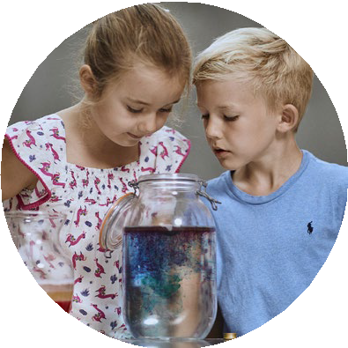
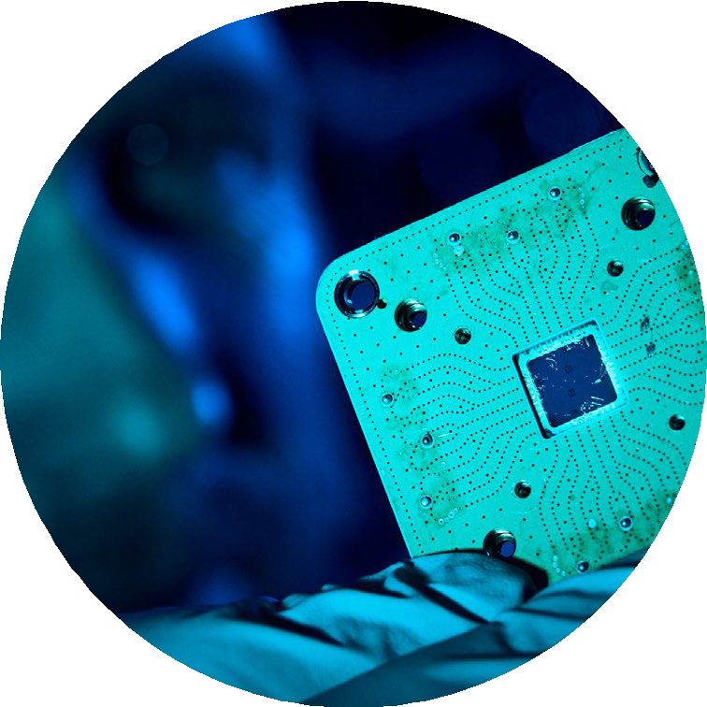
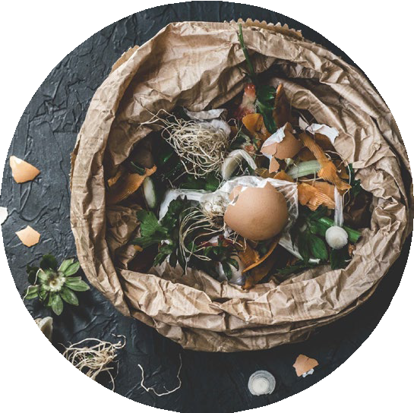
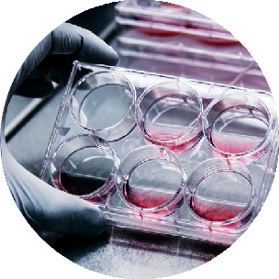
Grant awarding strategy 2030
Health
Progress research and innovation in prevention and treatment of cardiometabolic and infectious diseases
The life science ecosystem
Invest in scientific research, education and innovation to enable a world class life science ecosystem
Sustainability
Advance knowledge and solutions to support the green transition in society

Slide 4
Health
Strategic themes:
Preventing cardiometabolic disease
Understanding and managing cardiometabolic disease
Fighting inequity in health
Strengthening epidemic preparedness

Slide 5
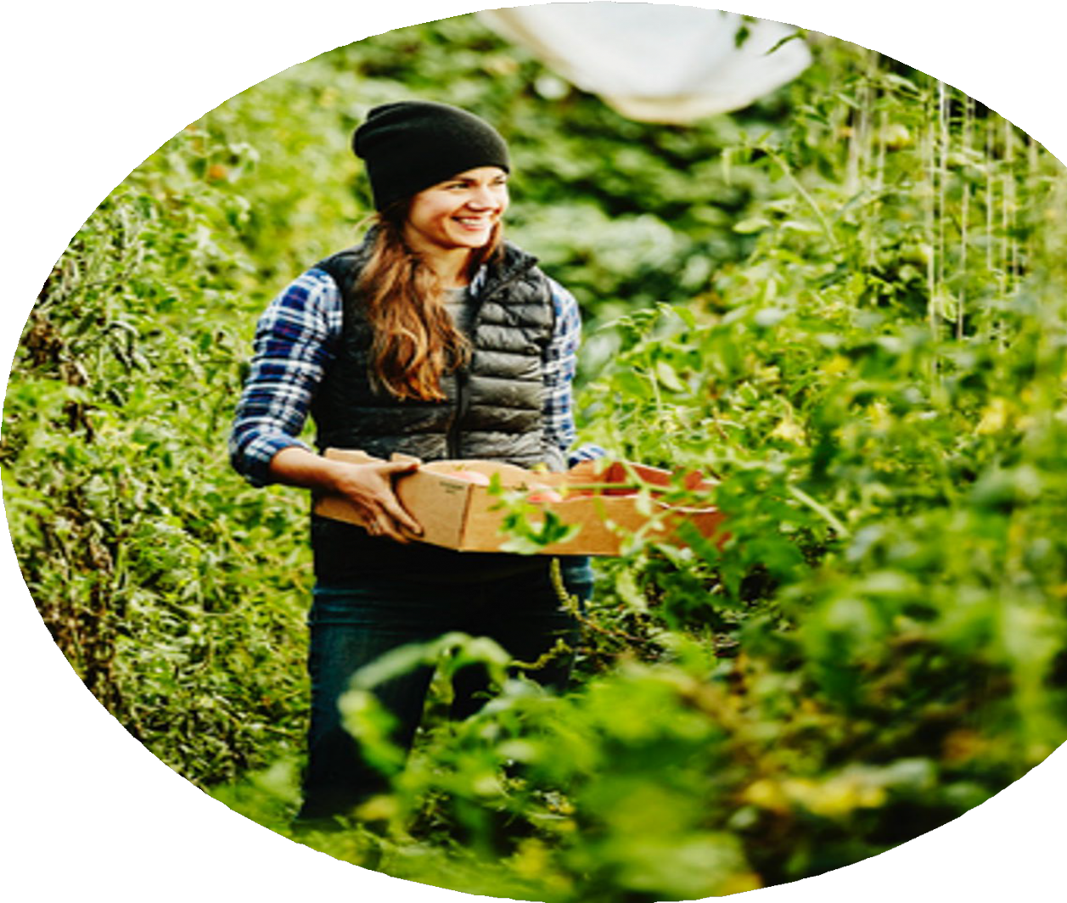
Sustainability
Strategic themes:
Sustainable and high-yield agriculture
Sustainable food for healthy diets
High-impact climate change mitigation technologies
Supporting society in the green transition

Slide 6
Life science ecosystem
Strategic themes:
Fundamental research
Enabling research infrastructures and technologies
Translational capacity and societal impact
Education and science capital

Slide 7
How we award grants
Open competition
E.g. projects, fellowships, prizes, etc.
Strategic and mission-driven
E.g. research centres, academies, own initiatives
Partnerships
E.g. public-private, private- private, etc.
Impact and strategic investments
E.g. impact bond, equity loans, etc.
Examples
Examples
Examples
Examples
Challenge programme
Investigator grants
Postdoctoral Fellowships
Interdisciplinary Synergy Programmes
Project grants
NNF centres for Biosustainability, Basic Metabolic Research, Protein Research, ReNEW, CO₂ Research Center, Quantum Computing Programme
BII, LIFE
Data Science Academy
Steno Diabetes Centres
Danish Refugee Council, UNICEF, World Diabetes Foundation
PAD partnership with Gates Foundation among others
Repair Impact Fund
AMR Action Fund
Den Sociale Kapitalfond Invest
Quantum Foundry
NNF Cellerator

Slide 8
Open competition grant types (selected)
Industrial Biotechnology and Environmental Biotechnology
Plant Science, Agriculture and Food Biotechnology
Clinical & Translational Medicine
Data Science
Natural and Technical Sciences
Bioscience & Basic Biomedicine
Endocrinology & Metabolism
Large Collaborative Grants
Tandem
Data Science Collaborative Research Projects
Challenge Programmes
Interdisciplinary Synergy Programmes
Project Grants
Project Grants
IICT
Research Career Programmes
Investigator Grants
NERD
Investigator Grants
Postdoc Fellowships
Start Package Grants
BRIDGE
RECRUIT and Sabbatical Grants
Laureate Research Grants
PhD fellowships
Data Science Academy
Danish Cardiovascular Academy / Danish Diabetes Academy
Infrastructure Grants
Infrastructure Grants
Innovation Grants
Innovation Grants
Go to https://novonordiskfonden.dk/en/grant/ for full grant list
8

Slide 9
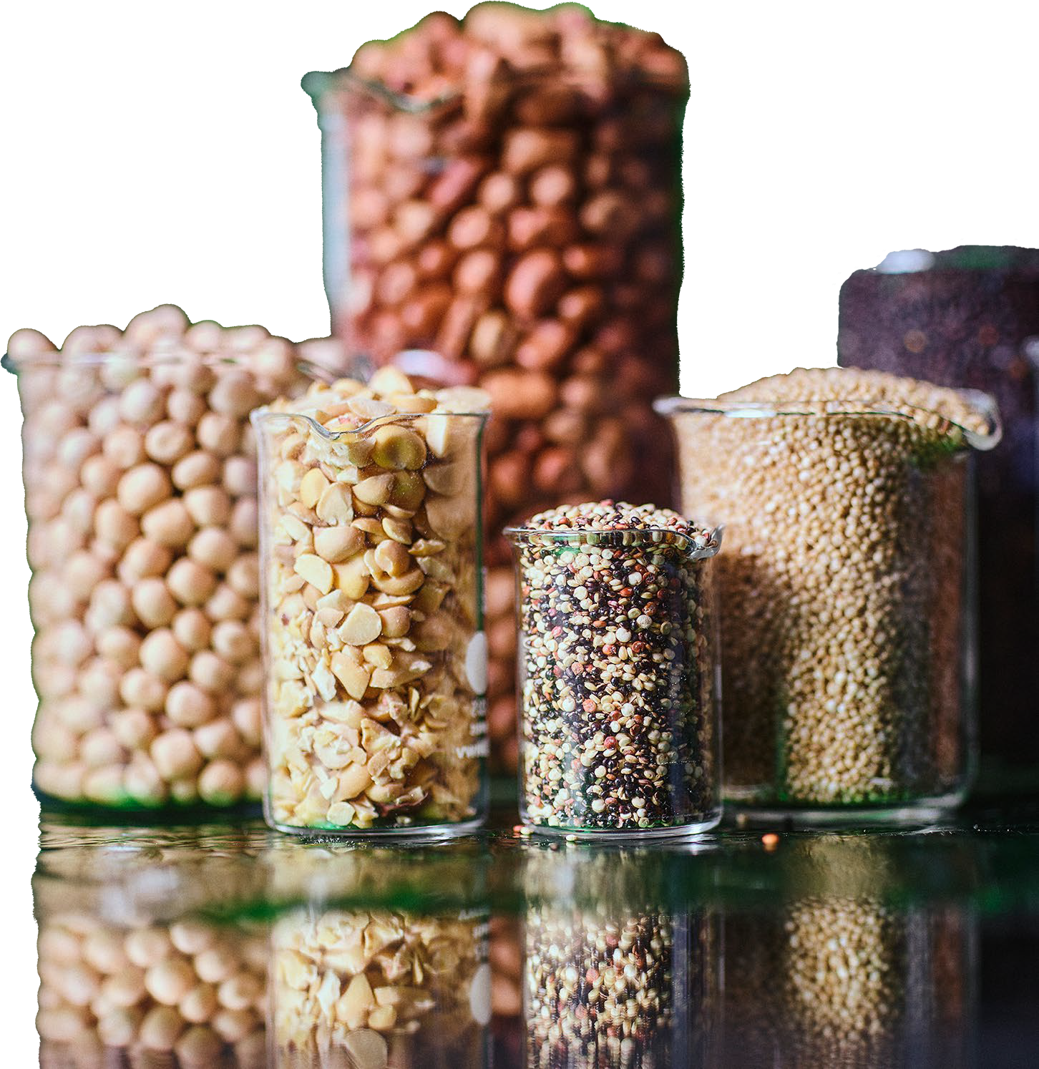
Agenda
Large Collaborative Research Programmes
Project Grants
Research Career Programmes Research Infrastructure Programme Innovation Grants
Conferences, symposia and workshops

Slide 10
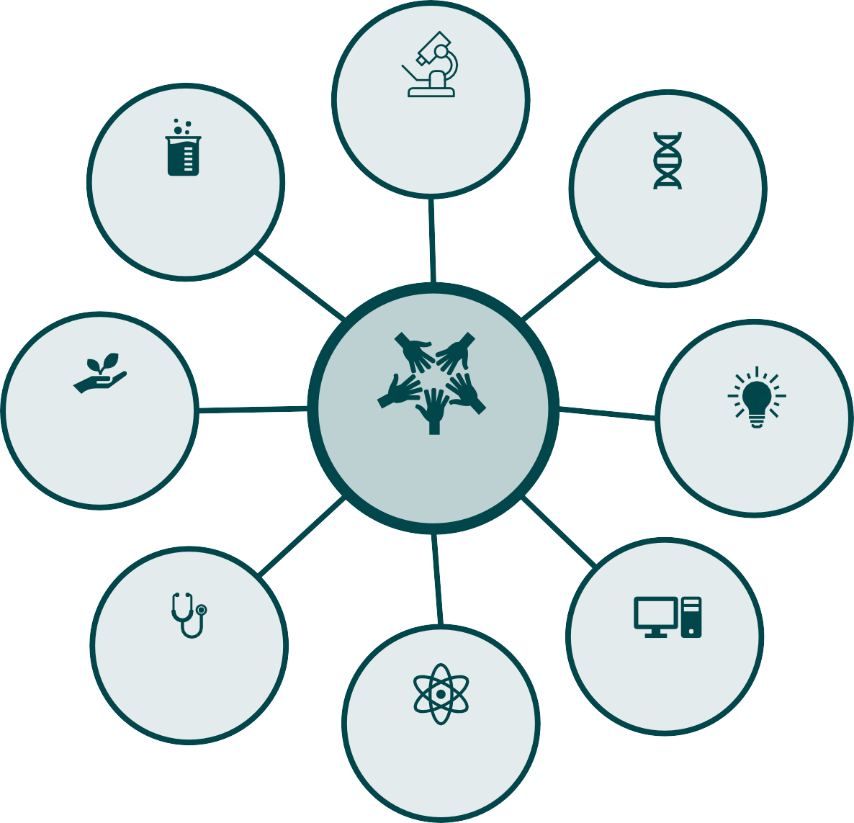
Interdisciplinary Synergy Programmes
Support for research projects across disciplines, organisations, and national borders, aiming to resolve complex interdisciplinary challenges.
Key information
Interdisciplinary Synergy Programme:
Exploratory Interdisciplinary Synergy Programme:
Pursue creative and high- risk/high-gain interdisciplinary research ideas
Break down or overcome the barriers that exist between different disciplines
Consortia with 2 - 4 research groups
Main applicant anchored in Denmark. 1-3 interdisciplinary co-applicants (may be international)
Ideally founded on early data showing feasibility of the idea
Grant budget: DKK 15 million over 4 years
Expected application deadline:
June 2024
Technical science
Aimed towards early-stage or unexplored ideas
Grant budget: DKK 5 million over 3 years
Expected application deadline:
August 2024
Biotechnology
Biomedical research
Agri-Food Sciences
Innovation
Interdisciplinarity
Health science research
Data science
Natural sciences

Slide 11
Data Science Collaborative Research Projects
Collaborative projects aiming to provide new algorithms, methods and technologies within data science or computational science, e.g., artificial intelligence, statistics, bioinformatics, applied math, computer science, big data analytics, simulations, mathematical modelling
Key Information Research area
Research collaborations between data scientists and domain experts (medical doctors, basic scientists, etc.)
Consortia with 2 - 5 collaborators
Main applicant anchored in Denmark, co-applicants may be international
At least one applicant must be from a Danish-based data science group
Data science + applications
Grant budget
Biomedicine
Grant budget: up to DKK 30 million over 5 years
Expected application deadline:
March 2024
Clinical Research
Natural Sciences
Data Science & AI
Technical Sciences
Biotechnology
Agri-Food Sciences
Innovation

Slide 12
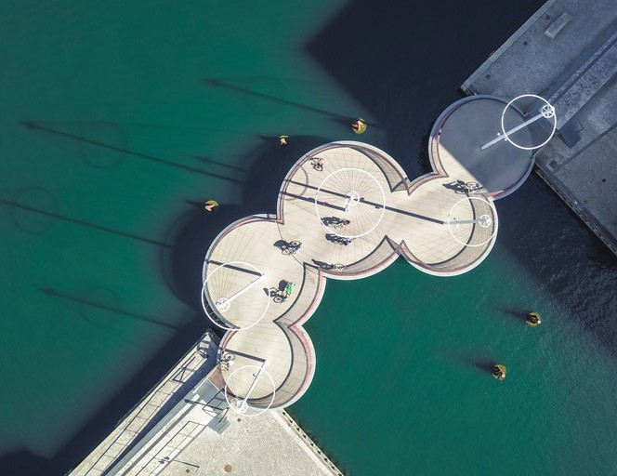
Tandem Programme
Translational research collaboration between basic and clinical researchers
Key Information
Research areas
Projects should be clinically relevant, cross-disciplinary, and have a translational scope
One basic scientist and one clinician apply together (equal part)
Main applicant anchored in Denmark. Co-applicant may be international
Clinical researcher must have clinic responsibilities
To bridge the gap between basic science and clinical application (bench-to-bedside)
Clinical & Translational Medicine
Bioscience and Basic Biomedicine
Endocrinology and Metabolism
Grant budget
Grant budget: DKK 7 - 10 million over 4 years
Application deadline: 10 January 2024

Slide 13
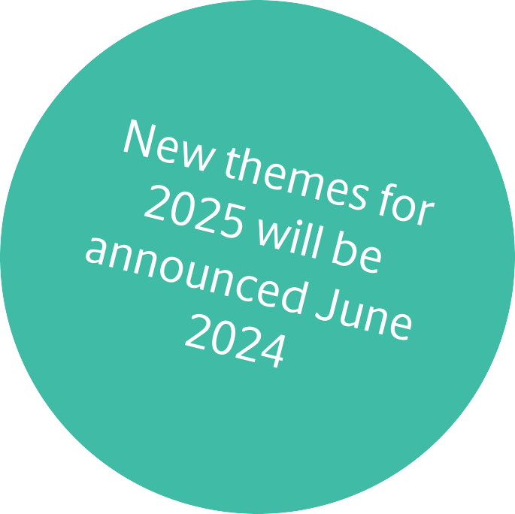
Challenge Programme
To overcome specific challenges in health, technology and sustainability
Key Information
Research area
Thematic
Substantial funding to challenging and ambitious projects focused on in-depth research
Annually selected research themes
A collaborative effort in a centre- like setup
Consortia with 2 - 4 research groups
Main applicant anchored in Denmark. 1 - 3 co-applicants (may be international)
Grant budget
Grant budget: DKK 30 - 60 million over 6 years
Expected application deadline:
October 2024

Slide 14
Agenda
Large Collaborative Research Programmes
Project Grants
Research Career Programmes Research Infrastructure Programme Innovation Grants
Conferences, symposia and workshops

Slide 15
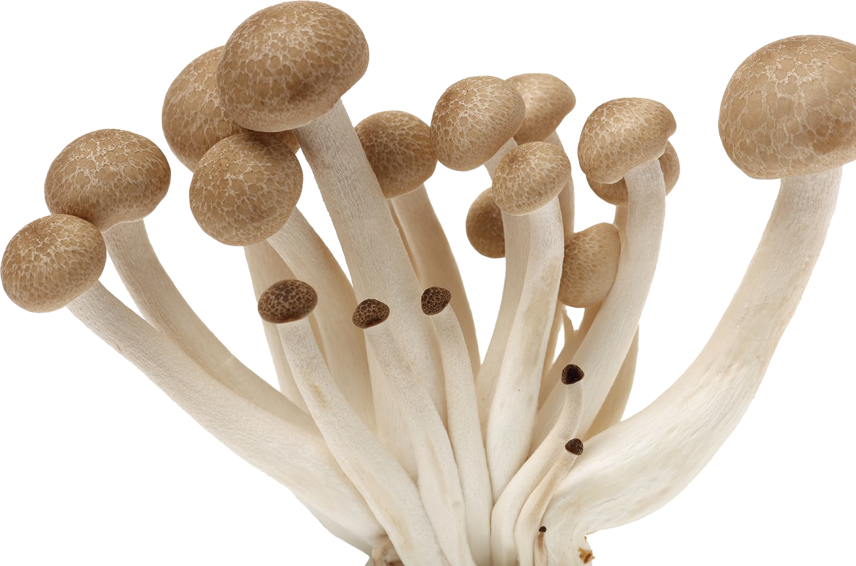
Project Grants
Promote fundamental research at the highest international level
Key Information
Testing of novel or continuation of ongoing research ideas
Independent research leaders can apply
Place of research is in Denmark or the Nordic countries
Research areas
Endocrinology and Metabolic Research (Nordics)
Clinical and Translational Research (Denmark)
Bioscience and Basic Biomedical Research (Denmark)
Natural and Technical Sciences (Denmark)
Plant Science, Agriculture and Food Biotechnology (Nordics)
Industrial Biotechnology and Environmental Biotechnology (Nordics)
Grant budget
Grant budget: Up to DKK 1 - 3 million over 1 - 3 years
Expected application deadline:
August - September 2024

Slide 16
Project Grants
Promote fundamental research at the highest international level
Key Information
Research areas
Endocrinology and Metabolic Research (Nordics)
Clinical and Translational Research (Denmark)
Bioscience and Basic Biomedical Research (Denmark)
Natural and Technical Sciences (Denmark)
Plant Science, Agriculture and Food Biotechnology (Nordics)
Industrial Biotechnology and Environmental Biotechnology (Nordics)
Grant budget
Testing of novel or continuation of ongoing research ideas
Grant budget: Up to DKK 1 - 3 million over 1 - 3 years
Expected application deadline:
August 2024
Independent research leaders can apply (Postdocs can also apply if they have their own salary secured)
Grant budget: Up to DKK 4 million over 3 years if collaboration between PI’s from two different Nordic countries
Place of research is in Denmark or the Nordic countries

Slide 17
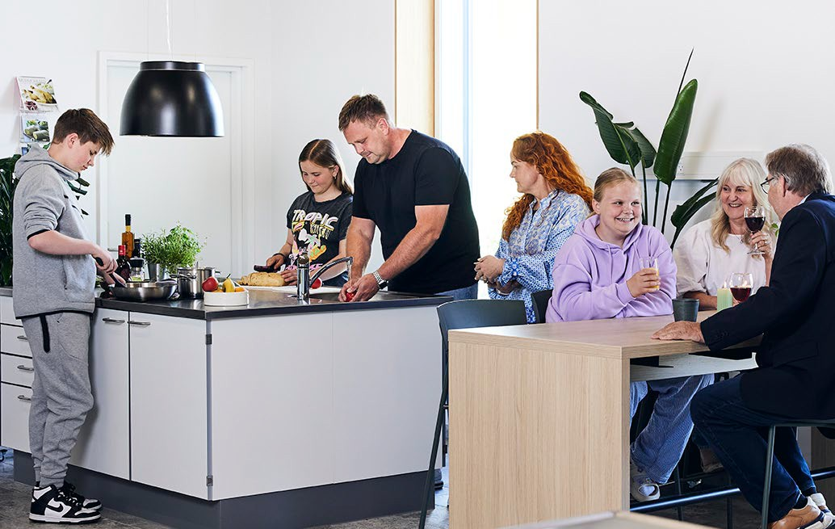
Project Grants in Causal Factors in Obesity
Promote fundamental research at the highest international level
Key Information
Research areas
Endocrinology and Metabolic Research (Nordics)
Clinical and Translational Research (Denmark)
Bioscience and Basic Biomedical Research (Denmark)
Natural and Technical Sciences (Denmark)
Plant Science, Agriculture and Food Biotechnology (Nordics)
Industrial Biotechnology and Environmental Biotechnology (Nordics)
Grant budget
Grant budget: Up to DKK 1 - 3 million over 1 - 3 years
Application deadline: 18 January 2024
Grant budget: Up to DKK 4 million over 3 years if collaboration with a co-PI outside Denmark
Identify and validate causal physiological and psychological factors for obesity development
Independent research leaders can apply (postdocs can also apply if they have their own salary secured)
Place of research is in Denmark (with international co-PI)
17
“Foto: Nationalt Center for Overvægt. Fotograf: Anne Kring“

Slide 18
Investigator-Initiated Clinical Trials (IICT)
To improve the treatment of patients through new medicine and new technology and to ensure the highest quality in treatment.
Key Information
Larger clinical trials in Denmark
without commercial purpose
Grants are available for both monocentric and multicenter national trials.
Led by specialist physician at a Danish hospital where the trial is anchored
Must have approvals from relevant public authorities before the grant is activated
Research areas
Clinical & Translational Medicine
Grant budget
Grant budget: DKK 5 - 20 million over 3 - 5 years
Expected application deadline:
August 2024

Slide 19
Agenda
Large Collaborative Research Programmes Project Grants
Research Career Programmes Research Infrastructure Programme Innovation Grants
Conferences, symposia and workshops

Slide 20
Investigator Grants
Support excellent research leaders at different career stages, and promote their career progression and research at the highest international level
Key Information
Grant may cover applicant’s own salary (see call details)
Research areas
Endocrinology and Metabolic Research (Nordics)
Clinical and Translational Research (Denmark)
Bioscience and Basic Biomedical Research (Denmark)
Plant Science, Agriculture and Food Biotechnology (Nordics)
Industrial Biotechnology and Environmental Biotechnology (Nordics)
Data Science (Denmark)
Distinguished investigator
Professor level
Place of research is in Denmark or the Nordic countries
Ascending investigator Associate professor level Approx. 7 - 18 years from PhD
Grant budget
Grant budget: Up to DKK 10-11 million over 5 years
Application deadline: January - August 2024
Emerging investigator Starting research leaders Approx. 4 - 8 years from PhD

Slide 21
Investigator Grants
Support excellent research leaders at different career stages, and promote their career progression and research at the highest international level
Key Information
Grant may cover applicant’s own salary (see call details)
Place of research is in Denmark or the Nordic countries
Grant portfolio cap of DKK 4.0 million/year as PI (at project start)
Can not be a group leader at one of the NNF research centres
Research areas
Endocrinology and Metabolic Research (Nordics)
Clinical and Translational Research (Denmark)
Bioscience and Basic Biomedical Research (Denmark)
Plant Science, Agriculture and Food Biotechnology (Nordics)
Industrial Biotechnology and Environmental Biotechnology (Nordics)
Data Science (Denmark)
Distinguished investigator
Professor level
New eligibility criteria
Ascending investigator Associate professor level Approx. 7 - 18 years from PhD
International recruitment at Ascending Investigator level
Grant budget
Grant budget: Up to DKK 10 million over 5 years
Relocation add-on: Up to DKK 10 million and 2 years
Application deadline: January 2024
Emerging investigator Starting research leaders Approx. 4 - 8 years from PhD

Slide 22
Postdoc Fellowships
Knowledge, training and research experience in an excellent international research environment
Fellowships abroad
Key Information
Research areas
Grant budget
Support young promising and ambitious researchers, max. 5 years from having obtained a PhD
Bioscience and Basic Biomedical Research
Interdisciplinary Postdoc Fellowships at MIT, Stanford Bio-X, University of Oxford, Weizmann Institute of Science
Grant budget: Up to DKK 4 million over 4 years
Application deadline: January – February 2024
Minimum 2½ years abroad
Facilitate return to the Danish research environment for up to 1 year after stay abroad
Fellowships at Nordic host institution
Key Information
Research areas
Grant budget
Support young promising and ambitious researchers, max. 6 years from having obtained a PhD
Plant Science, Agriculture and Food Biotechnology
Industrial Biotechnology and Environmental Biotechnology
Grant budget: Up to DKK 2.5 million for up to 3 years
Application deadline: August 2024
Minimum 1 year at a Nordic research institution
Additional stay abroad for 6 – 24 months is encouraged

Slide 23
NERD Programme - New Exploratory Research and Discovery
Supporting a single principal investigator at any career stage with ample funding and a long time horizon, providing the required long- term stability and continuity to explore truly exceptional ideas
Key Information Research areas Grant budget
Supports researchers at any career stage after obtaining the PhD degree
Fundamental research within the natural and technical sciences, e.g., physics, chemistry, mathematics, computer science, and technical sciences.
Not eligible: Projects within biotechnology, biomedicine or health science.
Explicitly describe how the outcome of the project may have potential future applications in the life sciences, health sciences, or sustainability.
Grant budget: Up to DKK 14 million over 7 years
Application deadline: 28 February 2024
Grant can cover applicant’s own salary
First evaluation of all applications is anonymous
Grant portfolio cap of DKK 4.0 million/year as PI (in first funding year)

Slide 24
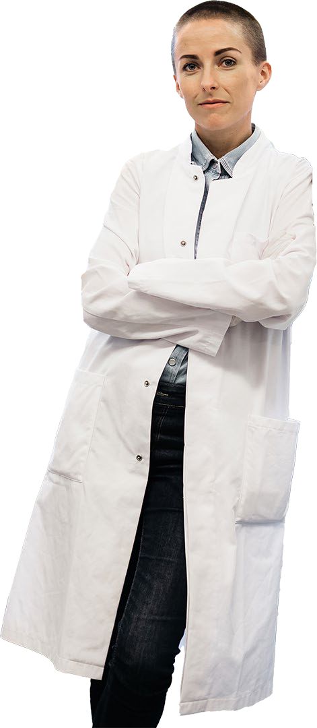
International recruitment & retainment programmes
RECRUIT
Recruiting the most talented or leading researchers from abroad
Key Information
Recruitment from abroad across all career levels
Applicants must be endorsed by the recruiting universities accordingly to a nomination quota
Research areas
Natural and Technical Sciences, incl. data science
Sustainability and biotechnology
Grant budget
Up to DKK 20 million over 7 years at the assistant professor level,
Up to DKK 35 million over 7 years at the associate professor level,
Up to DKK 50 million over 7 years at the full professor level.
Potential extension grant of up to DKK 10 million over 5 years
Application deadline: 15 March 2024
Laureate Research Grant
For outstanding established scientists to either come to Denmark or stay in Denmark to carry out their ground- breaking research
Key Information
Independent research programme for 7 years or more
Applicants are nominated by the host institution
Research areas
Biomedicine, incl. basic, translational, clinical and/or epidemiological research
Grant budget
Grant budget: Up to DKK 50 million over 7 years (potential continuation of up to 7 years and DKK 35 million)
Application deadline: 16 November 2023 and February 2024 (2-stage application)

Slide 25
International recruitment & retainment programmes
RECRUIT SABBATICAL GRANTS
Sabbaticals to advance researcher’s continuous development and benefit the Danish research ecosystem
Key Information
Supports university faculty in a time-unlimited positions
Researchers from abroad going to Denmark or from Denmark wishing to visit a foreign research group
Grant can cover applicant’s own salary
Applicants must be endorsed by the Danish universities according to a
nomination quota
Research areas
Natural and Technical Sciences, incl. data science
Sustainability and biotechnology
Grant budget
Up to DKK 1 million over 1 year (may be split into multiple shorter periods distributed across a maximum of 4 years)
Application deadline: 15 March 2024

Slide 26
Start Package Grant - For faculty recruitment
To increase researchers’ mobility and make Danish universities more competitive when recruiting top researchers of any nationality to time-unlimited research positions
Key Information Research areas Grant budget
Recruitment from abroad, from another Danish institution (with career progression), or from industry
The candidate must be offered a time-unlimited faculty position
Applications must be submitted by the recruiting institution (the person with appointment authority)
Biomedicine and health science
Sustainability and biotechnology
Natural and technical sciences
Data science
Up to DKK 4 million over 4 years for a position at the assistant professor level in a tenure-track position
Up to DKK 6 million over 4 years for a position at the associate professor level
Up to DKK 8 million over 4 years for a position at the full professor level
Up to DKK 8 million for a clinical- or clinical chair professor position
Application deadline: four quarterly deadlines per year

Slide 27
Agenda
Large Collaborative Research Programmes Project Grants
Research Career Programmes Research Infrastructure Programme Innovation Grants
Conferences, symposia and workshops

Slide 28
The Research Infrastructure Programme 2024
Develop, establish and upgrade state-of-the-art research infrastructures to achieve excellence in research and innovation
Exploratory Research Instrumentation Programme
Research Infrastructure Programme
Equipment Upgrade Programme
Develop new instrumentation and methodologies from idea to prototype
Open-access research infrastructure
with technical support
Key Information
Open-access user community incl. academia and industry
Large equipment, operating expenses, and technical staff
Applicant holds a time-unlimited academic (VIP) or technical (AC-TAP) position
Extend the life-time of a NNF funded research infrastructure
Key Information
Key Information
Bridge the gap between fundamental research and innovation
Applicants must hold a PhD (both academic and AC-TAP can apply)
Invited applicants only
Sustainable business plan
Equipment upgrade and partial technical staff
Applicant must have documented interest and expertise
in instrument/methods development
Grant budget
Grant budget
Grant budget: up to DKK 3 million over 4 years
Application deadline: 11 January 2024
Grant budget
Grant budget: DKK 2-7 million over 4 years
Application deadline: 11 January 2024
Grant budget: DKK 5-25 million over 6 years
Application deadline: 11 January 2024
Research areas: Health science, biomedicine, biotechnology, data science, natural and/or technical sciences

Slide 29
Agenda
Large Collaborative Research Programmes Project Grants
Research Career Programmes Research Infrastructure Programme Innovation Grants
Conferences, symposia and workshops

Slide 30
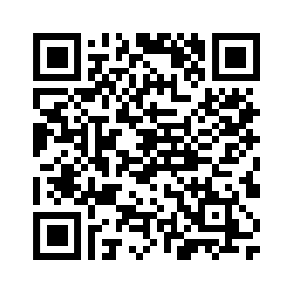
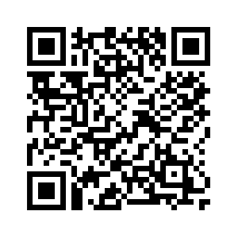
NNF Innovation Grants
Aim: To accelerate commercialisation of research findings and development of novel solutions and technologies
About innovation grants
Project maturation: Project activities up to Proof-of-Concept (pre-CVR)
Eligibility: Faculty members & researchers employed at Nordic universities, hospitals or other research institutions
Pioneer Innovator
Distinguished Innovator
Research Areas
Key Information
Emphasis on project and impact - less focus on PI and team
Key Information
Emphasis on the main applicant’s proven track record within innovation, i.e. experience with innovation projects / establishing spin-outs
Pharma, Medtech & Healthtech
Industrial/environmental biotechnology
Sustainable agriculture and food
Carbon capture (CC+U+S)
N₂O and methane emissions
Quantum technologies
Grant budget
Grant budget: Up to DKK 1 million over 1 year
Grant cycles per year: 2
Expected application deadline: March 2024
Grant budget
Grant budget: Up to DKK 6 million over 3 years
Grant cycles per year: 2
Expected application deadline: March 2024
For more innovation info, see this link: A4-NNF-Innovators-Guide_141222.pdf (novonordiskfonden.dk)

Slide 31
Agenda
Large Collaborative Research Programmes Project Grants
Research Career Programmes Research Infrastructure Programme Innovation Grants
Conferences, symposia and workshops

Slide 32
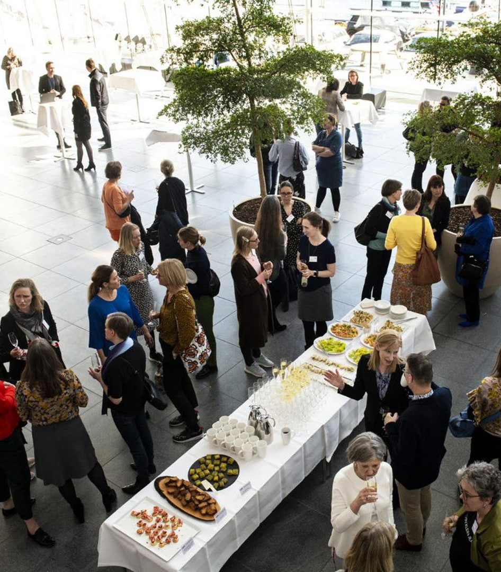
Conferences, symposia and workshops
Promote knowledge sharing and networking activities
Key Information
Research areas
Grant budget
Support medium-sized events with a duration of 1-3 days typically
Opportunities to present and discuss the newest research and innovation activities with peers
Applicants must be anchored at a university, museum or other research institution in Denmark.
Events are organised by the researchers themselves
Grant budget: DKK 50,000 - 500,000
Expected application deadline:
March 2024
Biomedicine and health science
Sustainability and biotechnology
Natural and Technical Sciences
Innovation
Research in Art History
Education and Outreach

Slide 33
When applying for competitive funding at NNF
DON’Ts
Do not finish application just before deadline
Do not artificially inflate the budget
Do not upload unrequested documents
Do not make pseudo-collaborations
Do not rely on the science to “speak for itself”
Do not expect all evaluators to be experts
Ensure you attach correct bench fee information (if you apply)
DOs
Read the application guidelines carefully and follow the instructions
Consider the committee you are addressing
Let peers/colleagues criticise your application
Make sure you have the required letters/documents
Contact the foundation if in doubt
NNF reimburses the extra costs institutions incur when grant recipients take parental leave
Unsolicited inquiries: https://novonordiskfonden.dk/en/how-we-work/unsolicited-inquiries/

Slide 34
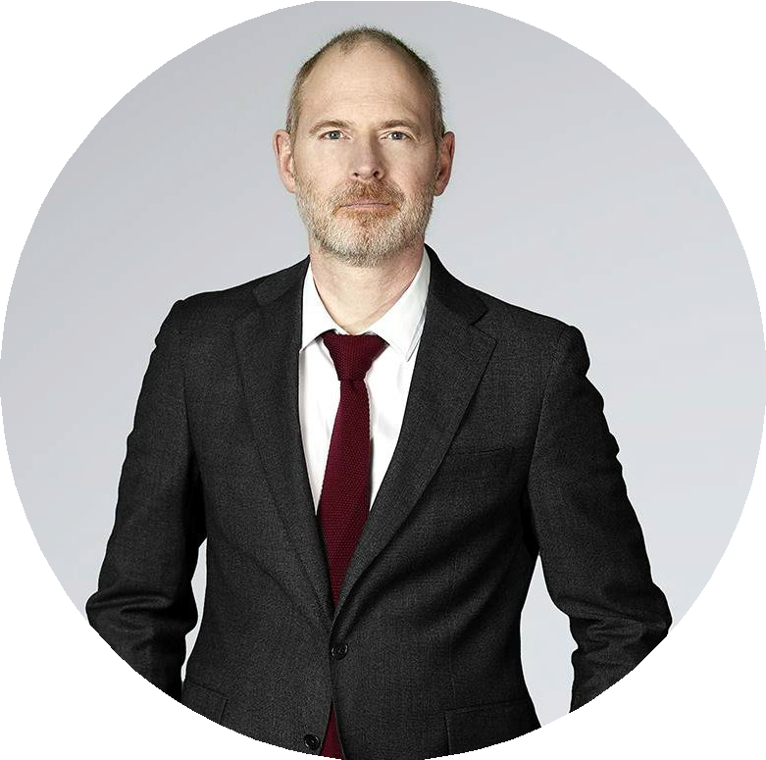
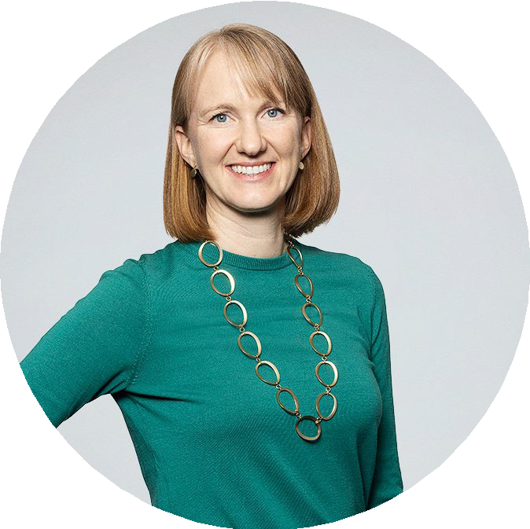
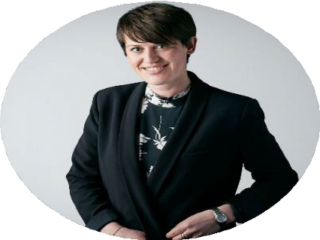
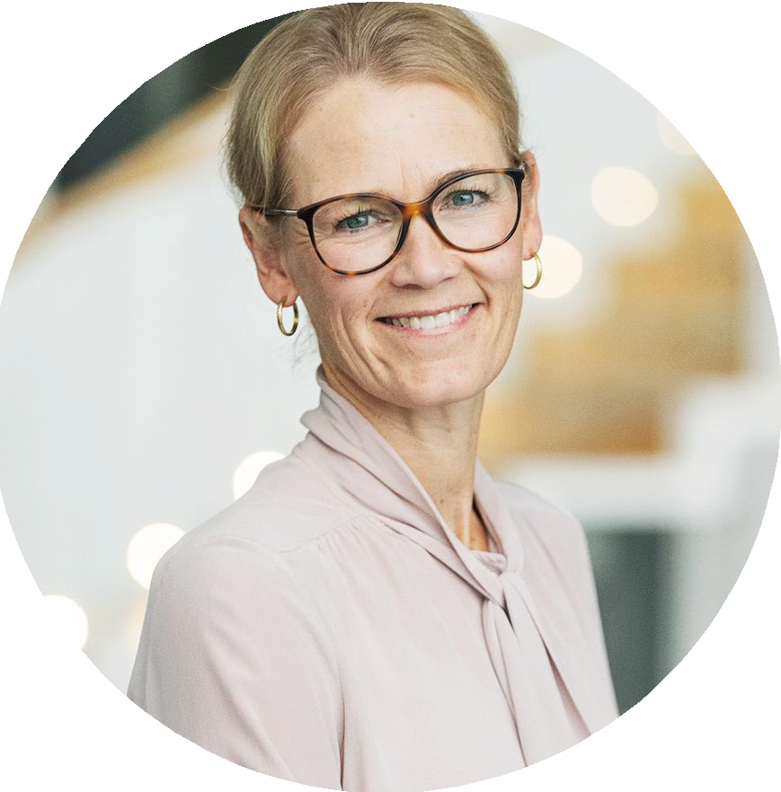
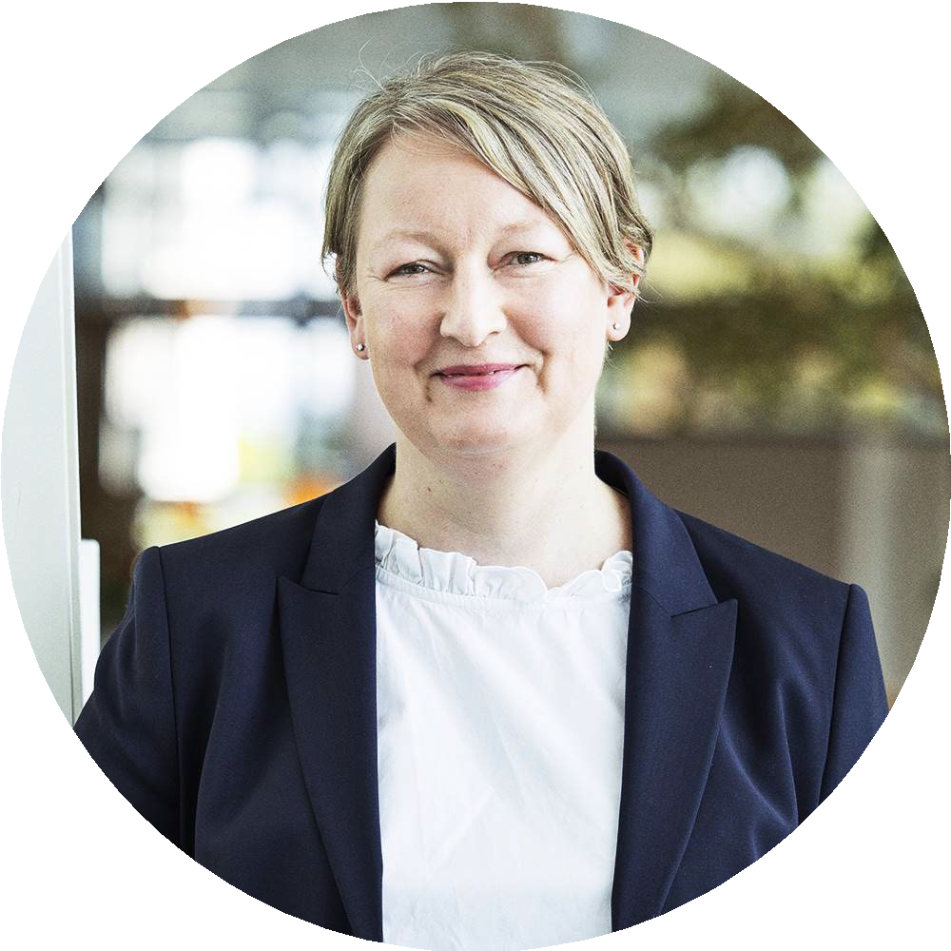
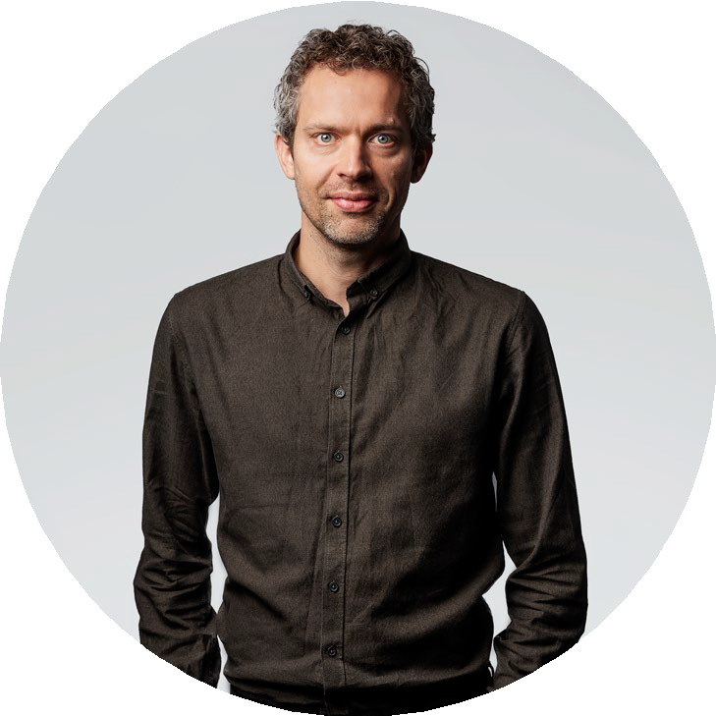
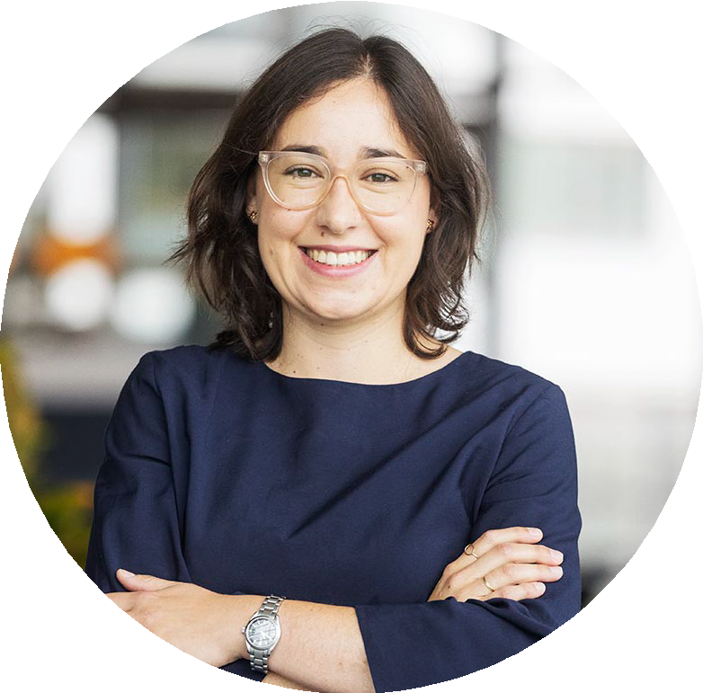
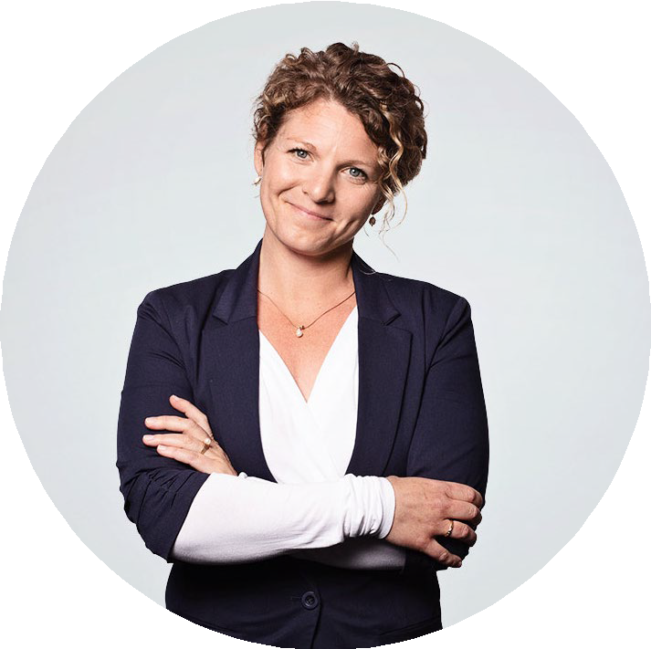
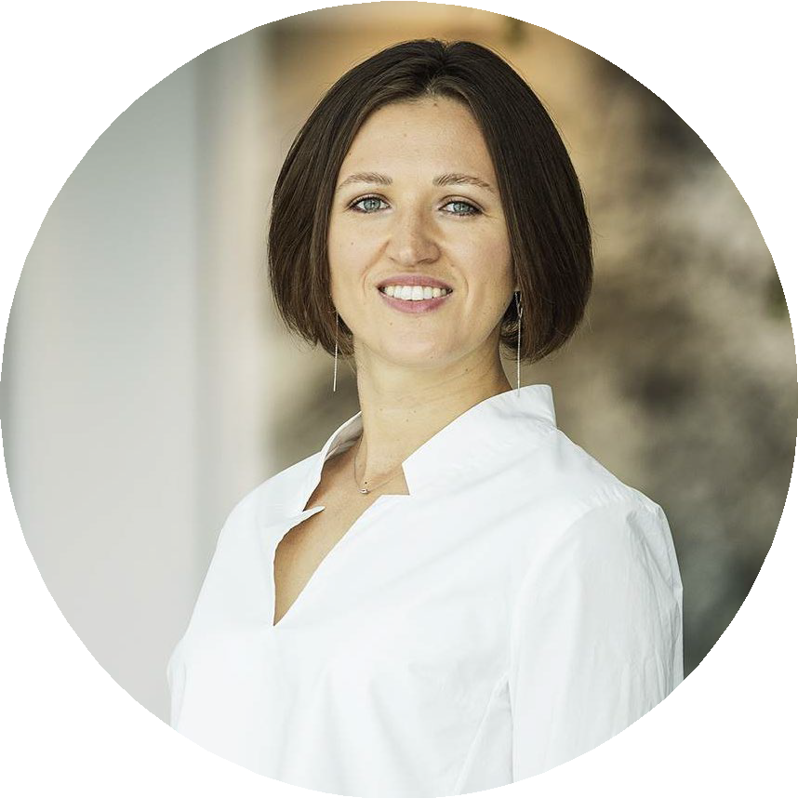
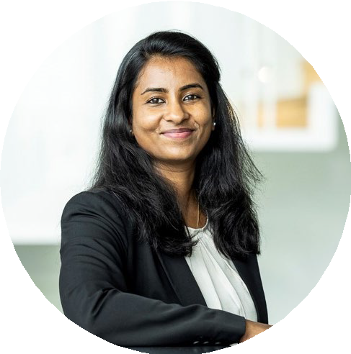
NATURAL AND TECHNICAL SCIENCES
Thomas Bentin TBE@novo.dk
INFECTIOUS DISEASES
Elizabeth Klemm EKK@novo.dk
NATURAL AND TECHNICAL SCIENCES
Kamilla Nørregaard KNR@novo.dk
MEDICAL SCIENCE
Marie Kveiborg MKV@novo.dk
NATURAL AND TECHNICAL SCIENCES
Ulla Gro Nielsen UGN@novo.dk
OBESITY AND NUTRITIONAL SCIENCES
Mads Fiil Hjorth MFH@novo.dk
More information on novonordiskfonden.dk/en/grant/
BIOTECH
Maria Santamaria Fernandez MSF@novo.dk
INNOVATION
GRANT MANAGEMENT
Eugenia Krasnopjorova EKR@novo.dk
INNOVATION
Sarah Kulahin Roed SRD@novo.dk
Drishya Nair DRN@novo.dk
34

Slide 35
Project supplement
Agreement between 6 private foundations and the Danish Universities
Based on analysis of data from Danish Universities done by Deloitte Consulting
Will be gradually implemented starting January 2024 and will apply to calls open from 2024.
Applies to grants under DKK 50 million awarded in open competition
Details in the applicant guidelines
Wet research
natural sciences, health sciences and technical sciences
DKK 250.000
per project-employed FTE
Dry research
humanities, social sciences, law and theology
DKK 200.000
per project-employed FTE
FAQ: https://dkuni.dk/aftale-om-en-faelles-model- for-finansiering-af-forskningsprojekter/
35

