Slide 1
VILLUM FONDEN 11-04-2023 Villum Young Investigator Info-meeting University of Southern Denmark
Science director
Thomas Bjørnholm

Slide 2
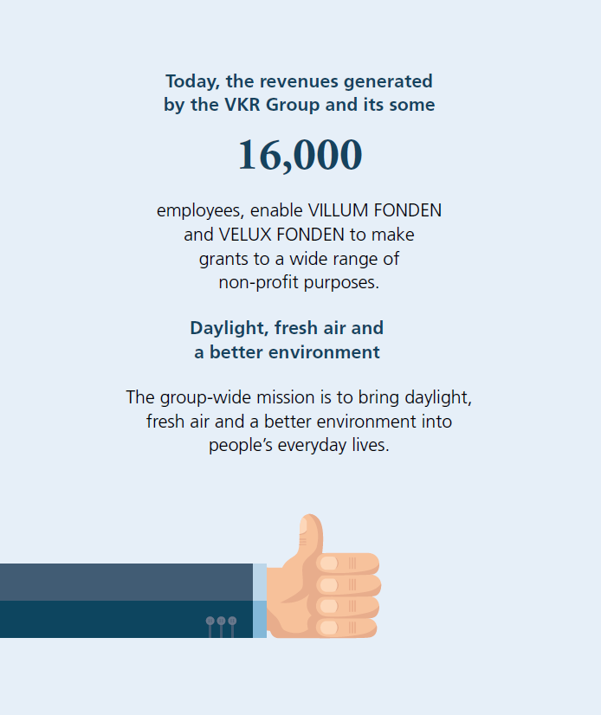
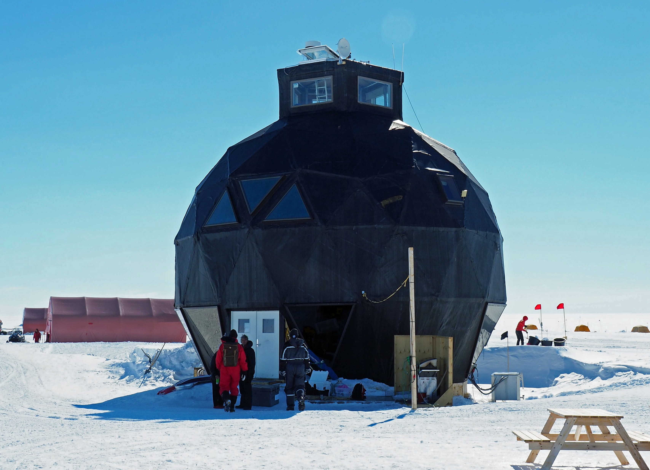
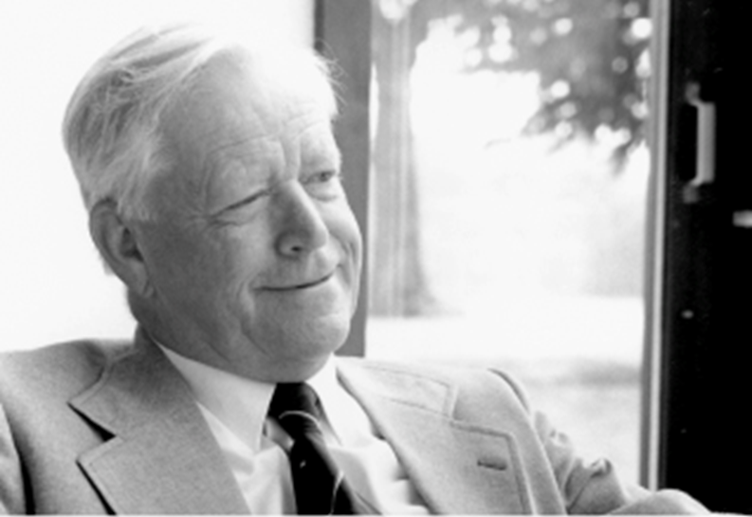
https://velux-my.sharepoint.com/personal/ckw_veluxfoundations_dk/Documents/Events%20og%20foredrag/%C3%85rslegat%202023/Pr%C3%A6setation%20-%20%C3%85rslegat-YIP%20-%202023.pptx?web=1
The VKR Group
20.000
(2022 average)
VELUX roof windows anno 2018; first roof window produced in 1942; logo from 1941
Notes:
The foundations both adhere to the arm’s length principle. In practice, this means that the foundations’ grants must not be in favour of the VKR Group’s commercial interest.

Slide 3
The Velux Foundations
Technical and Natural Sciences:
468 DKK M in 2022
Villum Young Investigator Program:
142 DKK M in 2022
Notes:
During the recent years, the number of grants as well as the financial size of these have increased. The total financial size of the grants are dependent on the surplus generated at the VKR Group. The surplus generated at the VKR Group enables the foundations to grant such a large amount – and hopefully will continue to do so.

Slide 4
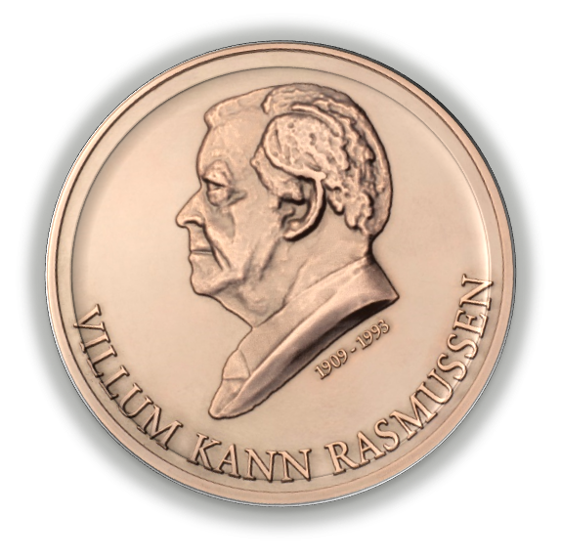
VILLUM FONDEN
Technical and Natural Sciences
Villum International Postdoc (VIPO)
3-4 yrs, DKK 1-2,5 million
(YIP+)
3 yrs,
DKK 4 million
Villum Kann Rasmussens
Annual Award
DKK 5 million
Villum Young Investigator (YIP) 5 yrs, DKK 7/9 million
Villum Onboarding and Family Support
Villum Investigator (VIP)
6 yrs, DKK 30/40 million
Villum Experiment (VEX)
2 yrs, DKK 2 million
Villum Kann Rasmussen Professorship
Villum Synergy (V-Syn)
Initiation: 2 yrs, DKK 2-3 million
Established: 3-5 yrs, 10-20 million
Pioneer centers (collaboration with DNRF+)

Slide 5
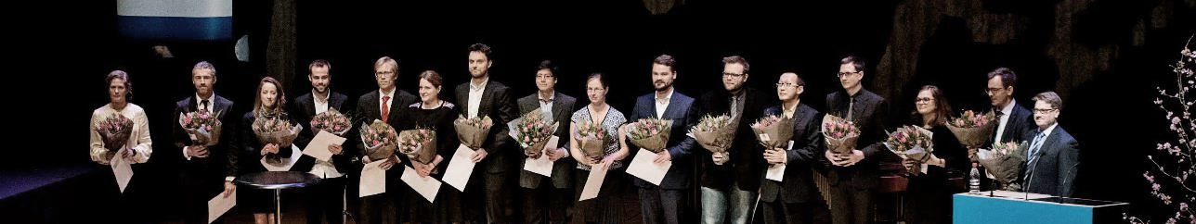
VILLUM FONDEN
Villum Young Investigator Programme
VILLUM FONDEN granted the first VILLUM Young Investigators in 2011 to 15 YIPs (of which 12 are now full professors).
2011-2022: 235 YIPs and 13 YIP+ investigators.
Total granted amount: 1,54 DKK M
Annual YIP workshops since 2015 (networking, common challenges etc.)
235
VILLUM YOUNG INVESTIGATORS SINCE 2011

Slide 6
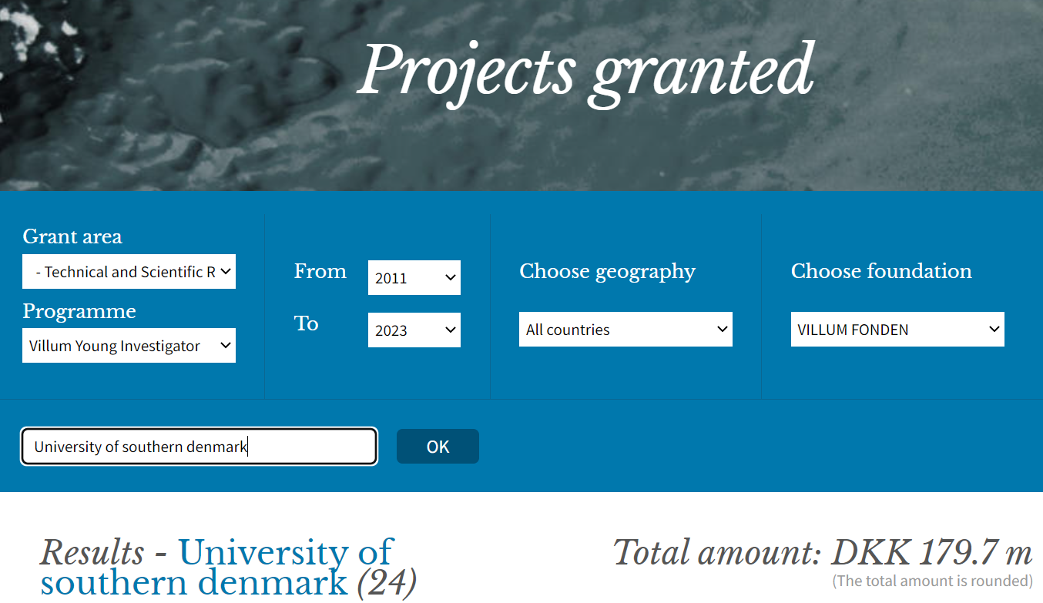
VILLUM FONDEN SDU YIP Grants (total)
235
VILLUM YOUNG INVESTIGATORS SINCE 2011

Slide 7
Your application: Explain clearly the state of the art and how your project adds to the current knowledge Describe what you consider your most original scientific key insight the project is based on. Don’t rush to the WP-description. A clear profile of you and your research compared to what is going on in your department and elsewhere A sober language, please – not too many buzz words
Villum Young Investigator Programme

Slide 8
Villum Young Investigator Programme
The scientific committee is looking for:
Excellence
Independence
Mobility
Signs of leadership skills
Invited talks
First, last authorships
Citations
Visibility
Support from the host institution

Slide 9
YIP grant recipients: Average phd-age: About six years Postdocs: 25-50% Gender: 20-50% female applicant/recipients. We hope to see a representative number of female applicants Research areas: all within Technical and Natural sciences (no prioritization)
Villum Young Investigator Programme

