Slide 1
Villum Experiment – Information meeting SDU 6 February 2024
Head of programme Anders Smith

Slide 2
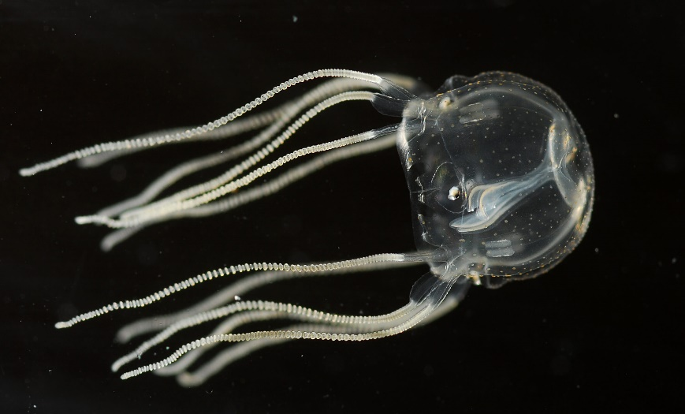
Villum Experiment
Can you build a battery from rust?
Learning without a conventional brain
Is the conventional peer-review funding
system missing out on unconventional ideas?

Slide 3
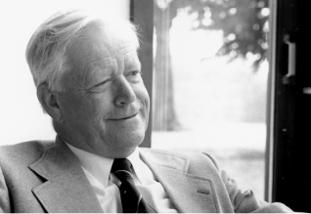
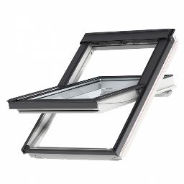
Villum Foundation
Philanthropic foundation created in 1971 by Villum Kann Rasmussen
Villum Foundation is a majority shareholder in the VKR Group, including VELUX
Main grant area: Technical and natural science
Annual grants approx. 1 billion DKK

Slide 4
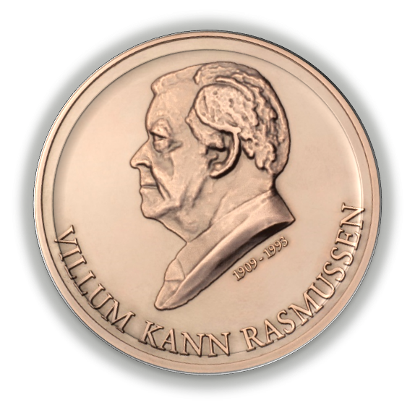
Science grants in Villum Foundation: People, Ideas, Talent
Villum International Postdoc (VIPO)
3-4 yrs, DKK 1-2,5 million
Villum Kann Rasmussens
Annual Award
DKK 5 million
Villum Young Investigator (YIP)
5 yrs, DKK 7/9 million
Villum Investigator (VIP)
6 yrs, DKK 30/40 million
Villum Mobility
Villum Experiment (VEX)
2 yrs, DKK 2 million
Villum Kann Rasmussen Professorship
Villum Synergy
Initiation: up to 3 yrs, up to DKK 4 million
Established: 3-5 yrs, 8-12 million
Pioneer centers (collaboration with DNRF, NNF, LF, CF)

Slide 5
Villum Experiment
Bold ideas – not incremental research
Double blind evaluation
Less consensus-driven
Open to active researchers at any career stage (beyond the PhD)
Grants of up to 2 million DKK and 2 years

Slide 6
Villum Experiment
The four stages in the acceptance of a scientific idea (J.B.S. Haldane):
This is worthless nonsense
This is an interesting, but perverse, point of view
This is true, but quite unimportant
I always said so

Slide 7
Villum Experiment: Application process
1
2
3
Scientific review panel*
Originality, potential,
appropriateness
Independent rating of applications. Each application is rated by three panel members. Each panel member has one decisive vote.
Screening of CVs**
Check for appropriate field of expertise of the applicant
In previous rounds, no applications have failed this screening
Board
Application
Pre-screening of topic
Decisive vote applications
Proposal (anonymous)
Applications ranked according to the panel’s evaluation
Final recommendation
CV
* 21 international researchers covering technical and natural science. The panel doesn’t meet or interact. ** Members of VILLUM FONDEN’s science advisory committee and the secretariat.

Slide 8
Villum Experiment: Criteria
Originality of the idea: The idea shows unorthodox thinking and introduces a unique approach and, if applicable, a novel hypothesis, a non-standard methodology, etc.
Potential impact of the idea: The idea holds the potential to answer a long-standing question in science, bring about a transformative understanding of a central topic, pave the way for a new research area or new method/technology or the like.
Appropriateness: The idea is unlikely to be fit for conventional research project programmes.

Slide 9
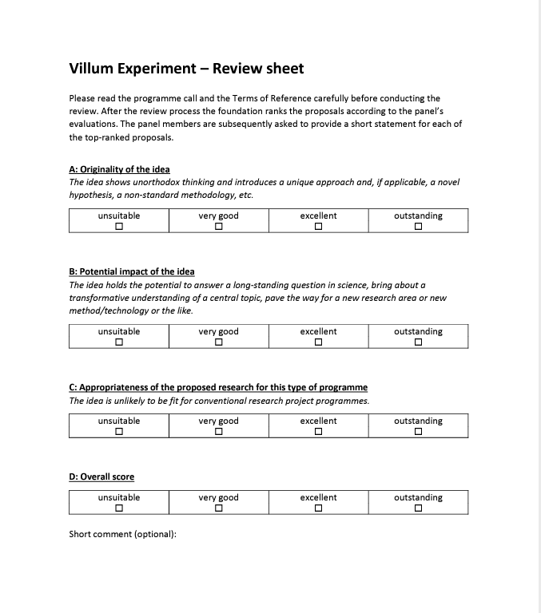
Villum Experiment: Review sheet
ERC-like scale: unsuitable – very good – excellent – outstanding
Translated to a numerical grade: -5, 10, 25, 50
Final grade the average of three evaluations
Confidence level is used as a tie-breaker

Slide 10
Villum Experiment: Grant statistics
Approx. 50 grants / 100 MDKK per year
7 rounds so far, 200 ongoing projects
Success rate SDU (2023): 9% (3 out of 34; 11% in 2022)

Slide 11
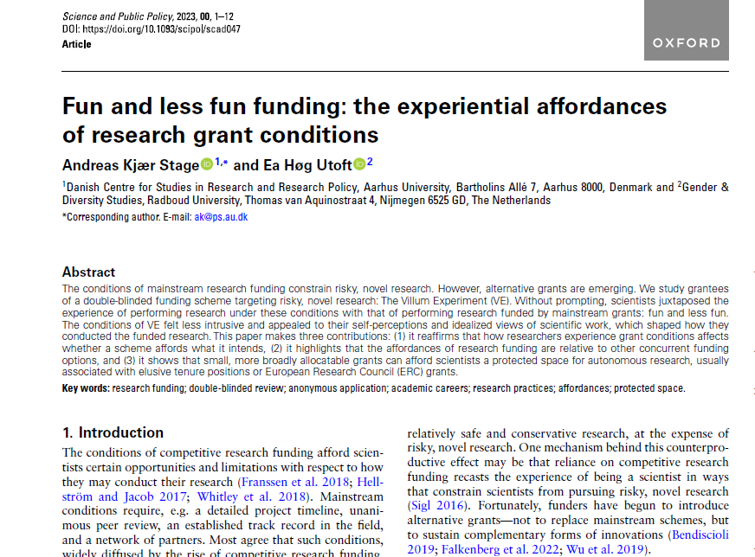
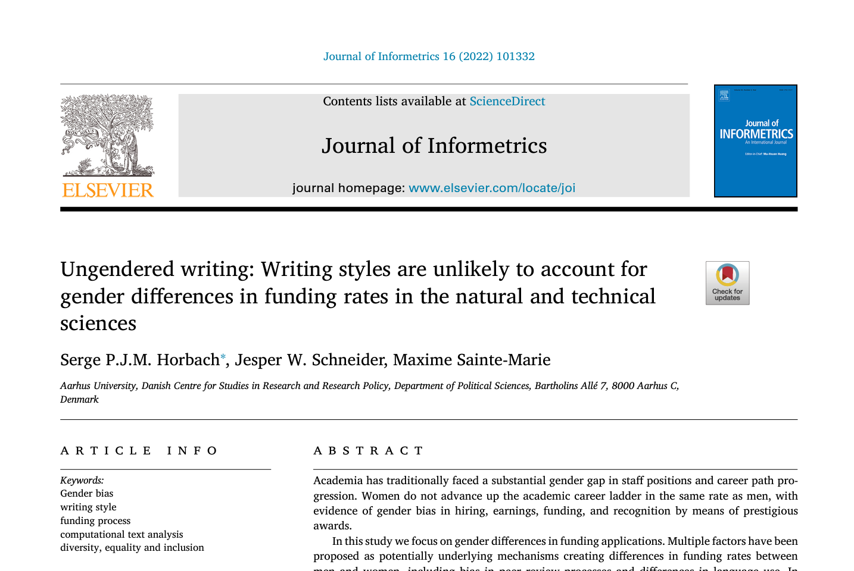
Villum Experiment: Does it work?
Ongoing study by The Danish Centre for Studies in Research and Research Policy at Aarhus University
Preliminary findings:
It feels different
The decisive vote is important
Past performance is not a predictor of success
Potential gender differences

Slide 12
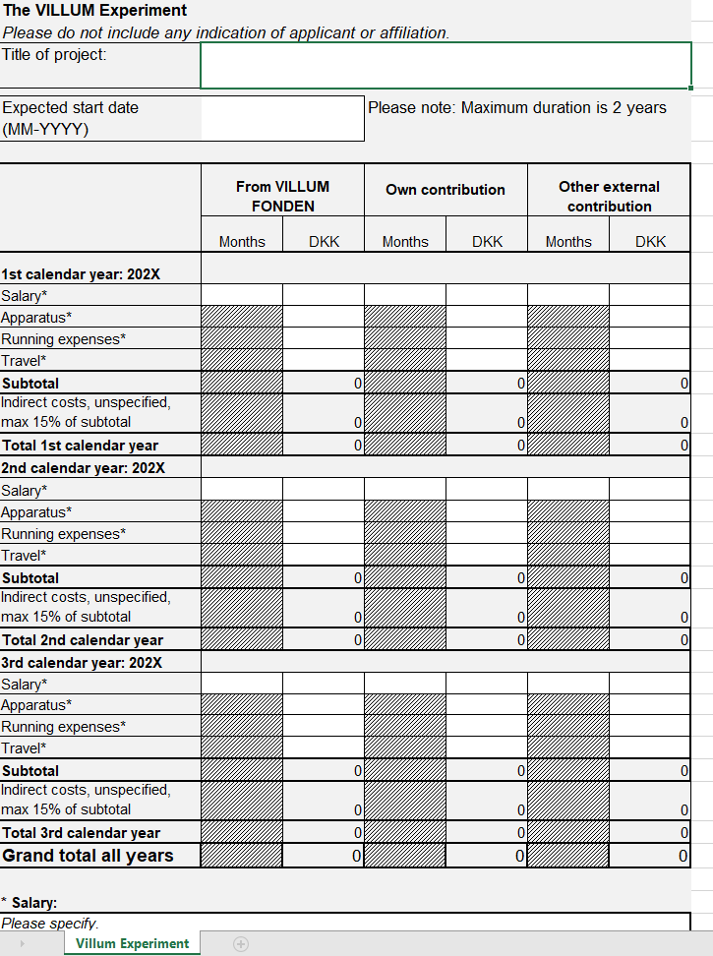
Villum Experiment: Conditions
Cannot apply two consecutive years
Only a single PI; no co-PI’s
Budget template (Excel 2019 or later)
15% flat rate for indirect costs
Remove all metadata from the pdfs before submission!
NOTE: If you have applied before, you cannot apply again with the same idea

Slide 13
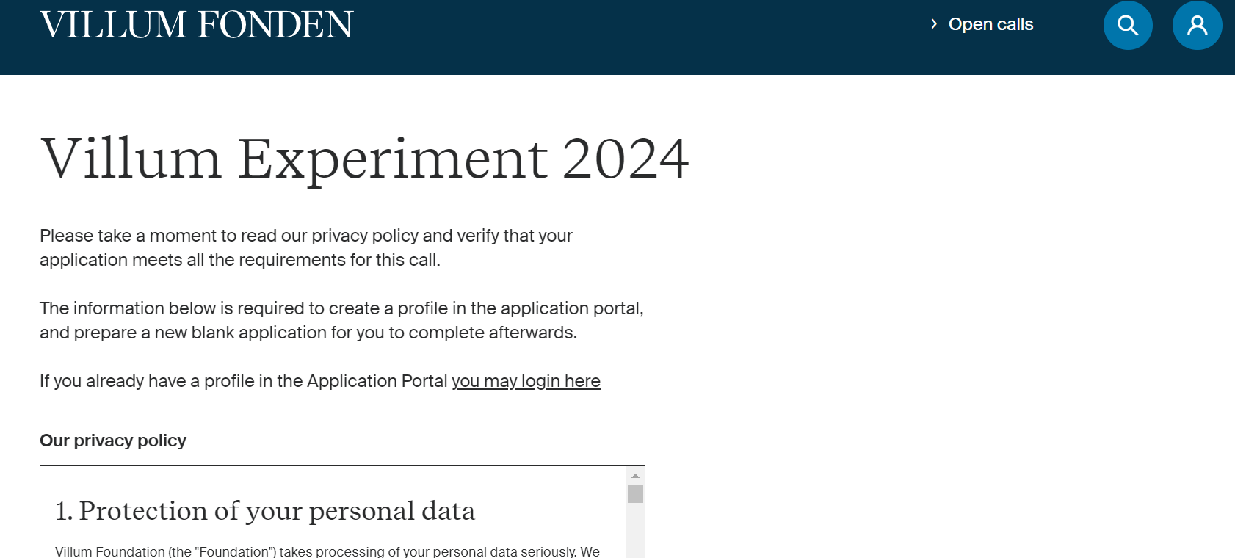
Villum Experiment: How to apply
All information available at https://veluxfoundations.dk/en/villum-experiment-call
Applications submitted through our application portal
Deadline 6 March 2024

Slide 14
Questions?

