Slide 1
Intro til generativ AI på SDU (ENG below)
Indhold:
Overblik over de nuværende rammer for studerendes brug af generativ AI i undervisning og eksamen på SDU
Inspiration til, hvordan du som underviser kan tage stilling til dine studerendes brug af generativ AI inden for rammerne
Links til ressourcer og mennesker, der kan hjælpe
Notes:
AI-generated content may be incorrect. --- Welcome to the workshop on creating effective teaching and learning activities with Copilot, an AI-powered tool designed to enhance education. In this presentation, we will explore the benefits of using Copilot, identify ways to use it to enhance teaching and learning activities, and develop hands-on experience using the tool.

Slide 2
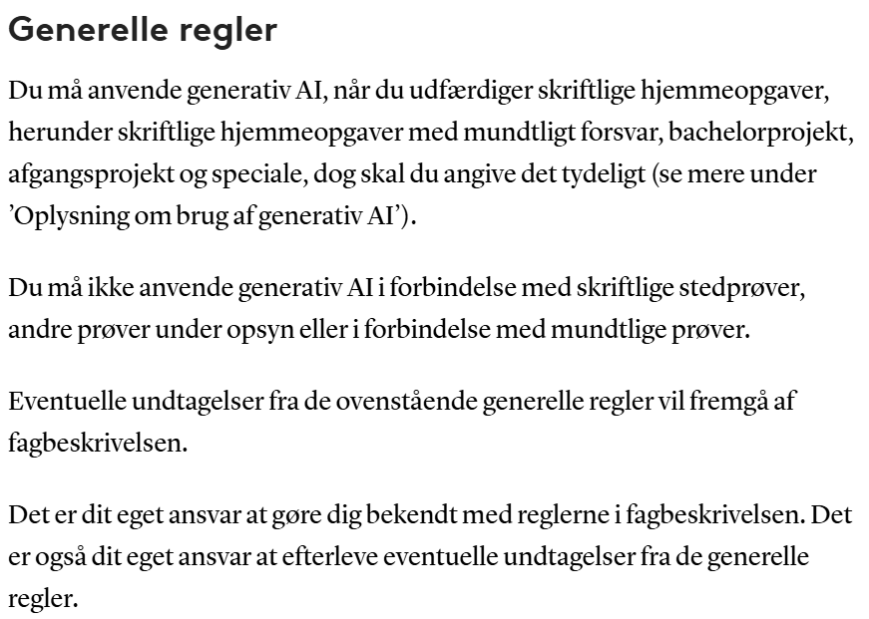
Generelle regler for studerendes brug af generativ AI på SDU (2025) OBS! Uddybet og opdateret version findes på mitsdu.dk/aipaasdu
Bonus: SDU AI kodeks

Slide 3

Hjælp dine studerende: Tag stilling som underviser! Når du tydeliggør dine forventninger, hjælper du de studerende til at bruge og deklarere AI korrekt i dit fag
SDUs vejledning sætter rammen, men de studerende har ofte brug for konkrete eksempler fra dit fag.
Ved at tage stilling på forhånd gør du det lettere for de studerende at forstå, hvordan de skal bruge og deklarere AI.
Overvej hvilke former for AI-brug der er relevante, og gør dine forventninger tydelige
Det er i sidste ende dig, som skal bedømme deres opgaver.

Slide 4

Dine overvejelser i dit fag: Forberedelse, undervisning og eksamen
Har de studerende fået en introduktion til brug af AI – og i så fald hvilken?
Hvilken introduktion ønsker jeg, at de får?
Kan jeg selv give dem den?
Er de studerende bekendt med SDUs regler for brug af AI?
Kan eller skal de studerende anvende AI på dette fag/kursus:
I deres forberedelse til undervisning?
I undervisningen
I deres forberedelse til eksamen?
Til eksamen?

Slide 5
Tag snakken med dine studerende: Inspiration til samtale
Tæller det negativt for min karakter, hvis jeg bruger generativ AI?
Må jeg bruge generativ AI til at skrive min rapport?
Jeg har gjort alt arbejdet til min opgave selv, men jeg har brugt copilot til korrekturlæsning. Hvordan sikrer jeg, at ingen tror, jeg har snydt?
Hvordan citerer jeg copilot?
Please lad være.
Hvorfor?
Kan jeg som studerende blive tvunget til at bruge generativ AI på min uddannelse?
Her afgør du som underviser, hvad der er relevant for dig og dit kursus. Oplagte temaer: Kilder, etik, vildledelse om egen indsats/arbejde (ink grænsen for, hvornår noget er ‘eget arbejde’), GenAIs rolle i læring (hvornår hjælper AI os med at blive bedre til at tænke? Og hvornår bliver det en krykke, vi ikke kan slippe?)
Husk at du kan sparre med kolleger, e-læringskoordinator og SDU UP!

Slide 6

Her finder du hjælp Der findes både online og menneskelige ressourcer til underviser og studerende
Teach GenAI / Learn GenAI Udviklet af AU, AAU, SDU, It-vest https://teachgenai.au.dk/learn-genai
SDU Biblioteks ressource om Generativ AI https://libguides.sdu.dk/ai
E-læringskoordinatoren på dit fakultet
SDU Universitetspædagogik
Bonus:
Prompts to help you learn, https://canvas.sydney.edu.au/courses/51655 University of Sydney
https://weteachwithai.com/ José Bowen
”Why we’re not using AI in this course, despite its obvious benefits” Patrick Lin

Slide 7
Intro to generative AI at SDU
Contents:
Overview of the current rules for students’ use of generative AI at SDU
Inspiration for your considerations regarding your students’ use of generativ AI
Links to resources and people who can help
Notes:
AI-generated content may be incorrect. --- Welcome to the workshop on creating effective teaching and learning activities with Copilot, an AI-powered tool designed to enhance education. In this presentation, we will explore the benefits of using Copilot, identify ways to use it to enhance teaching and learning activities, and develop hands-on experience using the tool.

Slide 8
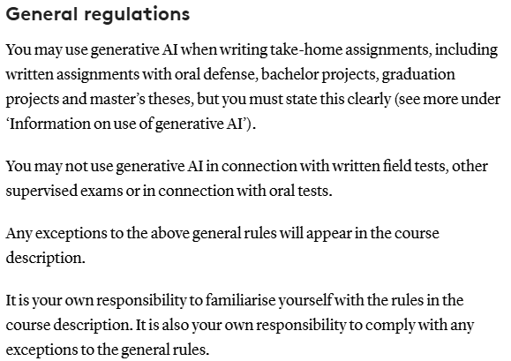
Overall rules for students’ use of generative AI at SDU (2025) NB! Extended and updated version available at mitsdu.dk/aipaasdu
Bonus: SDU AI codex

Slide 9
Help your students: Explore your perspective as an educator! When you are clear about your expectations, you will help students use and declare AI correctly in your course.
SDUs guides provide a framework, but students will often need concrete examples from your field.
By exploring your perspective in advance, you will make it easier for students to understand how to use and declare AI.
Consider which kinds of AI use are relevant, and make your expectations clear.
In the end, you are the one who will assess their exams.

Slide 10
Your considerations in your course: Preparation, teaching, and exam
Have the students received an introduction to use of AI – and if so, which one?
Which introduction would I like them to have?
Can I provide them with that introduction?
Do students know SDUs rules for use of AI?
Can or should students use AI in this course:
In their preparation for lessons?
During the lessons?
In their preparation for the exam?
At the exam?

Slide 11
Start the conversation with your students
Will it count negatively towards my grade if I use AI?
May I use generative AI to write my report?
I have done all the work for my paper myself, but I have used copilot as a spell checker. How to I make sure no one thinks I cheated?
How do I quote copilot?
Please don’t.
Why?
Can I as a student be forced to use generative AI in my education?
As a teacher, you choose which discussions are relevant to you and your course. Suggested themes: Sources, ethics, misrepresentation of one’s own efforts/work (inc limits for when something is ”own work”), GenAI’s role in learning (when does AI help us learn? When does it become a crutch we can’t let go of?)
Do reach out to colleagues, e-learning coordinator, SDU UP for sparring!

Slide 12
Find help here There are both online and human resources to support teachers and students
Teach GenAI / Learn GenAI Developed by AU, AAU, SDU, It-vest https://teachgenai.au.dk/learn-genai
SDU Library’s resource on Generativ AI https://libguides.sdu.dk/ai
E-læringskoordinatoren på dit fakultet
SDU Universitetspædagogik
Bonus:
Prompts to help you learn University of Sydney https://canvas.sydney.edu.au/courses/51655
”Why we’re not using AI in this course, despite its obvious benefits” Patrick Lin

