Slide 2
Budget Strategy 2016-2019
Savings corresponding to 16.4 million DKK (2019)
Reduction of workforce by 22 full-time positions at NAT (VIP:13, TAP: 9)
No study programmes are to be discontinued, but education activities must be optimised
Some research areas are to be discontinued
Still room for strategic selection

Slide 3
Consequences FKF
Departmental economy
Budgetafdelingen, februar 2016
Savings in 2019: 5,8 mio. kr.
Optimisation of our teaching constitutes 1,5 mill kr and reduction of workforce 4,3 mill kr
Reduction of workforce at FKF will be 7 employees distributed as: VIP: 5, TAP: 2

Slide 4
Reduction in educational costs The proces
25-26/1 – 2016: Teaching seminar
All involved in educational management present
Primo February: Departmental Heads suggests local teaching cuts
Primo March: Faculty management suggests faculty cuts to SDU
Primo April: SDUs board approve the cuts
A second teaching seminar is planned
Primo May: Department Head presents his suggestions to the Department
Ultimo May: Local study boards make their suggestions to meet the cuts
June 7th: Teaching seminar: Final plans

Slide 5
Departmental Heads suggestions
Initiative 1: Improve bachelor average pass rate from 0,7 – 0,8
Initiative 2: Reduce number of lab exercises on service courses

Slide 6
How to do it
Main objective:
Instead of running very large courses (+150 students) with students from many different areas, we use the opportunity of future separate enrolment to split the courses in minor courses (≈100 students) tailor made to the costumer.
In my opinion this will give better educations at lower cost
Simple estimates in savings:
Initiative 1 (increased pass rate)
100 (Stud) * 10 (ECTS/Stud) * (0,8-0,7) * 45.000 (ECTS/STÅ) / 60 (STÅ/ECTS) = 75.000 kr
Initiative 2 (reduced lab exercises)
Elimination of 1 lab exercise (4 hours) on a 100 student course
Cost lab exercise: ≈ 40.000 DKr
Cost tutorial: ≈ 15.000 Dkr

Slide 7
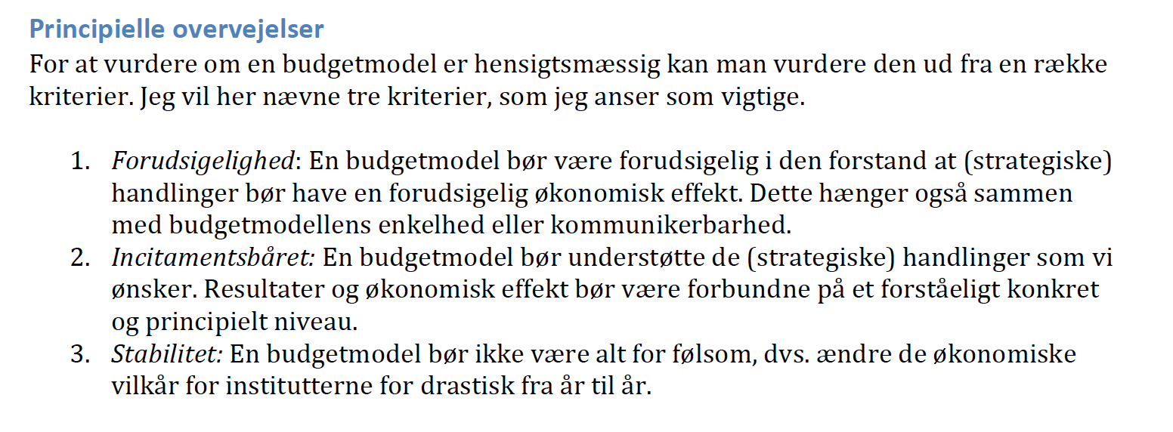
Ny budgetmodel
Budgetposter til forandring:
Uddannelsesbevillingen
Forskningsbevillingen
Omstillingspulje

Slide 8
Ny budgetmodel : Uddannelse

Slide 9
Ny budgetmodel: Forskningsbevilling

Slide 10
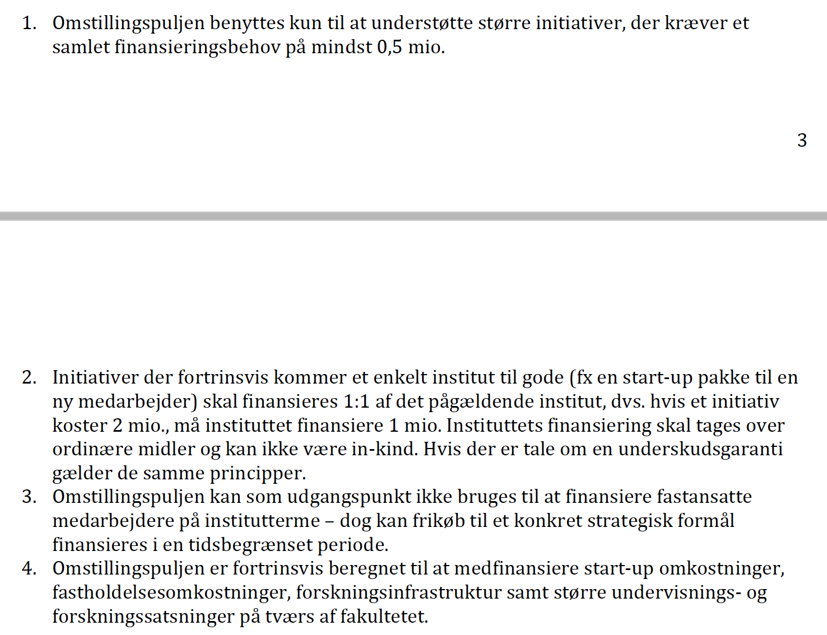
Brug af omstillingspulje – Ny model

Slide 11
Sammenligning Ny versus gammel model

Slide 12
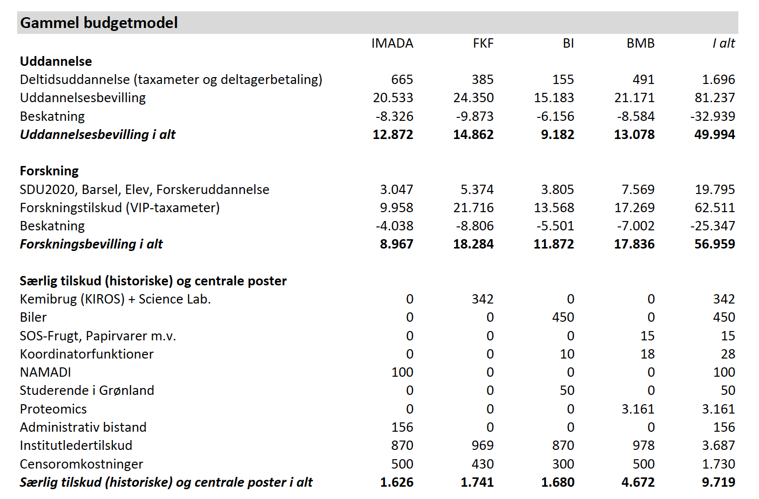

Slide 13
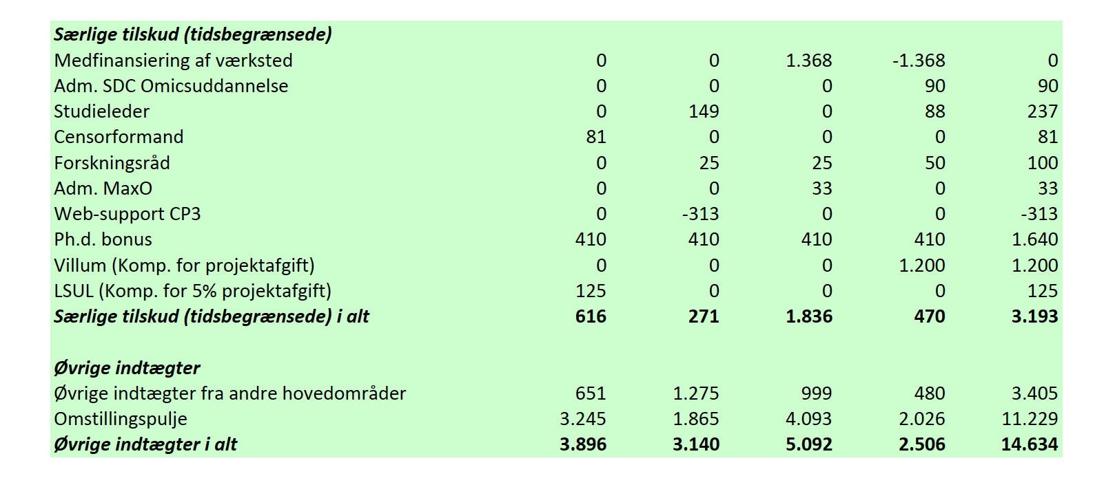

Slide 14
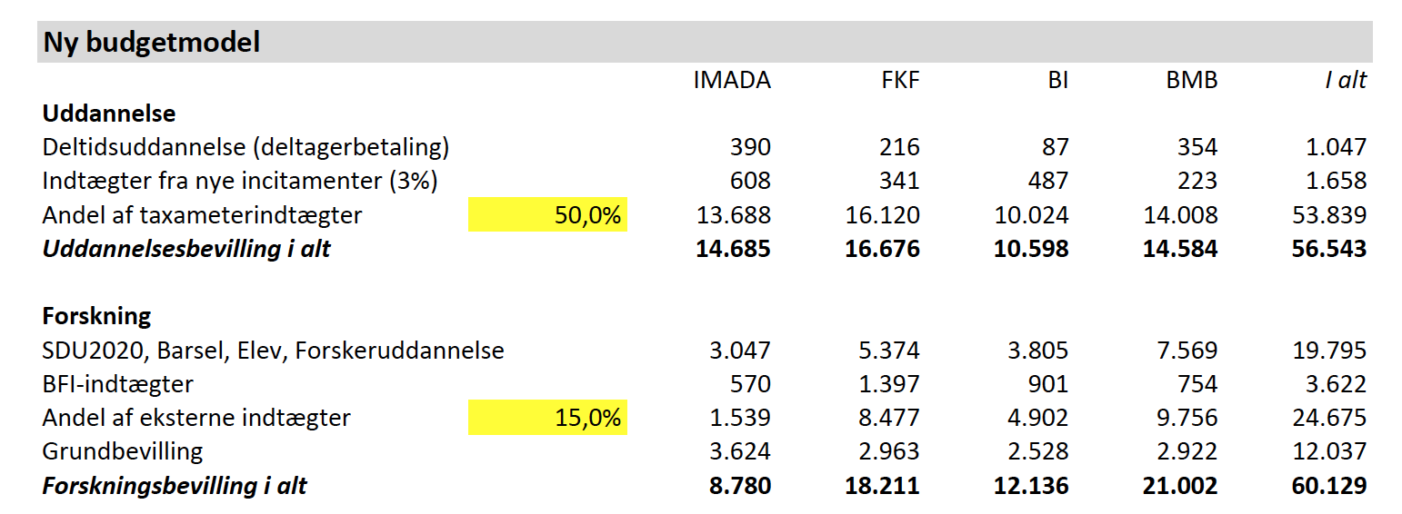

Slide 15
