Slide 1
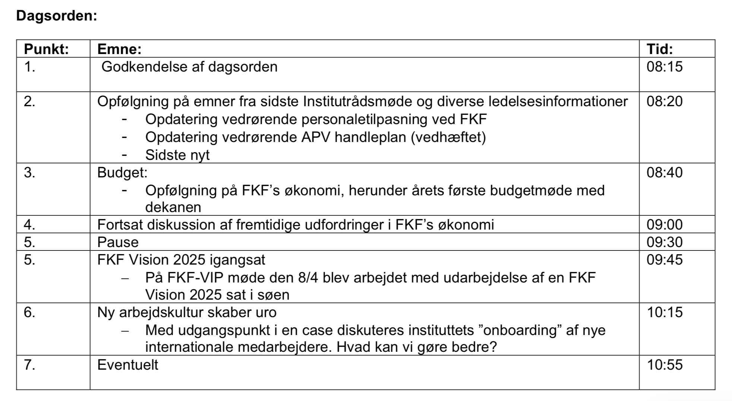
Institutrådsmøde 22-05-2019

Slide 2
The official landing platform for Physics at SDU
https://www.sdu.dk/da/fysikpaasdu

Slide 3
Institutrådsmøde 22-05-2019

Slide 4
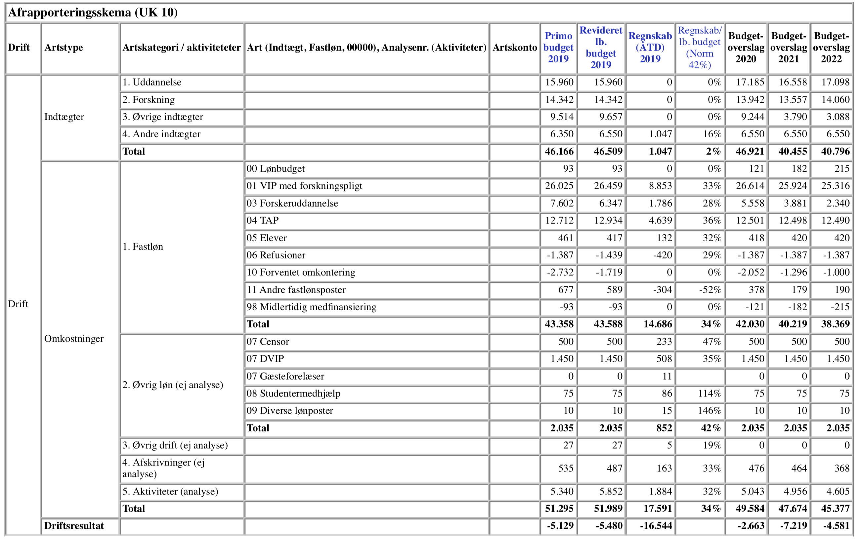
FKF Budgetopdatering 22-05-2019

Slide 5
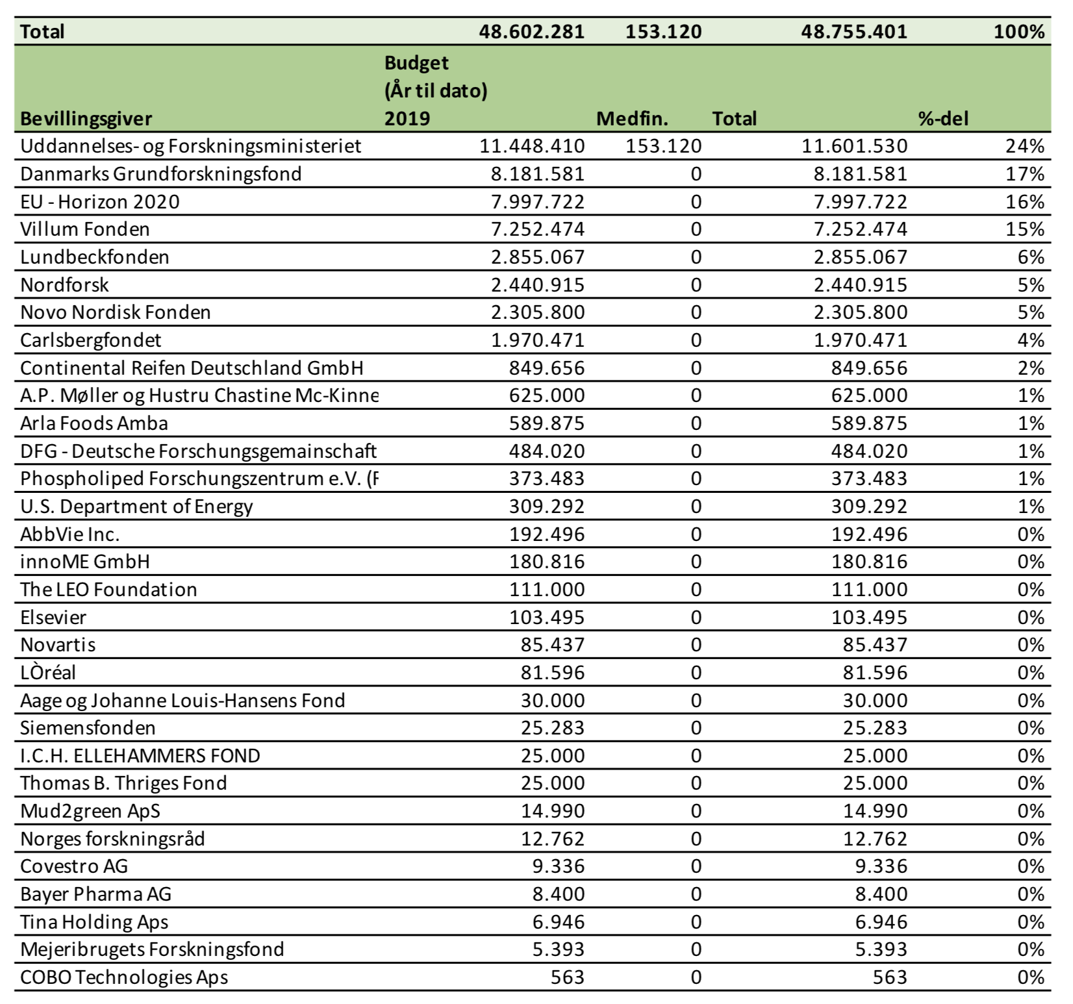
Ekstern bevillingsomsætning 2019

Slide 6
Institutrådsmøde 22-05-2019

Slide 7
5. | Future challenges for FKFs economy: PRIORITERING Skæv sammensætning af personale (faglig bredde blandt VIP i uddannelser) Studerende, der ikke består For få studerende på fysik og kemi – herunder frafald og forsinkelser samt større fravær blandt studerende grundet stress Dårlig økonomi grundet nuværende budgetmodel Slagkraftig dekan? Politiske beslutninger FKF’s manglende synlighed hos regionens og resten af Danmarks gymnasielærere Samarbejde/forventningsafstemning med gymnasier Manglende studieboliger, da pendlerstuderende har et højere frafald Forældet infrastruktur, og meget udstyr trænger til reparation Man-power blandt laboranter, herunder arbejdsmiljø og manglende fællesskabsfølelse – er instituttet ved at blive for stort? Svært at få eksterne midler Mangel på service/supportundervisning Manglende repræsentation i fondsbestyrelser

Slide 8
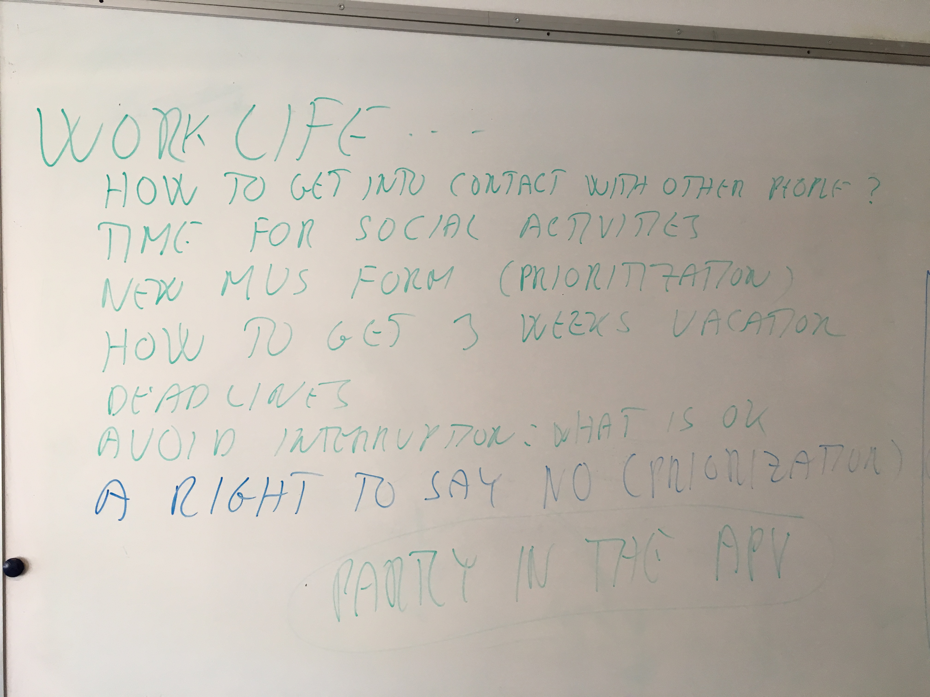
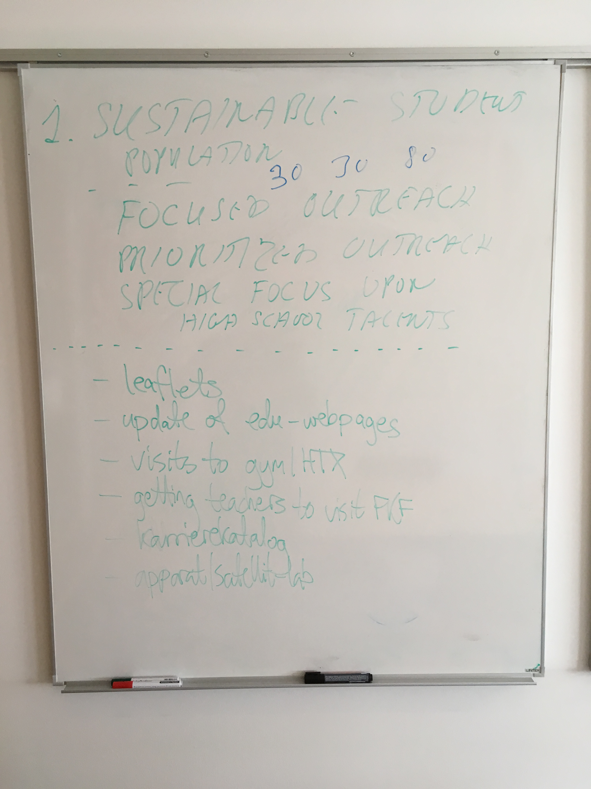
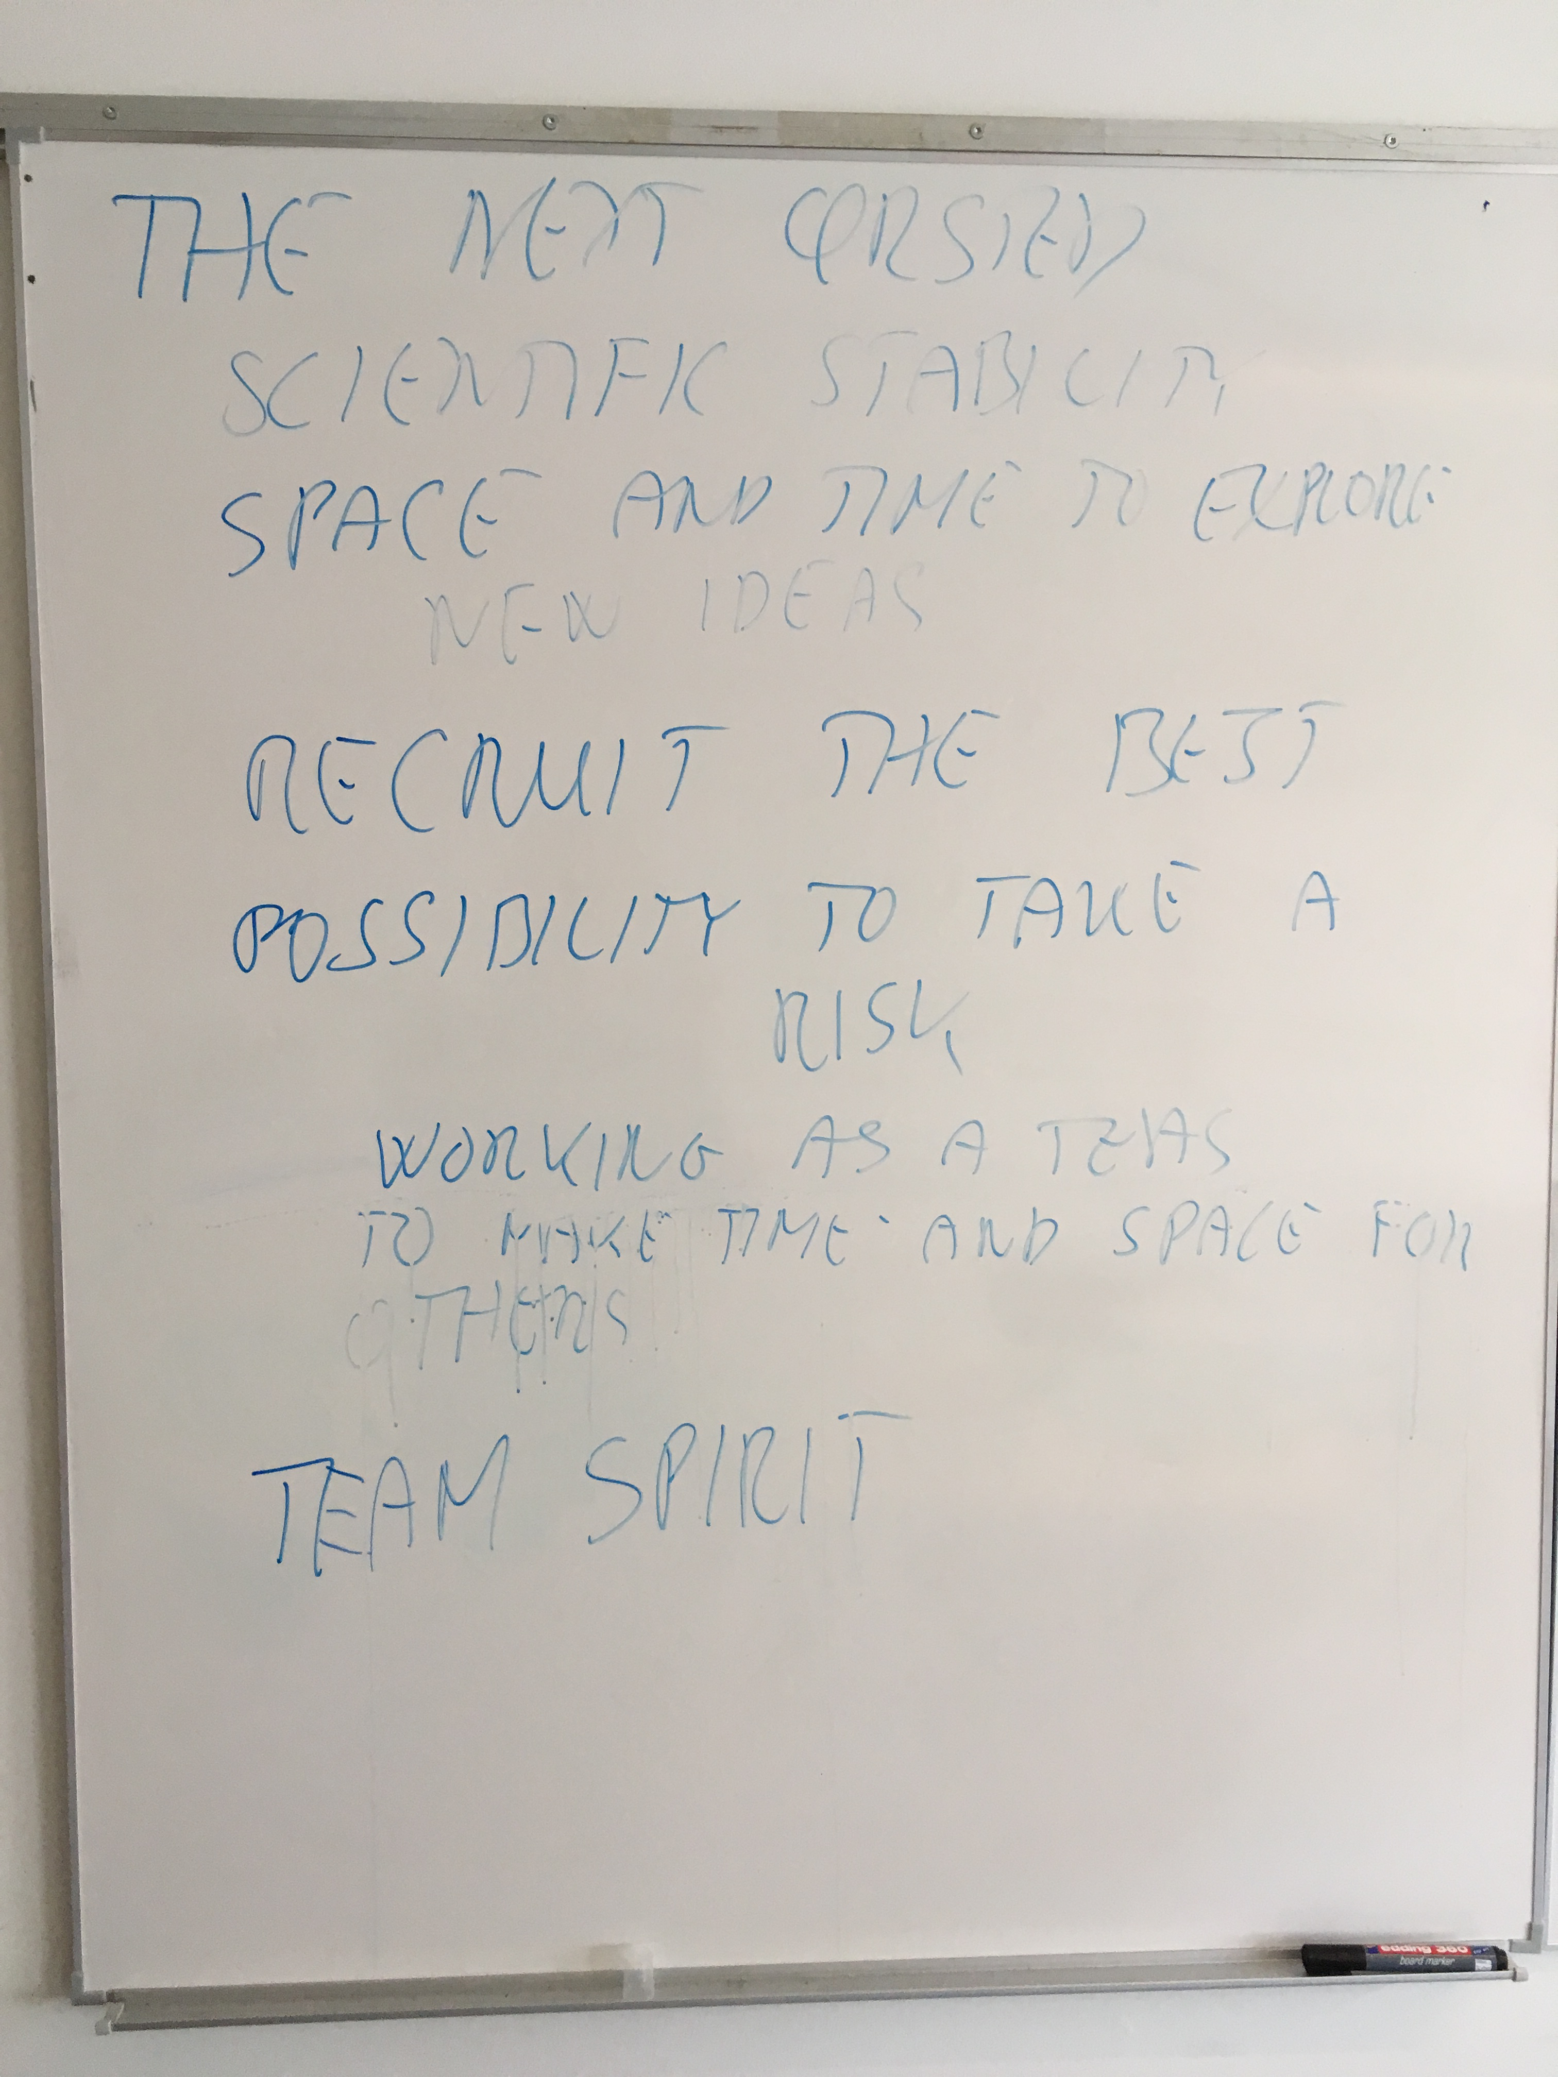
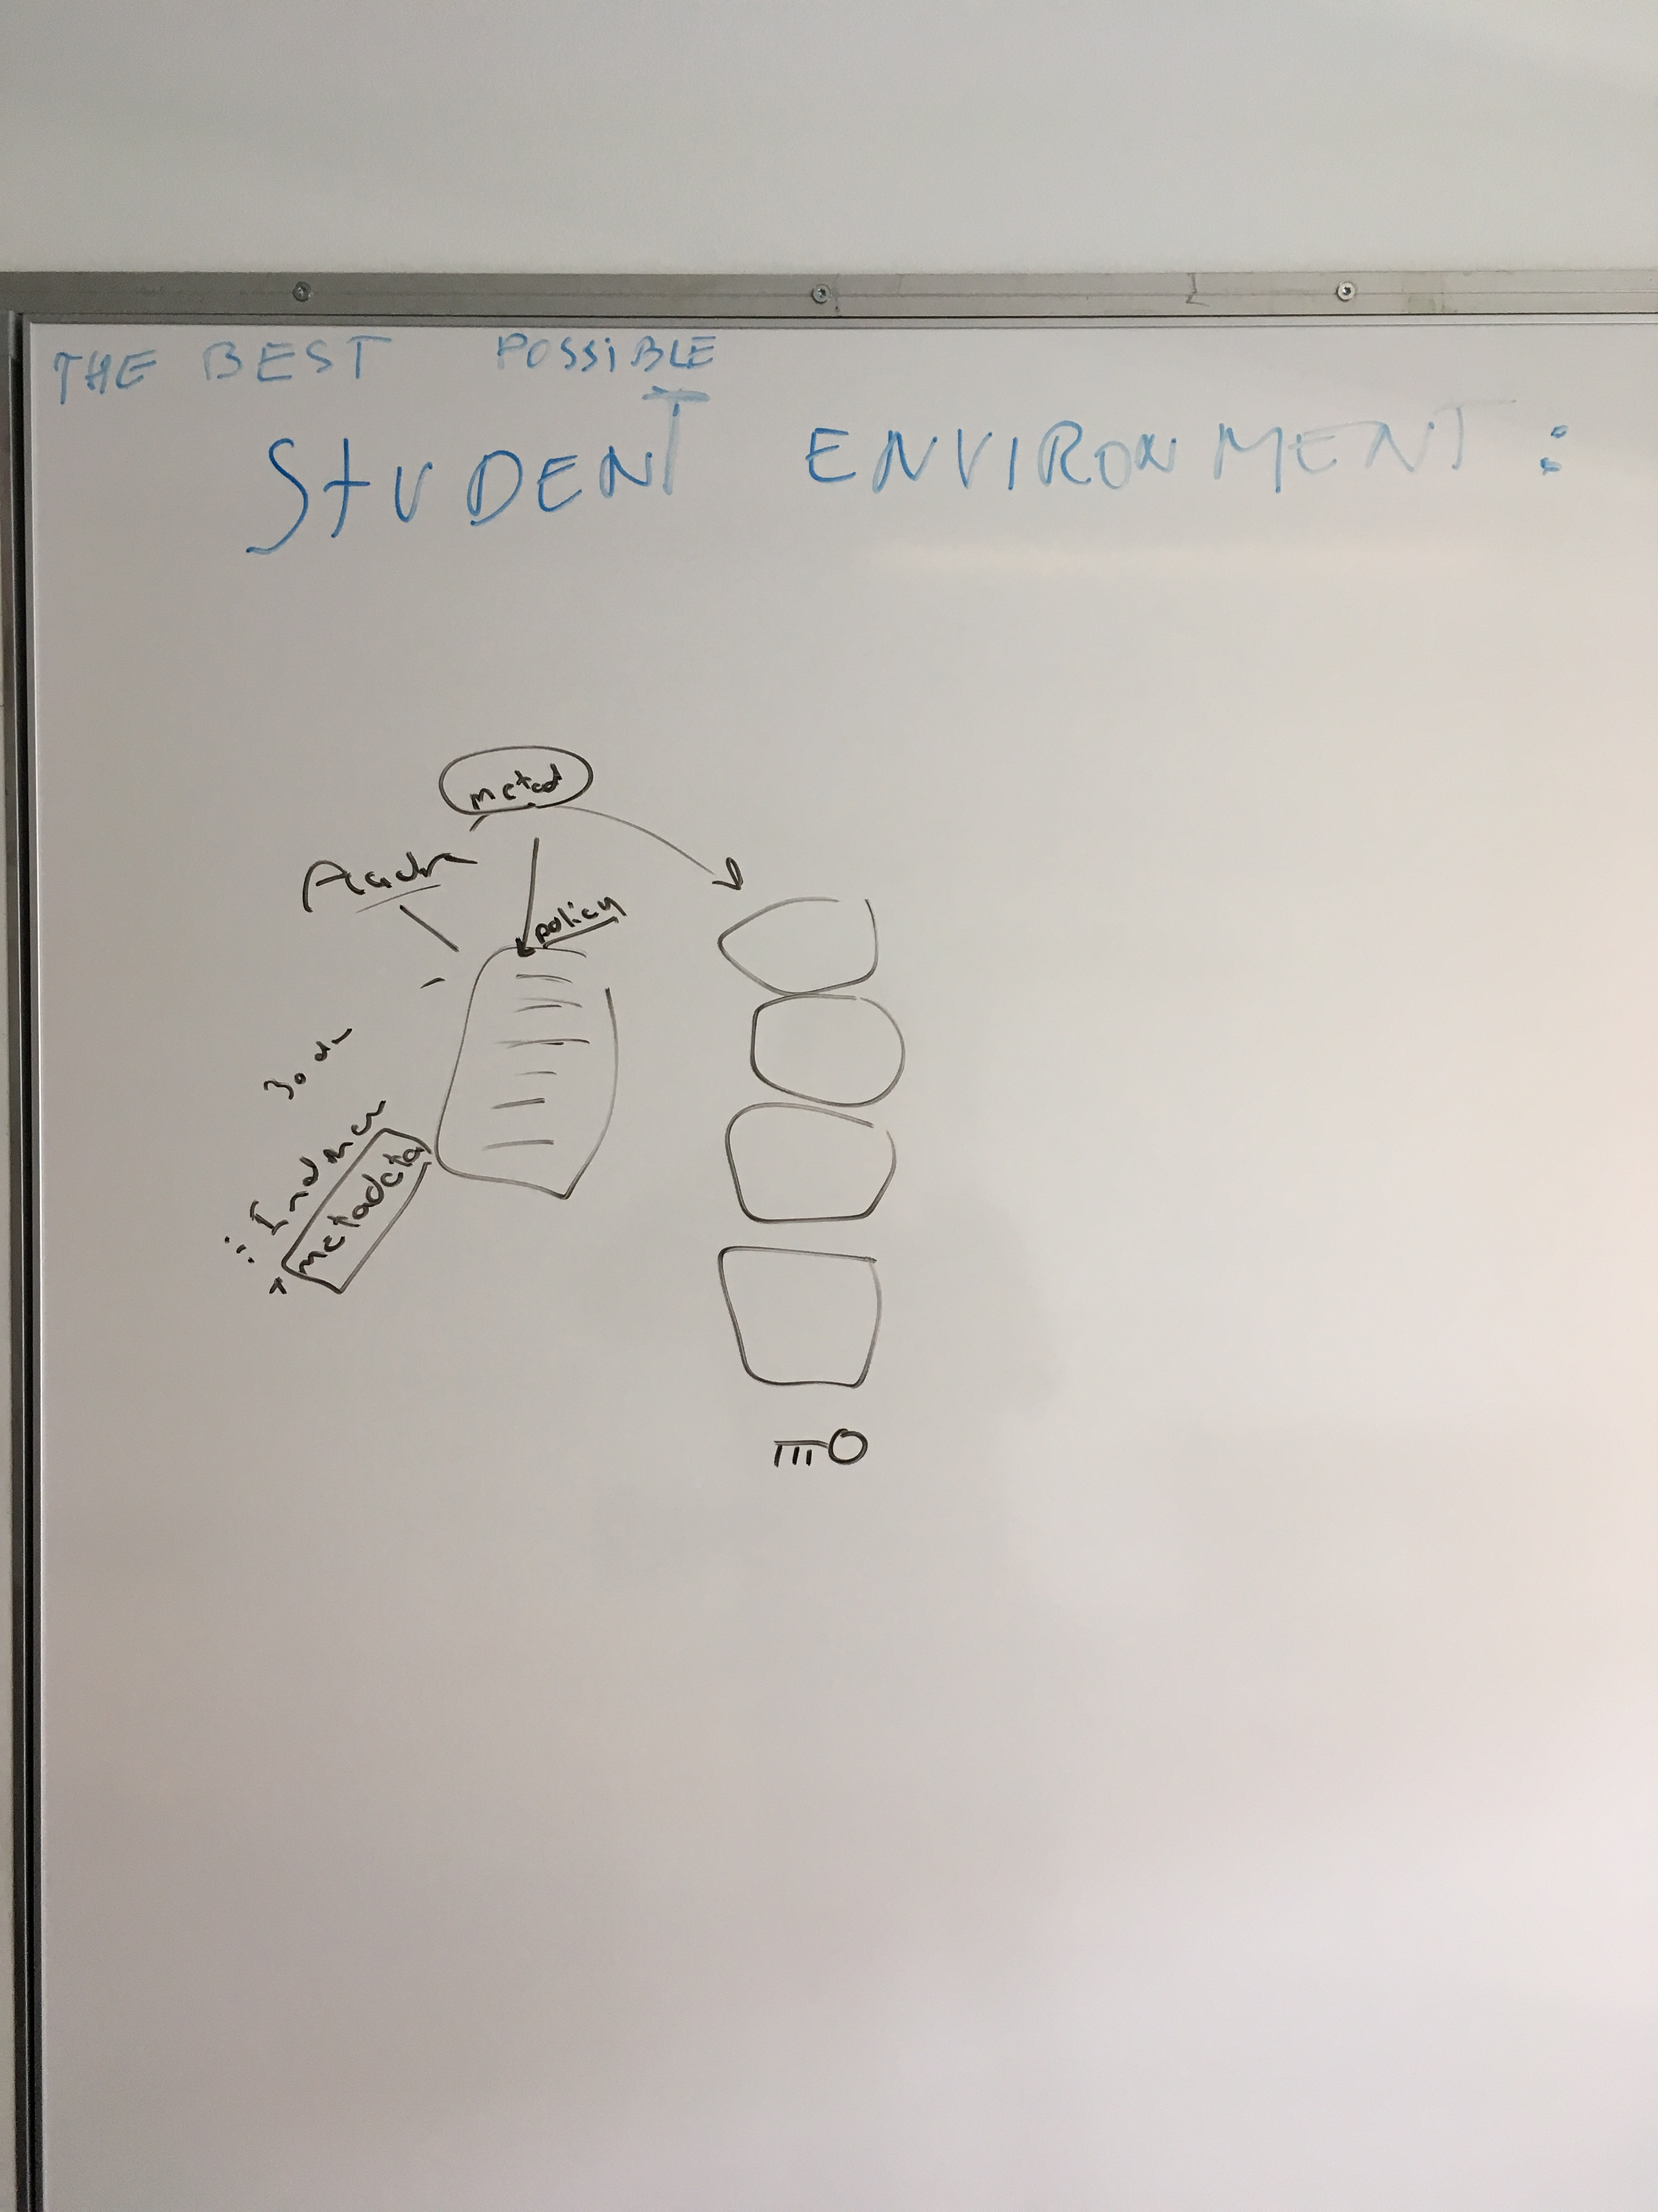
FKF anno 2025
FKF Management group’s suggestions to goals 2025:
A sustainable student population (Michael and Frants)
FKF has the best student environment (Jan and Carsten)
Work – Life – Balance (Ulla and Hans Jørgen)
Make FKF an attractive place for the next H.C. Ørsted
(Chris and Adam)

Slide 9
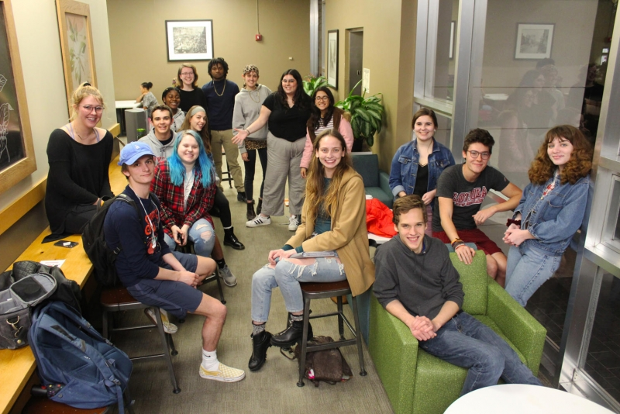
A sustainable student population

Slide 10
Dissemination to society and potential students
Society
Science show Public events demonstrating spectacular experiments
Harry Potter Festival Elexir production in castle dungeon at major annual city festival
Odense Physics film festival Science fiction films and explanations by physicist
Quantum Kate Youtuber explaining fundamental physics
Beer and Science Discussion of physics phenomena at a local browery
Scientific lectures External science lectures on current topics
Potential students
Apparatus lab Hands on practice with state of the art instrumentation
Nobel laurate lectures Nobel laurates present science to local high school students
Inspire-Educate-Innovate Society’s role models (science) present their career
ATV visits Arrangements together with the academy for talented youth
High School projects High School Students perform their study projects at FKF
Instrument service FKF offer free NMR and MS service to high schools

Slide 11
The best student environment Jan O./Carsten
Physical framework: Office places for BA and M.Sc. Thesis students. Tools (software?) we are missing?
Social environment: What defines FKF physically? Where do you go to ”hang out” (already existing event; torsdagste..). Are the segments of students different (1-2 year students vs. 3-5 year students) and how does that affect how we build the environment?
Contact/communication: How do we communicate with student, reply (time and content). The important element is that FKF staff has quality and credibility in their teaching – and that the student
Perception: What is it that students find important? When do they consider themselves being associated with FKF? (questionnaire, focused interview, who?)

Slide 12
Work-Life & Work-Work Balance - how to avoid the hamster mill
Hans Jørgen Aagaard Jensen
Ulla Gro Nielsen

Slide 13
Daily Dilemmas – What are the stress factors?
What is expected of me? [MUS with IL?]
How to prioritize your tasks?
Teaching, research, grant writing, outreach & recruitment, administration
When a new task, what old task should I not do?
Examples:
Lack of uninterrupted time
”Tid til fordybelse”
Vacation without disturbance (when exam work extends into July)
When did you last discuss over a cup of coffee with a colleague? Or a beer?
Do we need an FKF-VIP lounge with good coffee?
VIP team spirit
How do a new VIP get to know the ”old” VIPs?
When is it OK to say ”No” to students at your door?
When is it OK to say ”Later” e.g., to a short deadline
Missing deadlines may create stress for others

Slide 14
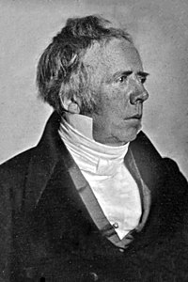
Make FKF an attractive place for the next H.C. Ørsted?
Born:
Rudkøbing 1777
Uddannelse:
Farmaceut: KU 1797
Beskæftigelse:
Farmaceut, universitetslærer, fysiker, kemiker, opfinder, ingeniør

Slide 15
Institutrådsmøde 22-05-2019

Slide 16
On-boarding af internationale medarbejdere
Case: John Smith, Gruppeleder for forskningsprojekt
Læs casen igennem
Diskuter hvorledes i forholder jer til situationen
Forslag til initiativer
Opsamling (kl. 10:35)
Nærmeste leder: Kollega 1 Bachelor/speciale studerende
Ulla og Hans Jørgen Sanne, Torben Karen Inger Philippe-Vincent, Kristian, Mikkel
Institutleder: Kollega 2
Frants Paul, Carsten og Ilia

