Slide 1
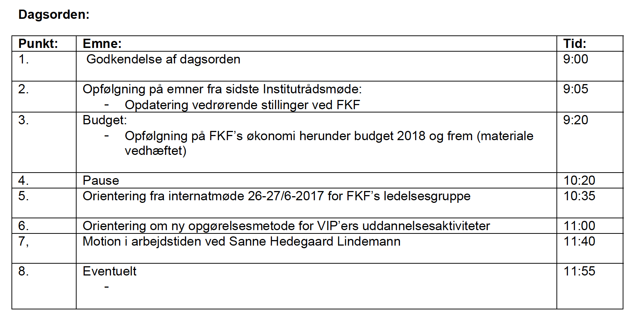
FKF Institutrådsmøde den 21/9-2017

Slide 2
Sectional economy
Let the money follow the students
Budget 2018 og frem:
Sektionerne modtager hvert år et fast driftsbeløb på 50.000 kr ved opfyldning i forhold til foregående års resultat, samt et beløb baseret på beståede specialer, bachelor og førsteårsprojekter som følger VIPen
Beløbet udmøntes med udgangspunkt i det foregående akademiske års afsluttede projekter.
MSc: 60 ECTS 8.000 kr, 30 ECTS 5.000 kr
BSc: 3.000 kr
1. års projekt med 4 studenter 4.000 kr

Slide 3
FKF – Sekretariatsfunktion 2017
Karen Cauthery Institutsekretær
Inger R. Hansen Uddannelse
Anna Johansen Økonomimedarbejder
Helle Damkjær Fleksjob – forefaldende opgaver
Tina Pedersen 32t Eksaminer m.m.
Centersekretær
Lone Charlotte Nielsen CP3 FKF finansieret per 1/9-2019
Ulla Lauritsen Memphys Ophører 31/12-2018
I alt 2.100
FKF – Sekretariatsfunk:on 2020+
NN Sekretariatsleder/institutsekretær
Inger R. Hansen Uddannelse
Anna Johansen Økonomimedarbejder
Helle Damkjær Fleksjob – forefaldende opgaver
Tina Pedersen Uddannelse (32t)
Centersekretær
Lone Charlotte Nielsen, CP3
I alt 2.117

Slide 4
Værksteder m.m. 2017
A-TAP Lars Duelund Lab – Manager, Memphys
A-TAP Mogens T. Jensen Kemibrug 50%/undervisning mm 50%
IT support Esben Mølgaard CP3 (50%)
Outreach NN
Teaching Esben Mølgaard Physics 50%
Betjent Bo Larsen Fleks 83% - Værksted
Ing. Ass. Danny Kyrping Elektronik - Værkstedsleder/lokaleansvarlig
Ing. Ass. Lars B. Hansen Mekanisk
Ing. Ass Torben Sørensen Mekanisk
Ing. Ass. Torben H. Jensen Elektronik
I alt 2.912
FORSLAG
Løbende implementering af INFRASTRUKTUREL SUPPORT UNIT:
A-TAP Mogens T. Jensen Kemibrug 50%/undervisning mm 50%
IT support Esben Mølgaard CP3 50% - CP3
Outreach Sara Zachau
Teaching Esben Mølgaard Physics 50%
Ing. Ass. Danny Kyrping Elektronik - Enhedsleder/lokaleansvarlig
Ing. Ass Lars B. Hansen Mekanik
A-TAP (opslået) NN 50% lab manager Memphys/50% fælles analytisk kemi udvikling
?? NN HPC/Analytisk kemi udvikling
?? NN Fill the gap

Slide 5
Laborantfunktionen (2017)
Birthe Haack Undervisning, Poul Nielsen, backup indk.b og NMR
Charlotte Damsgaard Laborantleder, undervisning, Christine McKenzie
Christian Jørgensen Undervisning, Ulla Gro, NMR ansvarlig
Gitte von Qualen Fleks 83% - opvask, rengøring mm
Lone Storm Undervisning, Trond Ulven, MS backup
Louise Johansen Undervisning, Stefan Vogel
Maria Pedersen Carsten og Bente 85%, undervisning 15%
Pia Hausmann Undervisning Kaare L. Rasmussen, MS ansvarlig
Sanne Hedemann Indkøber, undervisning
Susanne Hansen 31t/uge, undervisning
Tina Christiansen Martin, Annette 85%, undervisning15%
Pia Holm Fleksjob, ½ tid - opvask
Laborantpraktikanter
1 NN løbende 1 årig <25 år 40.000 kr/år
2 NN løbende 1 årig +25 år 98.000 kr/år
I alt 4.736

Slide 6
Lab technicians – overview
Undervisning 4 årsværk
Forskersupport 4 årsværk
Instrumentel infrastruktur 1 årsværk NMR, MS
Administration 1 årsværk Indkøb
Laboratoriepraktikanter ?? Forskersupport
To kommende pensioneringer svarende til 1,8 årsværk (U: 1,2 - F: 0,3 - I: 0,1 - A: 0,2)
Skal stillingerne genbesættes? JA. Undervisningssupport er essentiel
Skal vi fortsat organisere forskningssupporten til vådkemikere som i dag?
Alle laboranter har forskellige opgaver indenfor undervisning, forskning, instrument ansvar og administration.
Fordel: Alle laboranter har et spændende og afvekslende job
Ulemper: 6 vådkemikere har support medens 5 ikke har
Løsning: I stedet for at laboranterne tilknyttes en fast VIP vil de fremadrettet tilknyttes en bestemt funktion/instrument.
(Arbejdsgruppe: Charlotte Damsgaard, Ulla Gro Nielsen, Jan O. Jeppesen)

Slide 7
FKF principles for educational workload
FKF management agreement of 27/6-2017
New rules to be implemented by HD from fall 2017:
Elective courses with less than 12 students signed up. If the number of students are between 6 and 11 then the course must be held as a study group, where the students get less class hours and perform more unsupervised work. Study groups will be credited with 90 hours per 5 ECTS. Courses with 5 or less students signed up will be cancelled.
At no time more than 1 teacher is present per 12 students. This includes group and lab hours. Instruction videos are encouraged.
Elective lab courses will have an upper limit for the number of students, which can be extended if enough students signs up
Contact hours are limited to 9 hours per ECTS
Some elective courses should only run every second year in order to have at least 12 students per course.

Slide 8
How to count educational hours
FKF management group agreement of 27/6-2017
One important change will be that no matter what, the economy registration of our courses will be worse than hitherto, since it will include administration hitherto hidden.
We have two suggestions for a new registration of educational hours, which in my eyes are more similar than you think.
The easy part first: Chemistry/pharmacy Physics Agreement
1st year projects 3,4,5 stud. (30,40,50) 50 50
Bachelor 10/15 ects 24/36 24/30 24/36
Master 30 ECTS 40 40 48
Master 60 ECTS 72 (max 2 per year)
PhD 0? 90 30/year (max 90/year)
Educational responsible 150 300 200
Teaching allocation 100 0 100
Educational board 50 50 50
Internal censorships STÅ*4 5 + 0,5*antal stud. According to official censor regulation
Notes:
25 personer og 5 ects:
Kemi = 8
Fysik = 17,5

Slide 9
Registration of teaching hours at FKF
FKF management group agreement of 27/6-2017
Reference a 5 ECTS course with 12-30 students.
Other courses are scaled proportionally as far as possible.
The course responsible VIP is allocated 180 hours to cover everything (administration, planning , teaching, course development etc.) except exams.
Exam time is credited according to the general censor norms.
Courses with more than 30 students can be assigned extra hours for duplicated examinatorials. For every extra team of 30 students taught by a VIP, the VIP is accredited 2 hours per contact hour.
Lab courses and occasionally intense group teaching can be allocated extra hours for each team exceeding 12 students if needed. If the extra hours are given by a VIP without any course responsibility the credit is 2 hours per contact hour.
VIPs co-teaching a course and participating in developing the course are generally allocated 3 hours per contact hour according to agreement with the course responsible VIP. The total number of hours is still 180 hours.
VIPs responsible for a course for the first time can multiply the hours by 2.
VIPs responsible for a +100 student course can negotiate a reasonable number of hours with Head of Department.
The department head dis-courage the use of ISAs, but will accept 12 hours per 5 ECTs per student.
Any VIP can only get 36 hours credit in total for ISAs per year.
The use of phd students and postdocs as co-teachers is not credited and should not be used.

Slide 10
Betalte pauser med mere ved FKF
Alle statsansatte på fuld tid har ret til betalt frokostpause af op til 30 minutters varighed.
Frokostpausen er fastlagt til kl. 12:00 – 12:30 medmindre dette er i konflikt med opgaveafviklingen, i så fald afvikles frokostpausen når det kan indpasses.
På FKF er der tradition for 2 kaffepauser af 15 minutters varighed (fuldtidsansatte).
Kaffepauserne afvikles pt. kl. 9:00 – 9:15 og 15:00 – 15:15
(kaffepauser er en tiltrængt afbrydelse i arbejdet, hvorfor kaffepauser ikke bør afholdes kort tid efter arbejdstids begyndelse eller kort før arbejdstids afslutning)
Implementering af muligheden for 2 x 30 minutters motion i arbejdstiden per uge.
Som alternativ til kaffepauserne er der mulighed for at afvikle 2 x 30 minutters motion i arbejdstiden når dette kan indpasses i arbejdets afvikling. 1 Motions pause erstatter 2 kaffepauser a 15 minutter.
Generelt:
En pause starter når arbejdspladsen forlades og afsluttes når arbejdet genoptages.
Instituttet har tillid til at den enkelte medarbejder selv kan administrere ovenstående retningslinjer.
Frants R. Lauritsen, 28/9-2017

