Slide 1
Institutrådsmøde 15/9-2016

Slide 2
RI-råd SDU RIO Fyrtårnsprojekter Institutledermøde d. 14. september 2016

Slide 3
Etablering af SDU RIO Enheder koblet til SDU RIO
Følgende aktuelle enheder og funktioner indgår i SDU RIO:
SDU Erhverv
SDU Grants Office
EU forskerstøtte herunder samarbejde via SDEO
Erhvervs- / kontraktsjura i Rektorsekretariatet
SDU Cortex Lab og lignende i campusbyerne
Vækstlaboratorium Fyn (VLF), Demola og lignende indsatser
Tværgående koordinering af fyrtårnsprojekterne
Særskilt proces
Fakulteternes forskerstøtteenheder

Slide 4
Research & Innovation Etablering af RI-råd og SDU RIO
Direktion
Rektor
Direktør
HUM
NAT
SAMF
Prorektor
SUND
TEK
Rektor
sekretariat
Dekaner
Fælles- området
RI-råd
SDU RIO
Research & Innovation – SDU RIO
Er direktionens ansvarsområde
Koblet til fakulteterne via RI-råd
Beslutter sagerne på vegne af direktionen
Understøttes af sekretariat

Slide 5
SDU RIO Arbejdsgrupper
Arbejdsgruppe | Formand
RIO koordinationsgruppe | Henrik Bindslev
Entreprenørskab | Kirsten Ohm Kyvik, SUND
Virksomhedskontakt | Kasper Hallenborg, TEK
Employability | Marianne Holmer, NAT
Forskningsbevillinger | Nina Legind, SAMF
Policy | Per Krogh Hansen, HUM
Den gode start på RIO | Steen Kærn, RS
Kommunikation | Per Krogh Hansen, HUM
Videndelingssystem | Knyttes på eksisterende arbejde i IT-service

Slide 6
SDU’s samfundsengagement Fyrtårnsprojekter

Slide 7
Tværdisciplinære, strategiske indsatsområder
Droner
Open data
Velfærdsinnovation
Interesse-tilkendegivelser og udarbejdede projektforslag:
Fra droneteknologi til marked. Innovationsforløb med henblik på at identificere relevante anvendelsesområder og markeder for droneteknologien (TEK+SAMF)
Cultural Acceptance of Civilian UAVs - The Thrill of Drones WP1 (SAMF+HUM)
Understanding and engaging in consumer market development concerning drones -The Thrill of Drones WP2 (SAMF+HUM)
International New Venturing in the vicinity of a drone test center -The Thrill of Drones WP3 (SAMF+HUM)
Hvordan ny teknologi, herunder droner, påvirker samfundet (NAT)
Juridiske spørgsmål, herunder særligt regulativer, privatliv og forsikring (SAMF)
Platform til kommerciel udnyttelse af data.
De første demonstrations- og pilotprojekter er planlagt:
Smart City Odense og Odense Open Data (Odense Kommune og lokale virksomheder)
Geo Fyns Databooster (GeoFyn A/S, ejet af alle Fynske kommuner og ansvarlig for alle geodata)
Delprojekter:
Narrativ medicin (projektledelse: HUM)
Robo Trainer Light (projektledelse: TEK)
Sundhedssystemet og borgeren /forbrugeren/ samarbejdspartneren (projektledelse: SAMF)
Velfærdsteknologi - klinisk beslutningsstøtte (projektledelse: TEK)
Evaluation of risk for functional loss and disability in older citizens: screening platform & screening toolbox (projektledelse: SUND)

Slide 8
Institutrådsmøde 15/9-2016

Slide 9
Main features of the new budget model
Education:
A fixed percentage of education taximeter income
Income from four new incentive-driven study programmes is sent directly on
Research:
BFI income is sent directly on
Ordinary income equivalent to a fixed percentage of external income inc. overheads.
Basic funds for research coverage of teaching.
Offset funding based on Faculty’s old model (to be phased out).
Faculty’s strategic funds:
New principles for the Faculty’s strategic funds
Notes:
Education:
From now on, the departments will receive a fixed percentage of the total education income they generate.
Income from the four new incentive-driven study programmes is sent directly on without taxation to the departments who have earned it (transferred directly from SDU's budget model).
Research
BFI icome is sent directly on without taxation to the departments who have earned it (transferrd directly from SDU's budget model).
From now on, the department receives ordinary income equivalent to a fixed percentage of external funding inc. overheads.
Basic funding for research coverage of teaching. This will be set for four years at a time.
Offset funding in relation to the Faculty's old budget model. Phased out in percentages from 2016 and completely by 2020.
Faculty's strategic funds:
New principles for the Faculty's strategic funds.

Slide 10
Performance based budgetting Basic FKF income to cover salaries and running expenses
Education:
Based upon the STÅ production, each STÅ releases 46% in 2016 increasing to 50% in 2020
1 STÅ equal to 94.500 DKr in 2016
2015: 338 STÅ corresponding to 15 mill DKr using 46%
Incentatives: ≈ 0,5 mill DKr
Research:
A percentage of our external turnover
12% in 2016 increasing to 15% in 2019
Turnover in 2015: 56 mill DKr corresponding to 6,7 mill DKr
A basic amount to support research based teaching
5 mill DKr
c) All overhead minus 10% university tax
4,5 mill DKr in 2015
d) BFI income (210 papers in 2015)
1,4 mill Dkr 2015

Slide 11
Four new education incentives (transferred from SDU’s budget model):
International student on exchange at SDU, a special rate per STÅ of 15,000 DKK.
SDU student on international exchange, a special rate per STÅ of 75,000 DKK.
International self-funded student, special rate per STÅ of 40,000 DKK.
Research-based part-time education, special rate per annual student of 23,000 DKK.
The new incentive-driven education income will be sent directly on without taxation to the departments who have earned it.

Slide 12
Notes:
The figure illustrates the nature/construction of the individual departments’ economy. What strategic opportunities does the new budget model provide?
Note that the offset funding for BI is not visible in the figure due to a small amount of only 75 thousand DKK. This is low compared to the other departments’ amount of 0,5-2,5 million DKK.

Slide 13
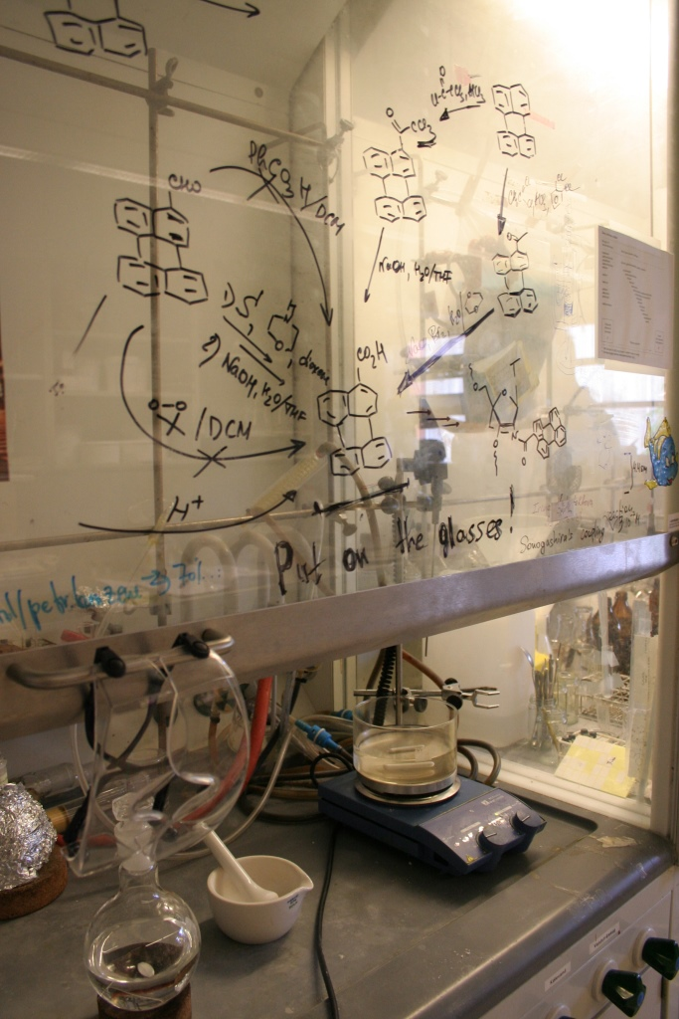
Example of education income
A 5 % increase in education taximeter income, e.g. through reduced drop out, will lead to an output of almost 2 % in FKF’s total income funding equivalent to ca. 780,000 DKK by 2017.
Education taximeter income represents a relatively good proportion of FKF’s total income funding. Is the full potential being realised? Is there room for improvement in reduction of drop out?

Slide 14
Example of research income
A doubling of external funding through increased procurement of grants has an output of 16% in FKF’s total income funding, equivalent to 6.8 million DKK by 2017.
The percentage of external funding represents a relatively large proportion of FKF’s total income funding. Is there unrealised potential? Is there room for improvement in procurement of external funding?

Slide 15
Research income and ordinary income
External funding increases the department’s ordinary income even if the external funding does not include overheads.
For example, a project with external funding of 0.8 million DKK plus overheads of 0.2 million DKK means that the department pays 0.1 million DKK to the vice-chancellor (10% of 1 million DKK), receives 0.12 million DKK from the dean (12% of 1 million DKK) and receives 0.2 million DKK in overheads. In this instance, the department receives 0.22 million DKK net. If a project with funding of 0.8 million DKK does not have overheads, the department will instead receive 0.016 million DKK net.

Slide 16
The Faculty’s strategic funds
To be used only for initiatives with financing requirements of at least 0.5 million DKK.
Initiatives that mainly benefit a single department are to be financed 1:1 by the department itself.
Cannot be used to finance salaries for permanent employees at the departments.
The Faculty’s strategic funds are primarily for contributing to start-up costs, retention costs, research infrastructure and larger teaching and research initiatives across the Faculty.
The Faculty’s strategic funds are to be reduced to 5% (at present ca. 10% of the total ordinary income)
Notes:
To be used only for larger initiatives with a total financing requirement of at least 0.5 million DKK.
Initiatives that mainly benefit a single dpeartment are to be financed 1:1 by the relevant department. The Faculty’s strategic funds cannot be used to finance salaries for permanent employees at the departments – however, purchases for a specific strategic purpose can be financed for a limited period. The Faculty’s strategic funds are primarily intended for contributing to start-up costs, retention costs, research infrastructure and larger teaching and research initiatives across the Faculty.

Slide 17
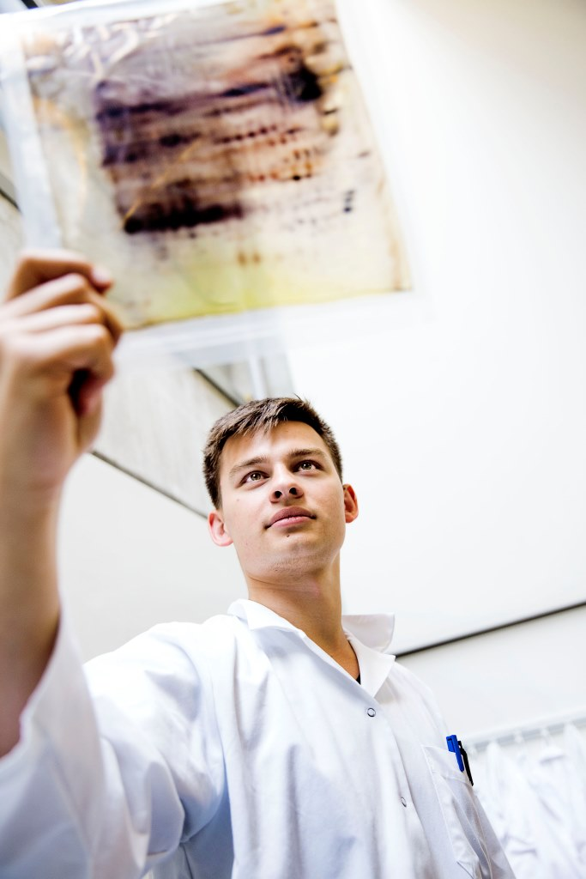
What does it mean for the department’s economy ?
The budget for 2017-2020 does not change because of the offset grant
The opportunity to increase income via more education income or more external funding
Draft budget to be presented in Nov./Dec.

Slide 18
Institutrådsmøde 15/9-2016

Slide 19
Reorganisation of FKF
The department will be split into sections with partly responsibility of own economy
Why?

Slide 20
Problems that needs to be solved
Internal FKF budget model based upon a 10-20 year old reality
Large diversity among the research groups
The unlucky funding situation with continuous cut downs. We need an old fashioned annum.
New budget model with Performance oriented economy

Slide 21
Example: FKFs budget for running expenses
Total budget tilrådighed: Ca. 2.500.000 kr
Faste udgiftsposter: 2015 2016
Kompetence udvikling 215.000 kr 200.000 kr
Kemikalier 191.000 kr 175.000 kr
Glas 245.000 kr 215.000 kr
Gas 315.000 kr 435.000 kr
Lab. Artikler 215.000 kr 275.000 kr
Værksted 85.000 kr 100.000 kr
IT 146.000 kr 200.000 kr
Rejser – Censorer 23.000 kr 75.000 kr
Personalegoder 52.000 kr 75.000 kr
Diverse (reparationer, licenser, møbler med mere) 561.000 kr 500.000 kr
Tjeneste rejser 156.000 kr 75.000 kr
Kontorhold 116.000 kr 110.000 kr
I alt 2.330.000 kr 2.435.00 kr

Slide 22
Process
Everybody goes home and diguest the idea embedded in a section structure with partly responsibility for own economy:
Can we use our bag of money better than today?
How do we use the performance oriented economy to improve our situation?
15/9: Meeting in Departmental Council
Start of the transformation process
What is the best way of doing it?
How do we involve the departmental staff in the best way?
15/9-30/6 2017:
Process
September 2017:
Implementaion in connection with budgetting 2018.
Defining the sections
Autonomy and responsibility
Economy

Slide 23
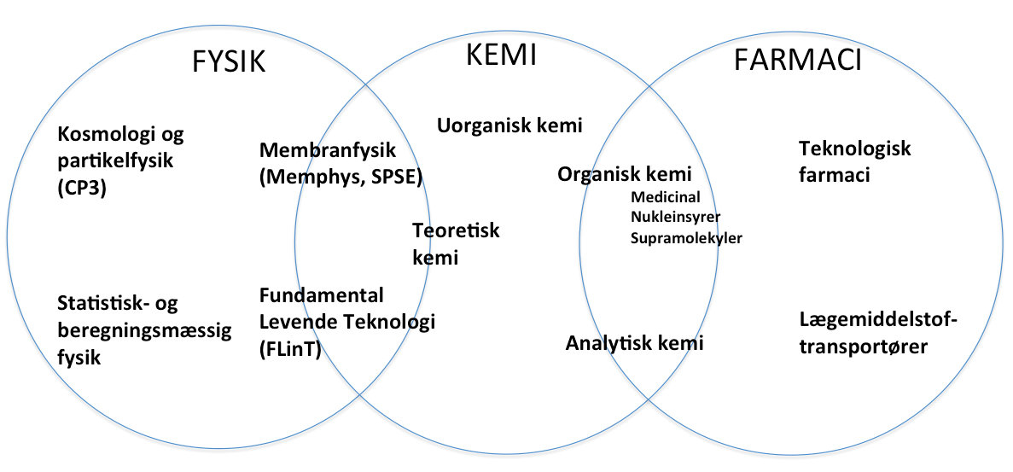
Organisationsdiagram FKF 2015
Institutleder
FYSIK
KEMI
FARMACI
SEKRETARIAT
VÆRKSTED
LABORANT
PhD

Slide 24
Institutrådsmøde 15/9-2016

Slide 25
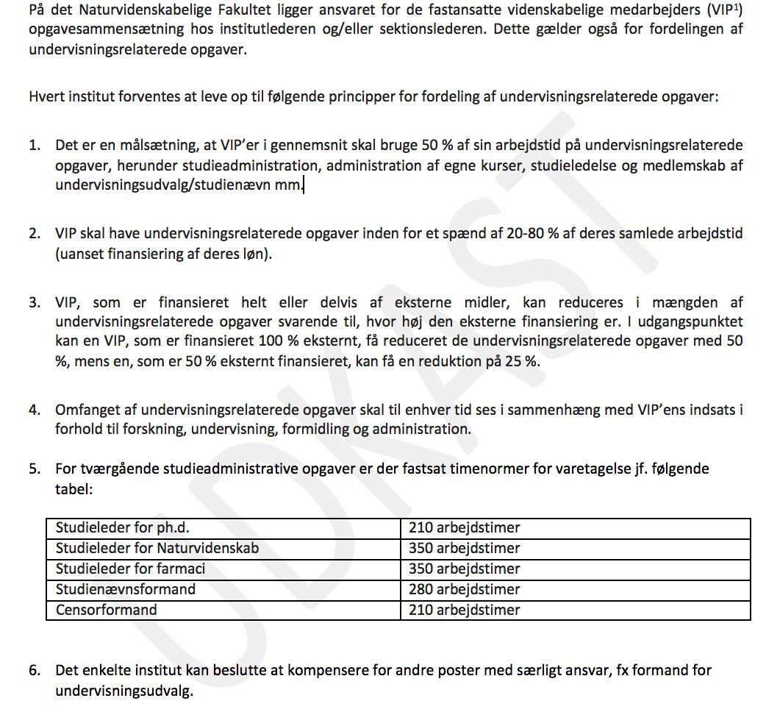
Opgørelse af undervisningsindsats: Ny model

