Slide 1
Department Forum
Department of Public Health (IST)
April 2022

Slide 2
Welcome back!
12.45 | Welcome and state of the Department /Jesper Bo Nielsen
13.10 | Visit from the new Rector at SDU /Jens Ringsmose
13.45 | User involvement in research – from idea to dissemination /Astrid Janssens
14.15 | Coffee break
14.45 | GDPR /Marie Kruse
15.00 | NytSUND /Jesper Bo Nielsen
16.00 | Thank you for today!
16.15 | Bus departure towards Odense
Department of Public Health

Slide 3
Vision for IST
It is our vision to contribute to the improvement of human health through research, education and communication at the highest level.
We will
maintain the department's position as leading in international research in relation to analyses of sickness and health over time and at further developing this position through strategic cooperation.
internationally and nationally aim at being of interest to both scientists and students whether in cooperation or as place of work.
through strategic collaborations maintain and develop the Department as an internationally visible leading research department within analyses of health and disease over time and under the influence of societal constraints and policy
strive for our efforts to be relevant and influential on health policies and thereby on human health at large
Our strengths are knowledge and skills in research-based analyses of sickness and health both in relation to individuals, the public and the overall society based upon these examples
Research based on public and private registers and databases
Studies on effects and mechanisms of action of pharmaceuticals and other chemicals with a human exposure potential
Studies on the interphase between citizen, patient and our health care system
Analyses on resource allocation, quality assurance and intervention strategies
Department of Public Health

Slide 4
IST - 2022
Around 250 employees + 100 guest researchers, student assistants and external teachers
Annual budget is DKK 109 mio. in 2022
External money account for DKK 60 mio. in 2022
Teaching on a number of bachelor and master programs
Teaching on different postgraduate courses in Denmark and other countries
Shared positions with the other faculties, the regions, OUH and UC
Department of Public Health

Slide 5
The body of IST
OUH
Danish Twin Registry
Danish shipping Industry
Epidemiology, Biostatistics and Biodemography
IST
Off-shore Industry
Clinical Pharmacology, Pharmacy & Environmental Medicine
Fishing Trades
Center for Maritime Health and Society
Danish Maritime Authority
Aalborg University
(Denmark)
Regions & Municipalities
Health Economics, DaCHE
Health Promotion
UC-Syd
General Practice
User perspectives
FEA
APO
Department of Public Health

Slide 6
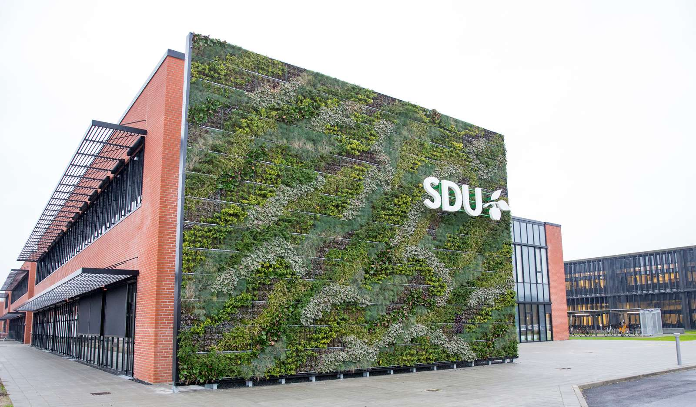
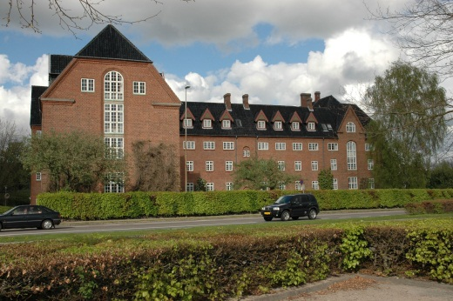
7 research units at IST
Esbjerg
Health promotion (Pernille Tanggaard Andersen)
Center for Maritime Health and Society (Lisa L. Froholdt )
Odense
Clinical Pharmacology, Pharmacy & Environmental Medicine (Kim Brøsen)
*Epidemiology, Biostatistics and Biodemography (Kaare Christensen)
General Practice (Jens Søndergaard)
Health Economics, DaCHE (Dorte Gyrd-Hansen)
User Perspectives (Birgitte Nørgaard)
Department of Public Health

Slide 7
Employees at IST
Employees at IST per April 2022
VIP | 163
PhD-students | 43
TAP | 43
Total | 249
Guest researchers | 100
Department of Public Health

Slide 8
Strategy for funding
It is an important part of IST’s strategy to increase our income based on successful applications to private funds, regional funding sources and international institutional funders.
Individual researchers or smaller groups will continue to apply for research funding, but IST will also aim for larger research initiatives with the potential for larger and long-term funding from external sources.
We will strive for more longer reaching collaborations including semi-permanent funding of researchers placed at IST but paid by an external source.
Department of Public Health

Slide 9
PhD funding
External funding has been and will remain the dominant funding source.
Remember to check whether funding from our Region is an option.
The department receives 13 1-year stipends in 2022 to be matched with other funding.
Department of Public Health

Slide 10
Peer-reviewed publications
Department of Public Health

Slide 11
Work environment
Focus areas in 2022:
Finding the best balance between working from home and coming to SDU
Prepare for moving to NytSUND
Planning to minimize transitional costs – laboratories, funding
How to best use the space available AND alligned with rules and regulations
Shared offices
The ‘GLP’ for working in shared offices
Online meetings in shared offices?
Department of Public Health

Slide 12
Welcome back!
12.45 | Welcome and state of the Department /Jesper Bo Nielsen
13.10 | Visit from the new Rector at SDU /Jens Ringsmose
13.45 | User involvement in research – from idea to dissemination /Astrid Janssens
14.15 | Coffee break
14.45 | GDPR /Marie Kruse
15.00 | NytSUND /Jesper Bo Nielsen
16.00 | Thank you for today!
16.15 | Bus departure towards Odense
Department of Public Health

