Slide 1
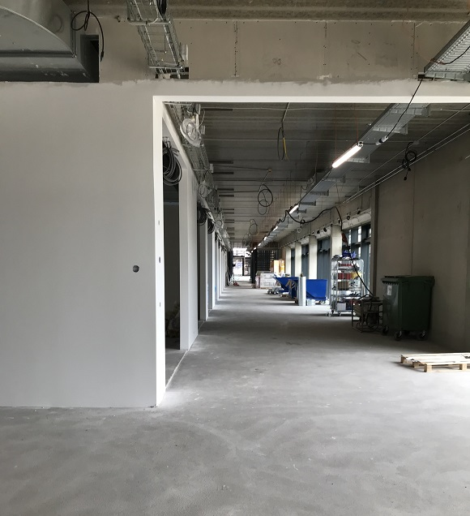
Moving plan
Which research units will move where?
When do we move?
Other potential questions or information?

Slide 2
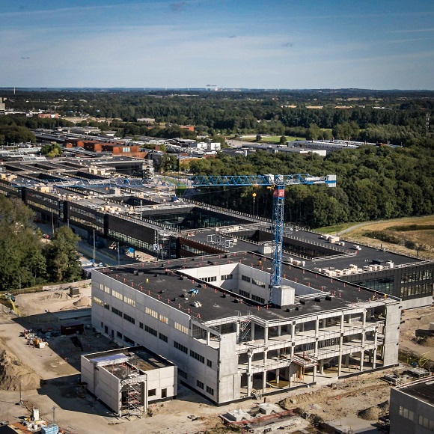
Nyt SUND

Slide 3
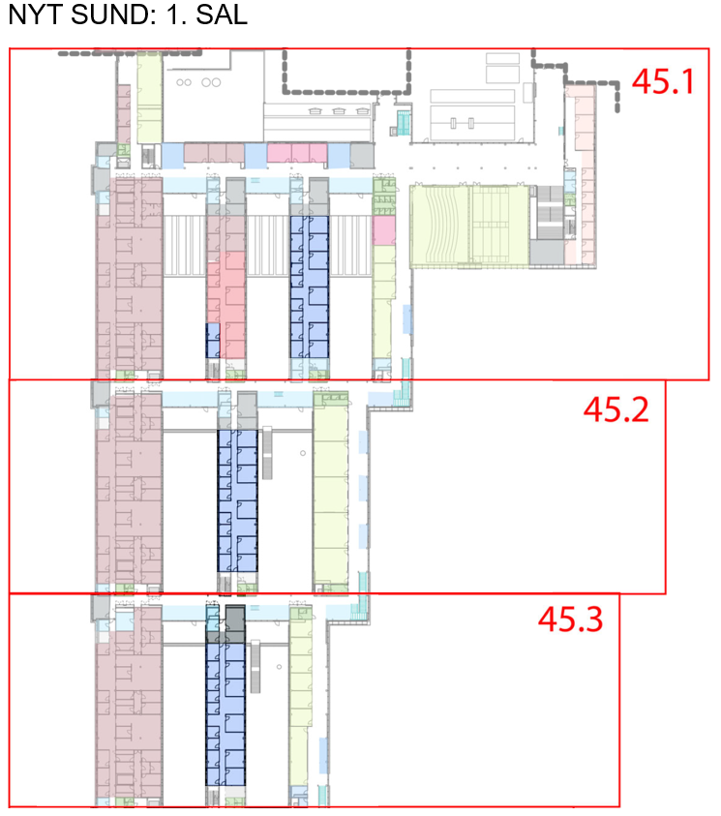
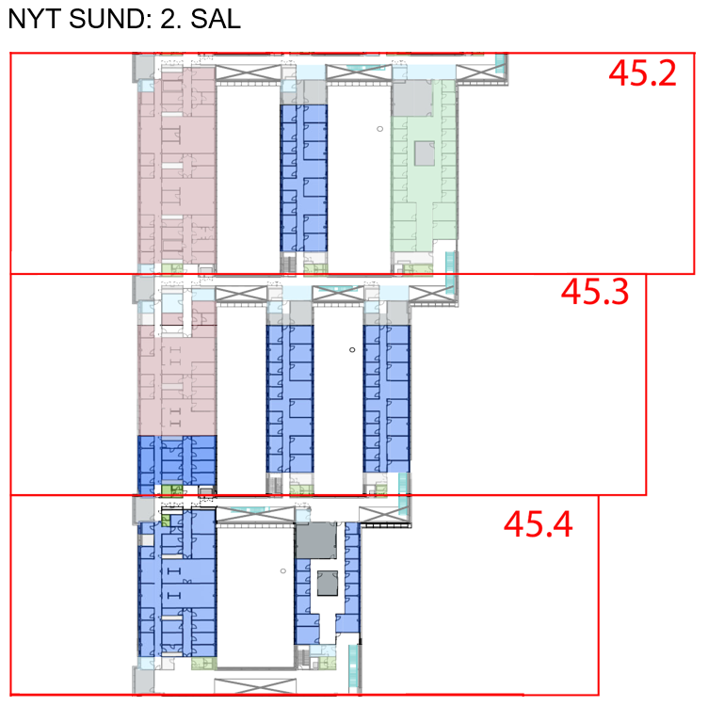
IST – 1. og 2. floor

Slide 4
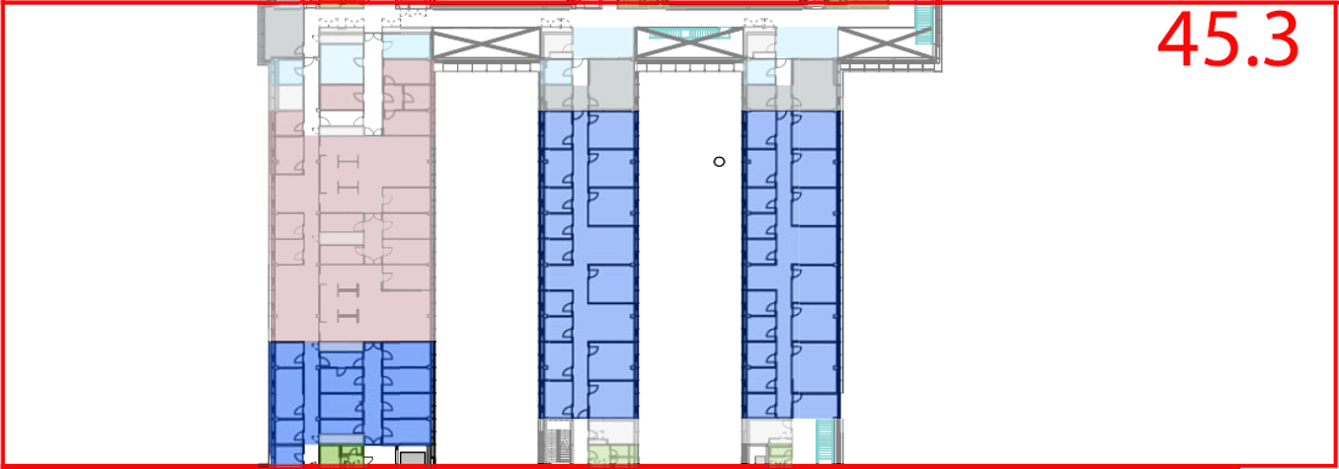
Office examples

Slide 5
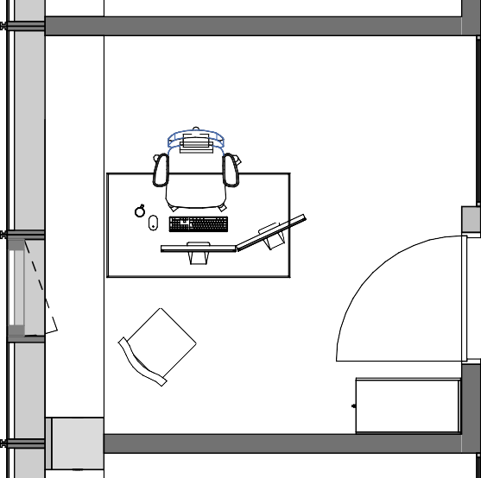
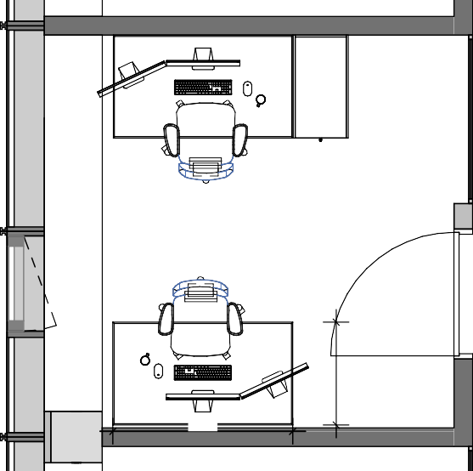
Office examples
V14-703a-2
Kontor 9,3 m²
V14-703a-2
Kontor 9,3 m²
1400

Slide 6
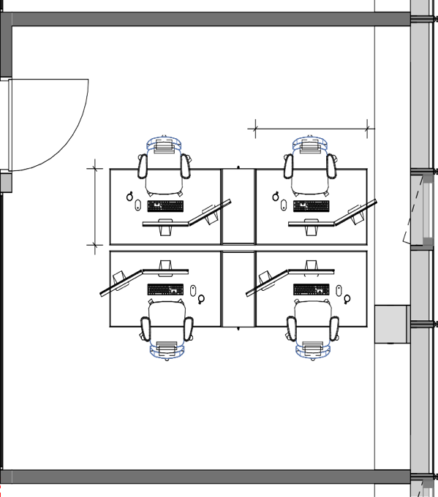
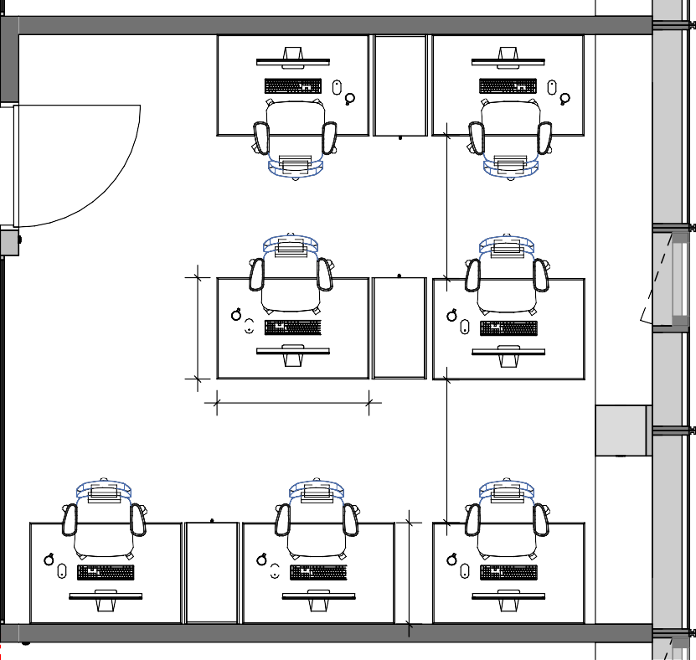
Office examples
1400
V14-703
Konto 22,6 m
d-2 r
²
V14-703d-2
Kontor 22,6 m²
1200

Slide 7
Sharing offices
Use 15 minutes to discuss with 1 or 2 others and write down your suggestions – hand them over to Line or mail them to Line (lbulstrup@health.sdu.dk)
How to best use space available AND follow rules and regulations
How best to adjust to shared offices
Good Office Practice for working in shared offices -
Online meetings/teaching in shared offices -

