Slide 1
APV 2021 Esbjerg

Slide 2
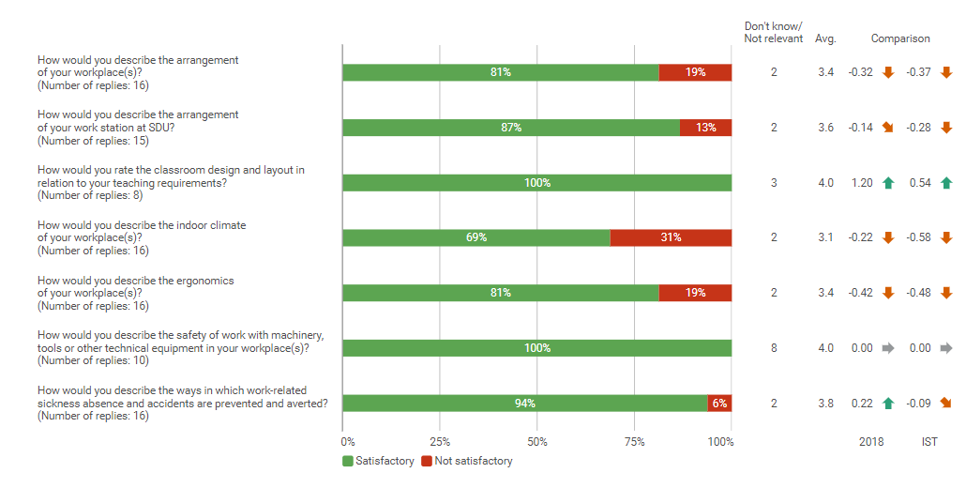
Physical APV (Esbjerg)

Slide 3
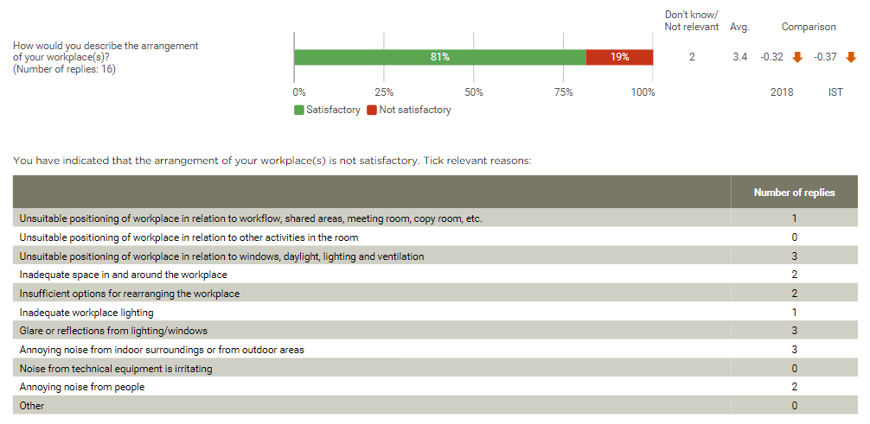
Arrangement of your workplace (Esbjerg)

Slide 4
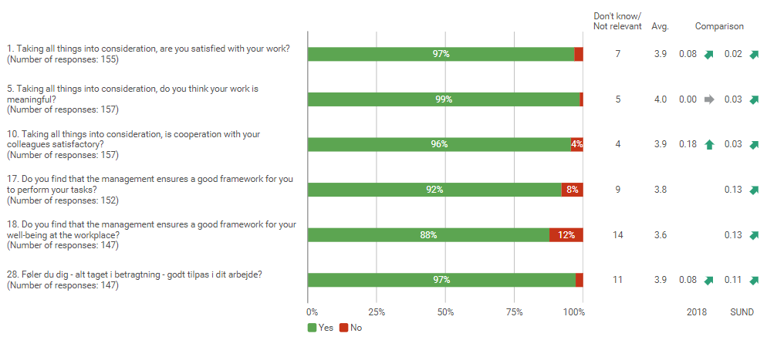
Psychological APV and well-being survey (IST)

Slide 5
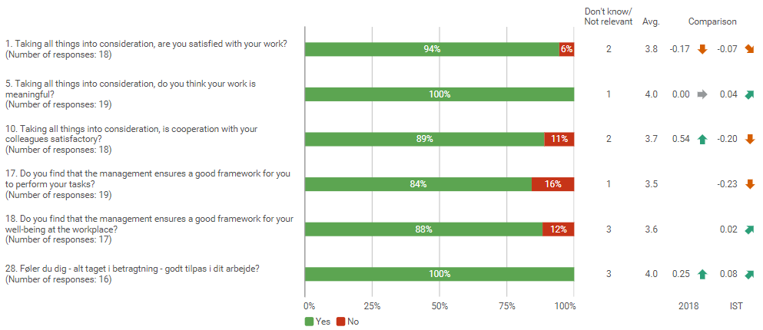
Psychological APV and well-being survey (Esbjerg)

Slide 6
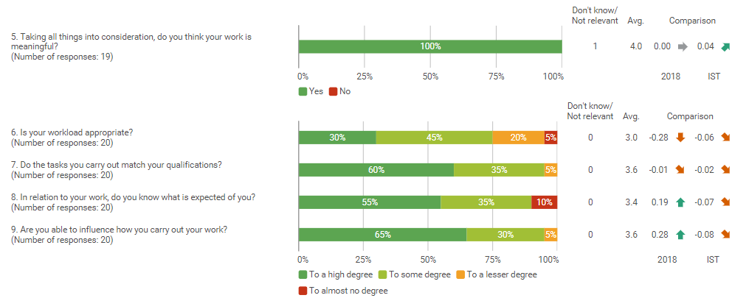
Work tasks (Esbjerg)

Slide 7
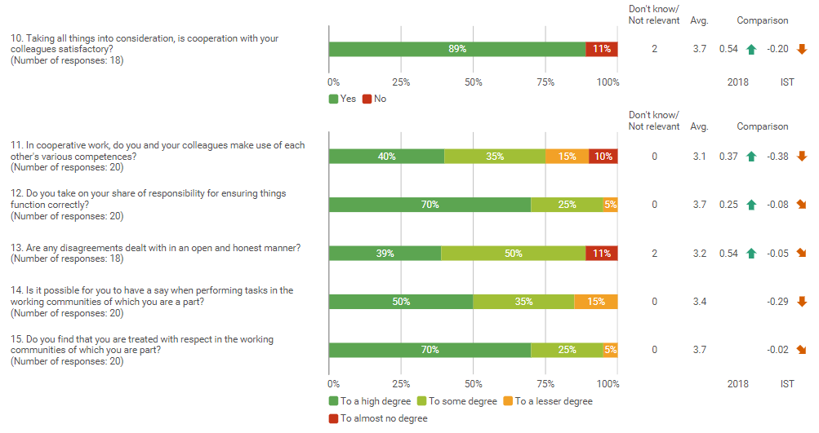
Cooperation (Esbjerg)

Slide 8
Management and Interaction (Esbjerg)

Slide 9
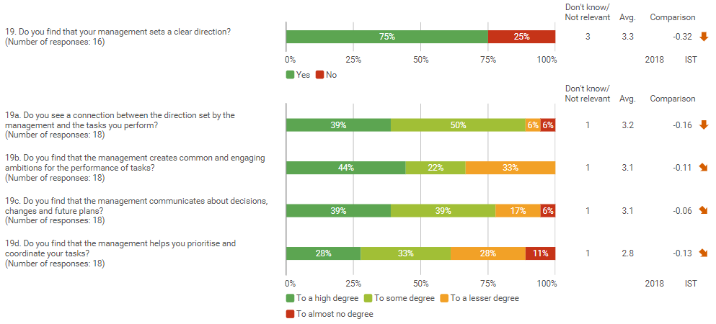
Direction (Esbjerg)

Slide 10
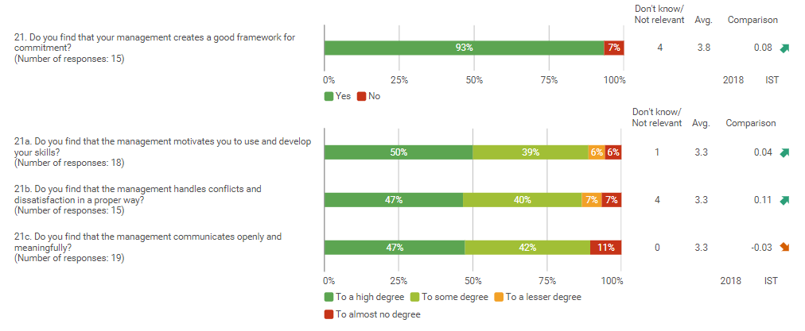
Commitment (Esbjerg)

Slide 11
Leadership (Esbjerg)

Slide 12
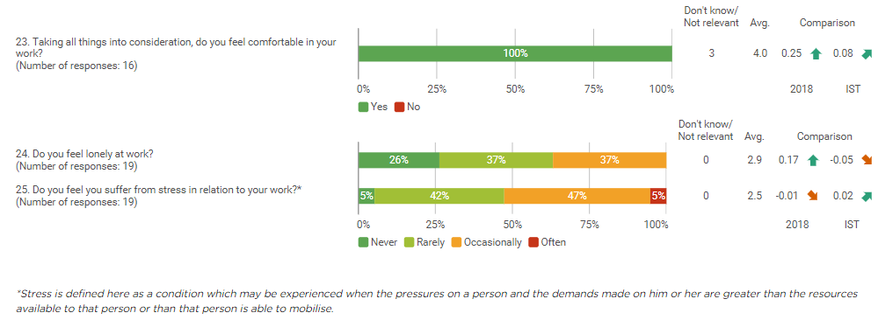
Well-being (Esbjerg)

Slide 13
Offensive behaviour

Slide 14
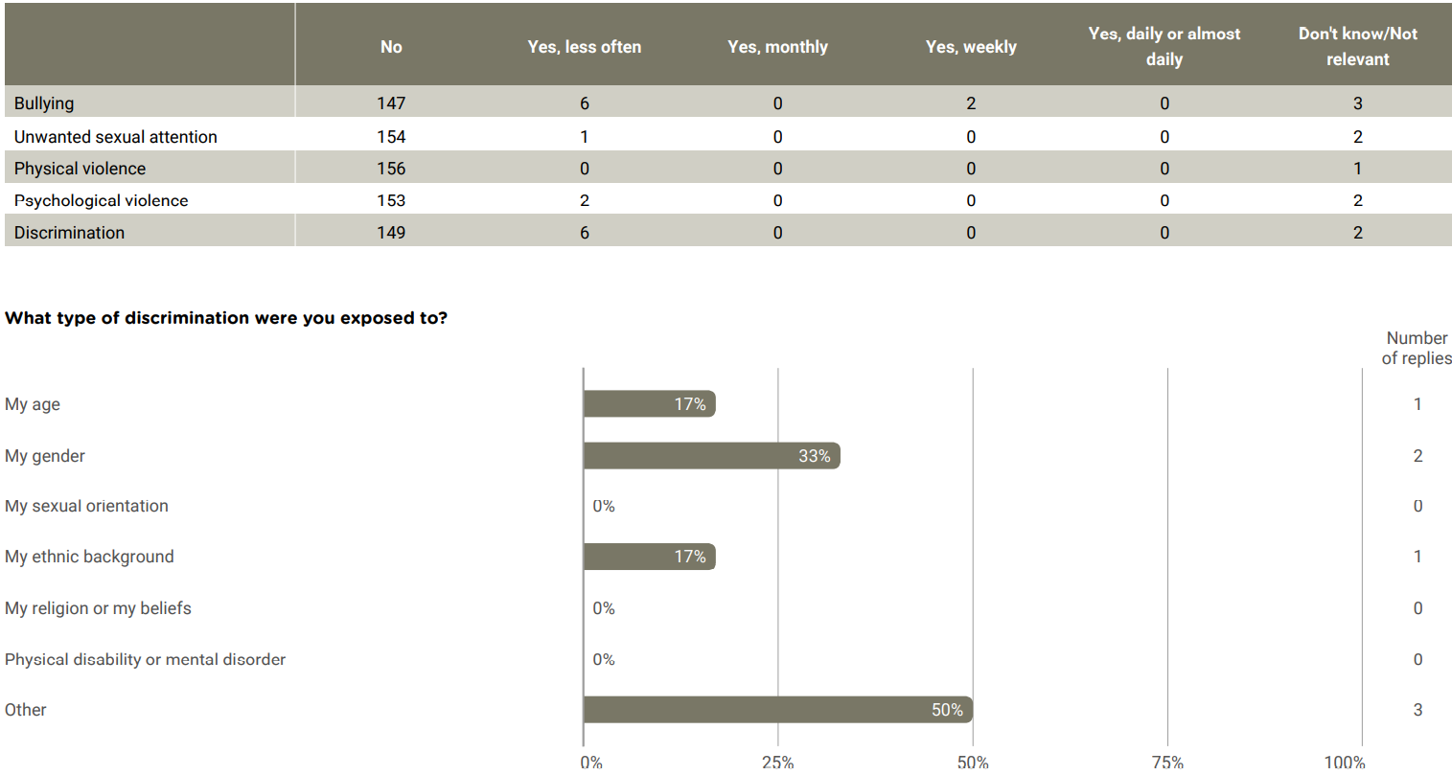
Offensive behaviour

Slide 15
Offensive behaviour

Slide 16
Well-being in connection with remote work

Slide 17
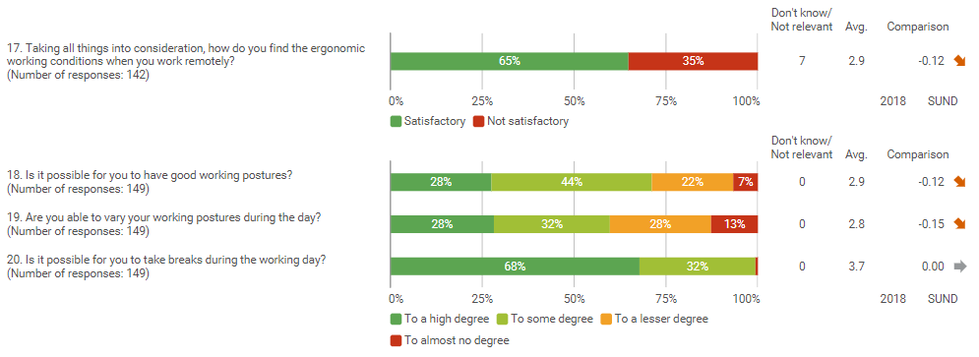
The arrangement of the remote workplace

Slide 18
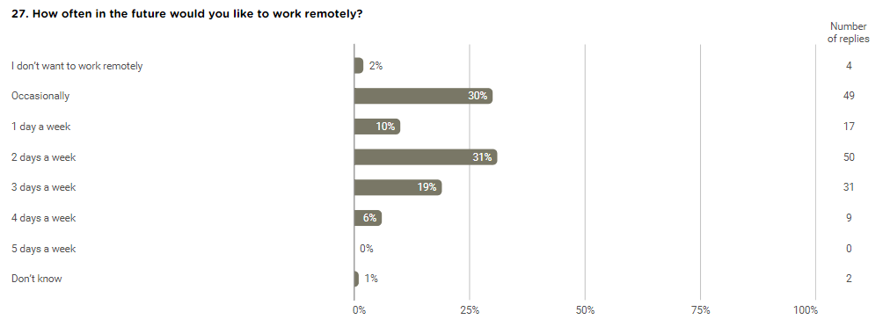

Slide 19
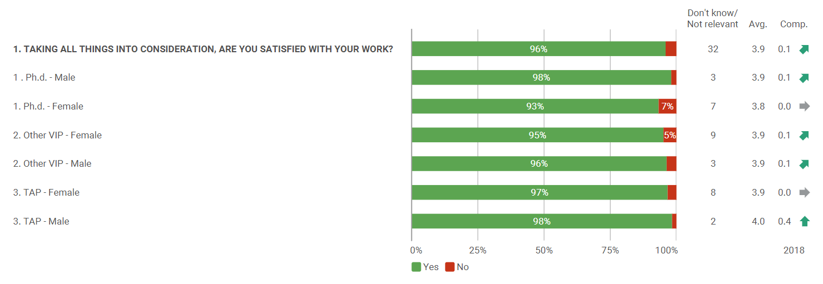
Job satisfaction

Slide 20
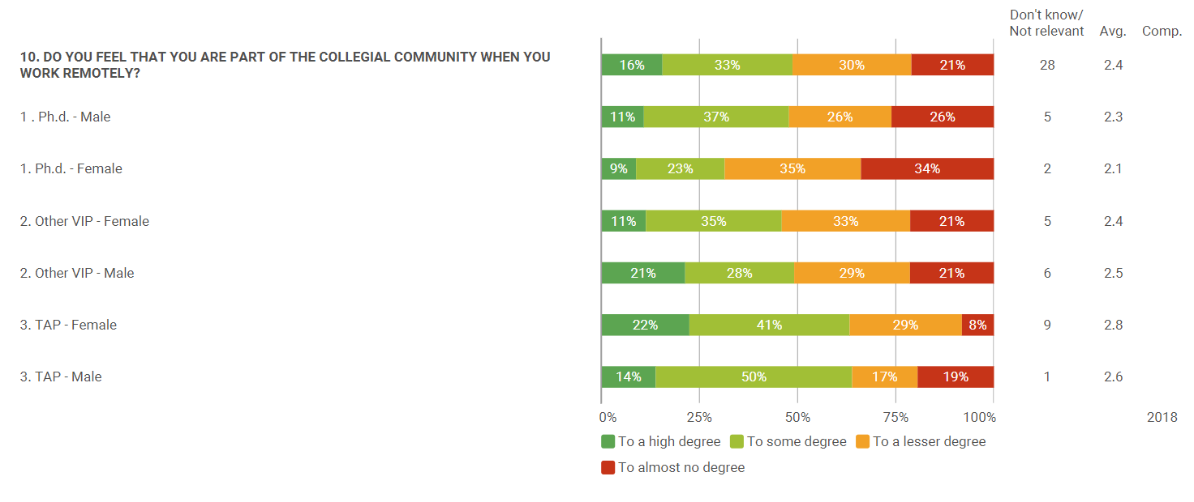
Collaboration in connection with remote work

Slide 21
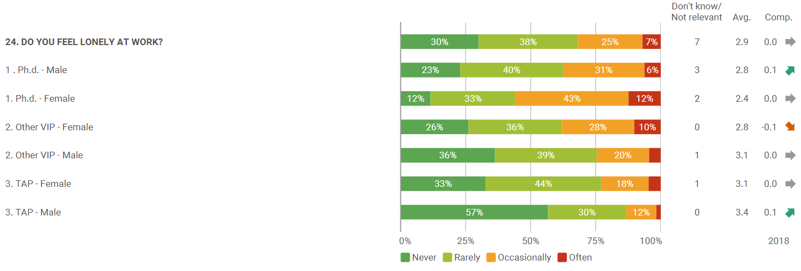
Well-being

Slide 22
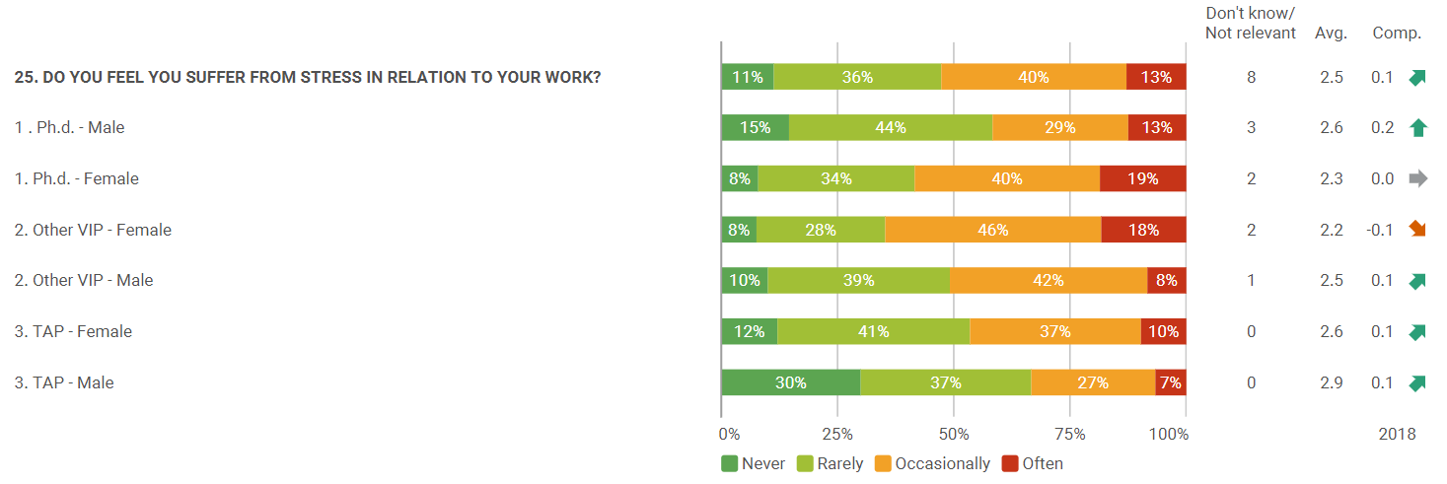
Well-being

Slide 23
Language

Slide 24
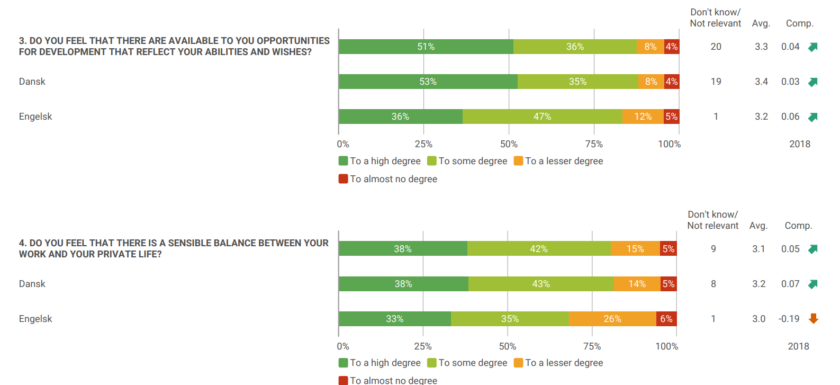
Job satisfaction

Slide 25
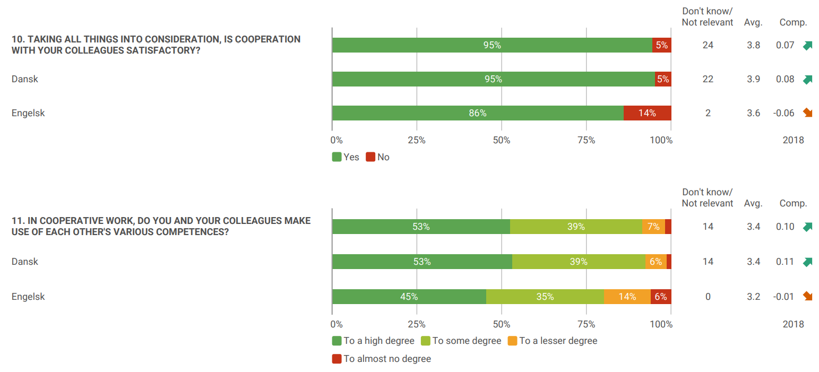
Cooperation

Slide 26
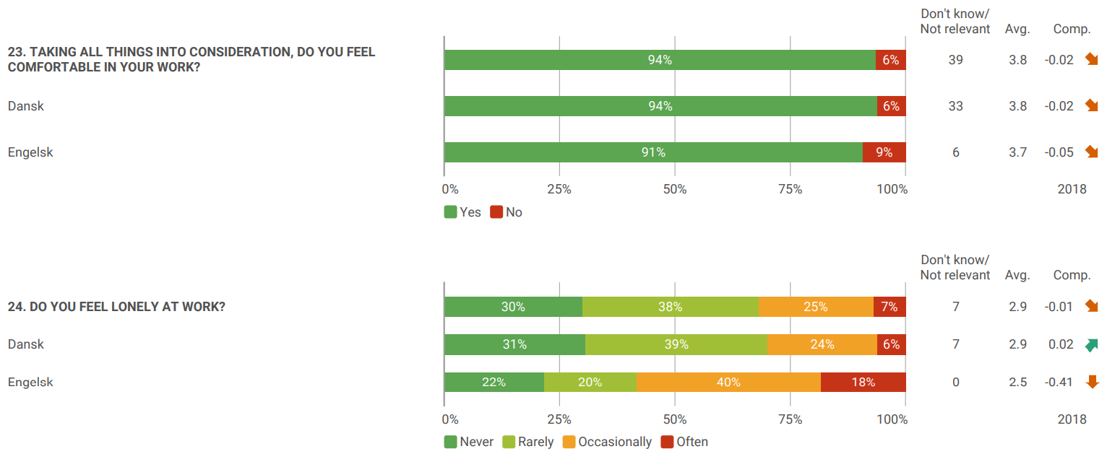
Well-being

Slide 27
Well-being

