Slide 1
APV 2021 WP 17,19 & 25

Slide 2
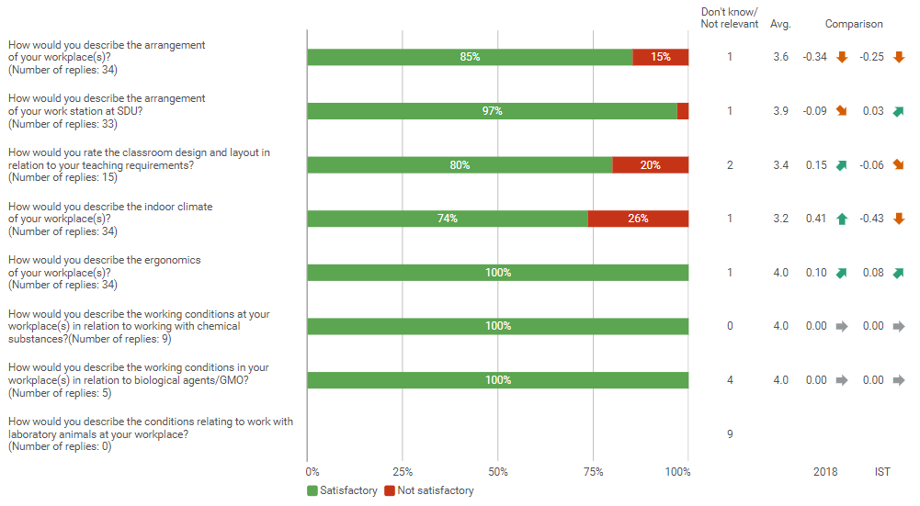
Physical APV (WP)

Slide 3
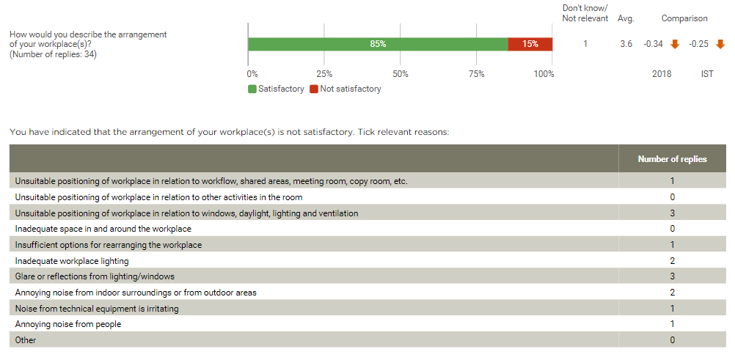
Arrangement of your workplace (WP)

Slide 4
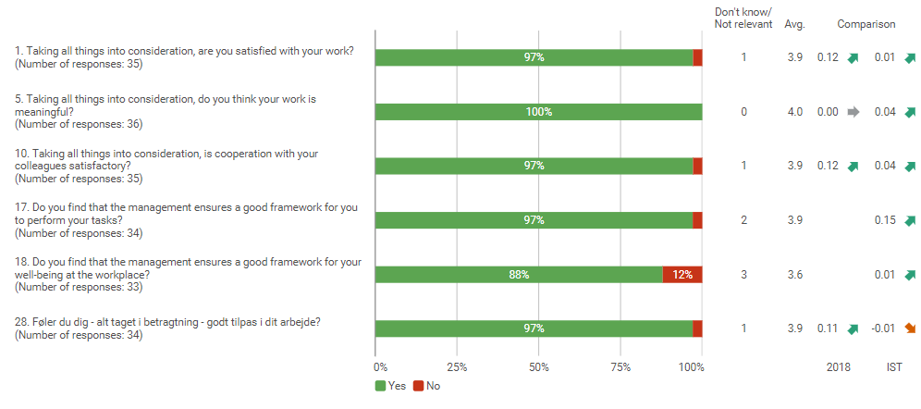
Psychological APV and well-being survey (WP)

Slide 5
Management and Interaction(WP)

Slide 6
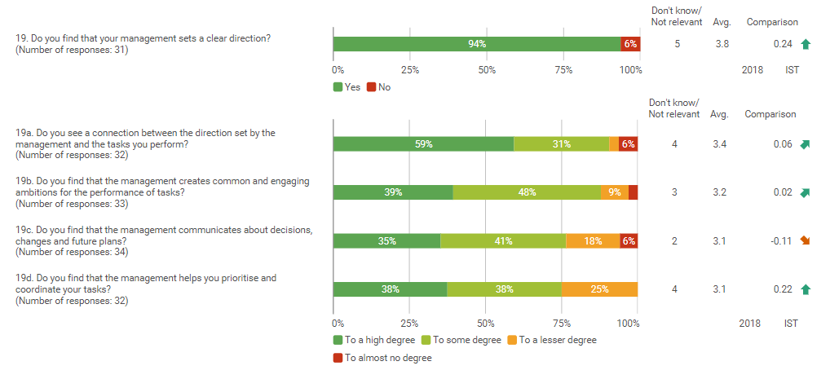
Direction (WP)

Slide 7
Leadership (WP)

Slide 8
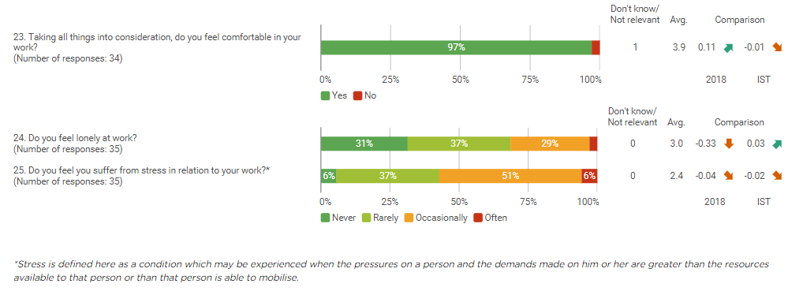
Well-being (WP)

Slide 9
Offensive behaviour

Slide 10
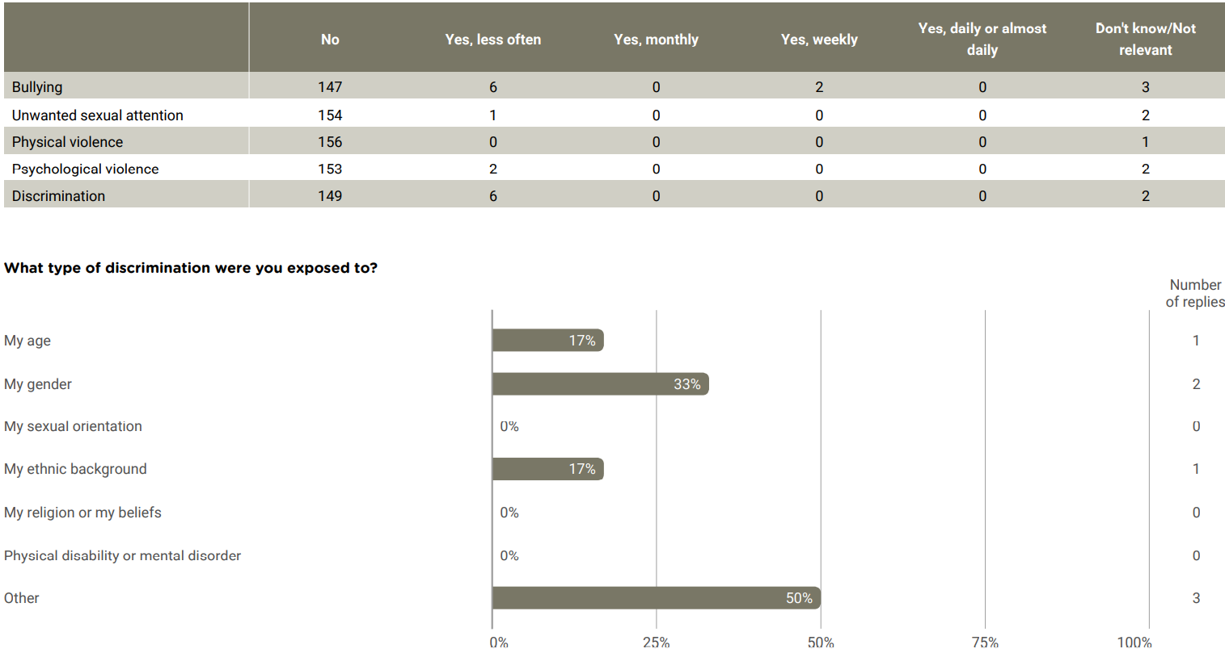
Offensive behaviour

Slide 11
Offensive behaviour

Slide 12
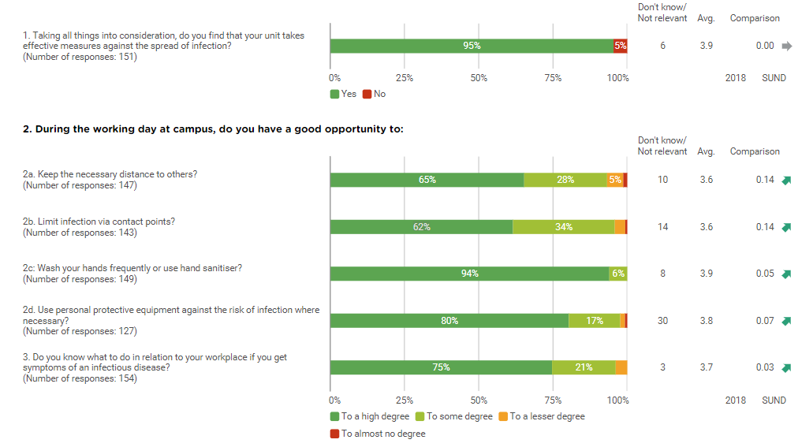
Risk of infection

Slide 13
Well-being in connection with remote work

Slide 14
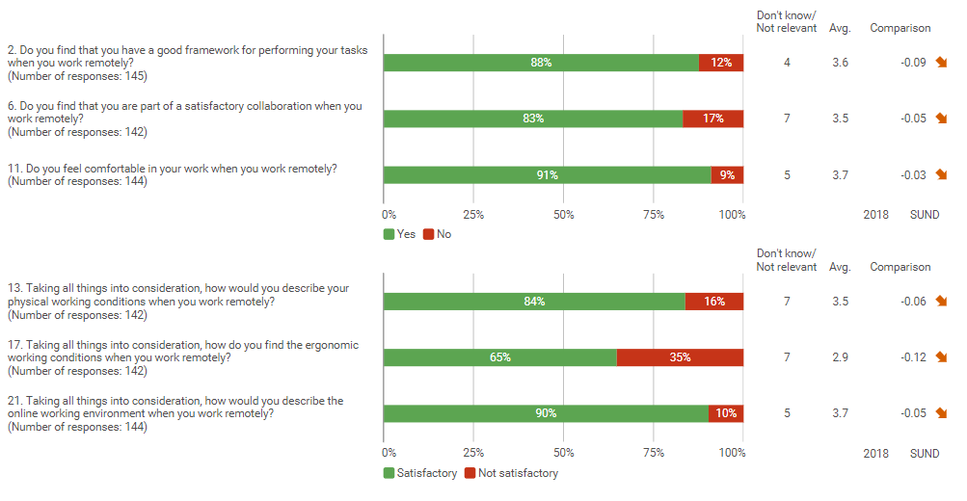

Slide 15
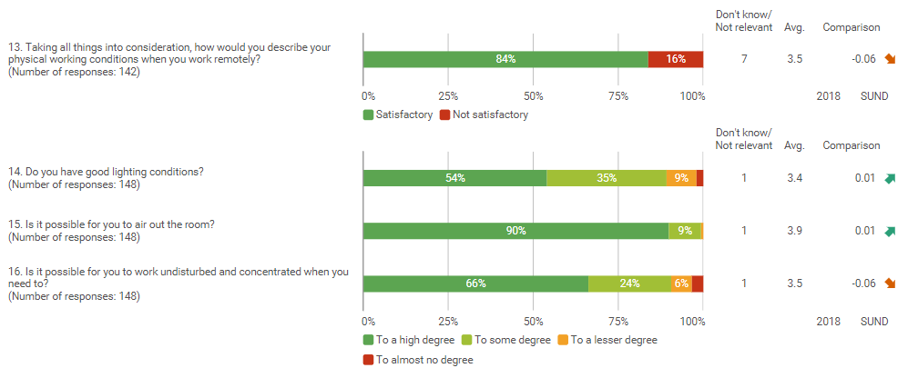
The arrangement of the remote workplace

Slide 16
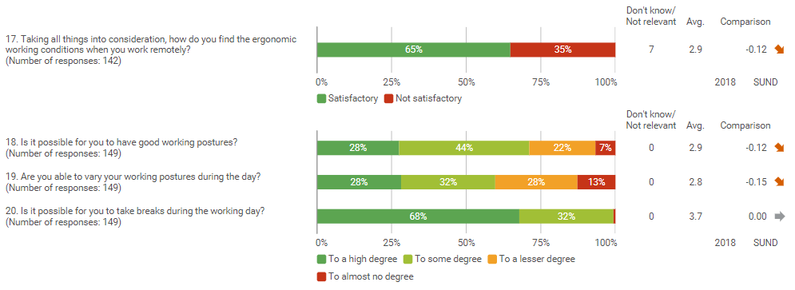
The arrangement of the remote workplace

Slide 17
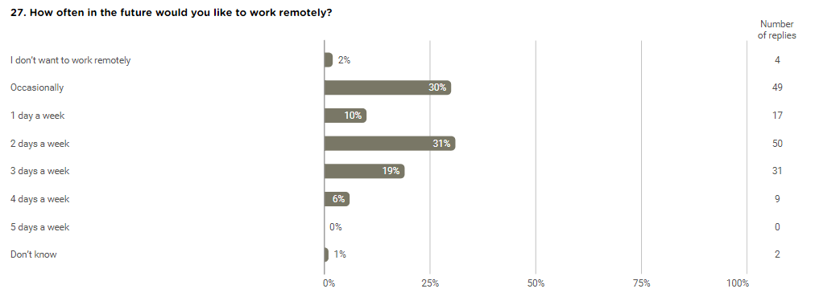

Slide 18
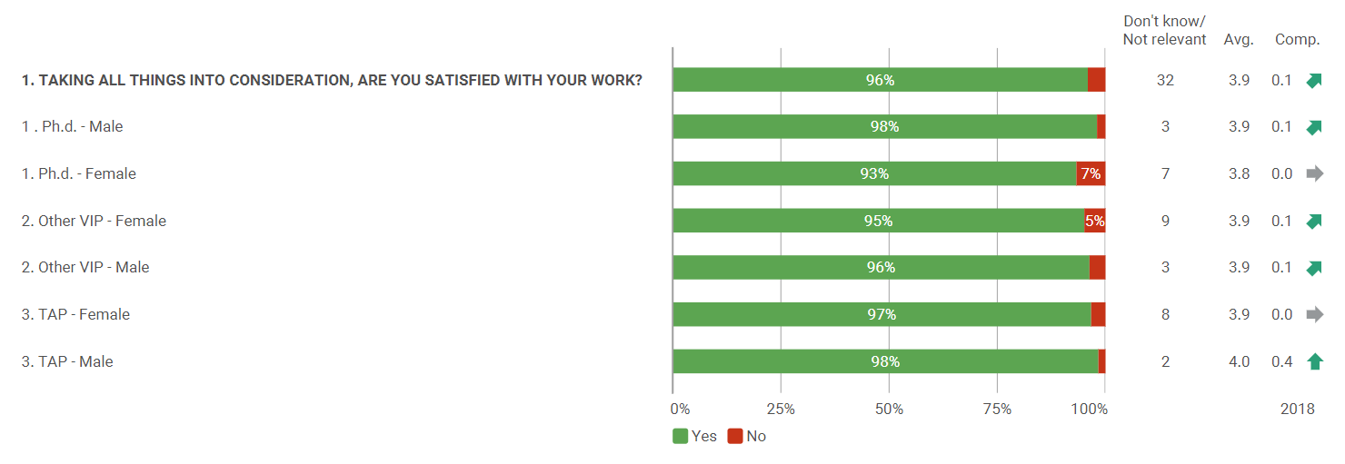
Job satisfaction

Slide 19
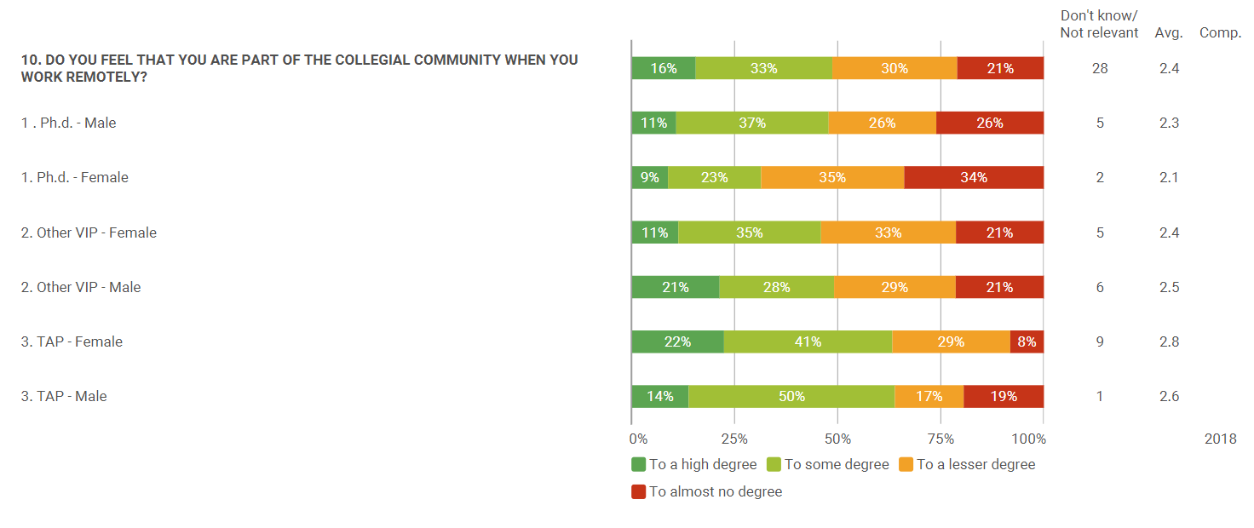
Collaboration in connection with remote work

Slide 20
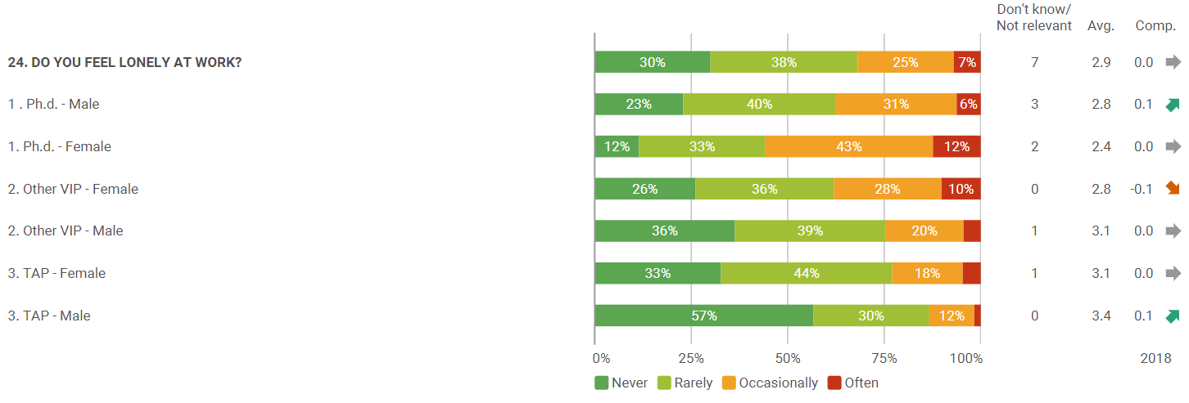
Well-being

Slide 21
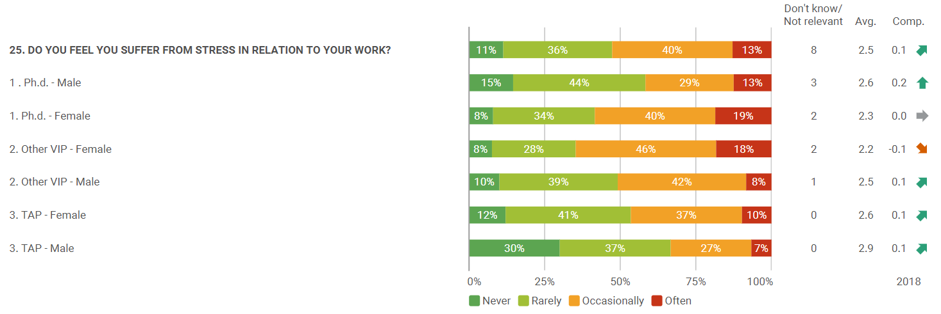
Well-being

Slide 22
Language

Slide 23
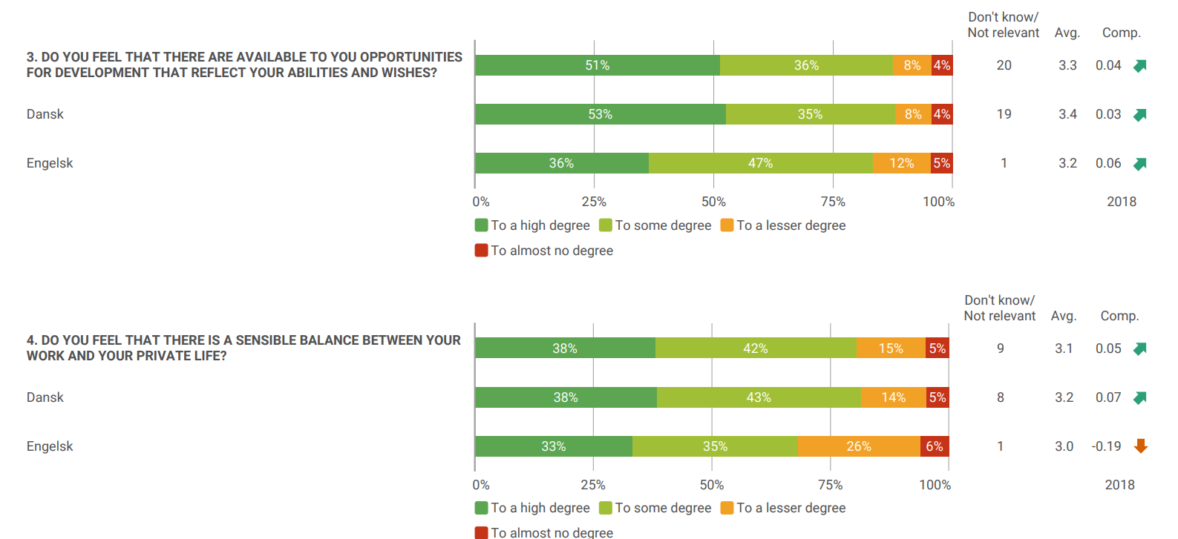
Job satisfaction

Slide 24
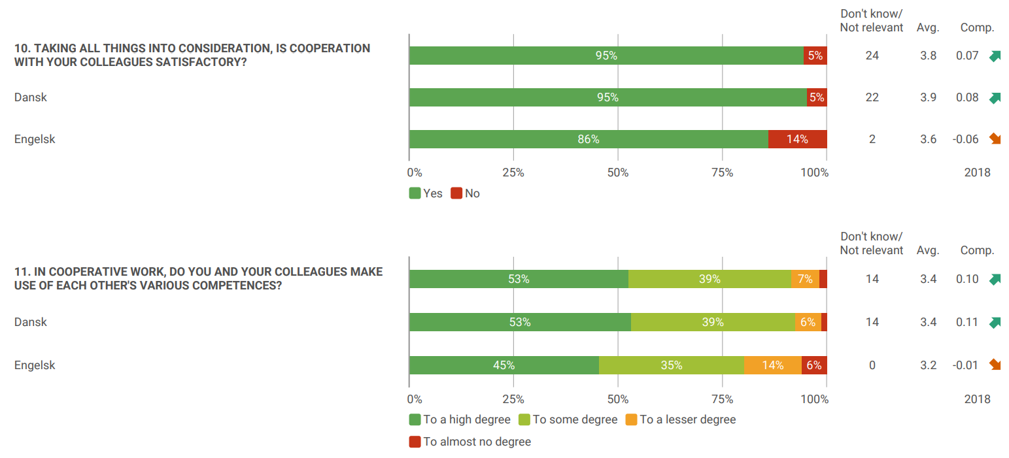
Cooperation

Slide 25
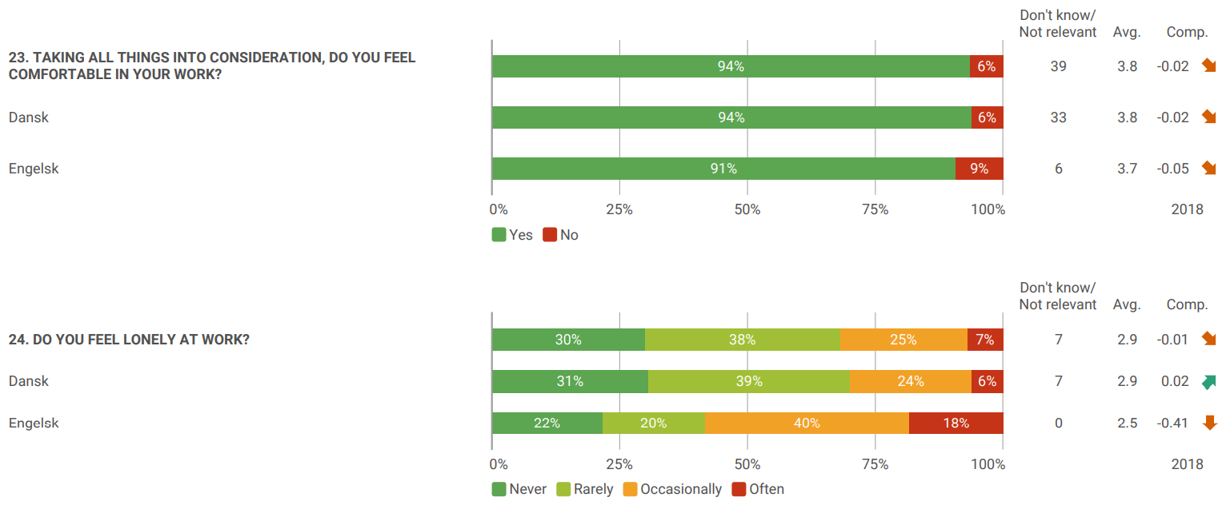
Well-being

