Slide 1
Digitalt kompetenceløft for de studerende på Det Samfundsvidenskabelige Fakultet…og lidt til

Slide 2
Baggrund
Strategisk forankring:
SDU ønsker at uddanne digitalt bevidste kandidater
SAMF vil "Integrere eksisterende og nye teknologier i uddannelserne som en vigtig del af en stærk digital kompetenceprofil på tværs af fakultetets uddannelsesportefølje."
SAMF’s mission er: "Vi adresserer samfundsmæssige udfordringer ved at engagere os i tværfaglig vidensskabelse, udnytte eksterne relationer og muliggøre fleksible læringsoplevelser, der giver vores kandidater mulighed for at deltage aktivt i og lede samfundets institutioner."
For at opfylde denne mission – og sikre, at kandidaterne succesfuldt kan være med til at sætte retningen for virksomheder og offentlige organisationer – er det afgørende, at digitaliseringen af samfundet og den teknologiske udvikling afspejles i uddannelsernes indhold og organisering.
Dansk Industri
Anbefaler, at regeringen formulerer en digital strategi for uddannelsessystemet "fra første skoledag til sidste arbejdsdag".
Udtrykker et behov for "Digitale Integratorer", der kan arbejde i spændingsfeltet mellem teknologi og politik, økonomi og/eller erhvervsliv.

Slide 3
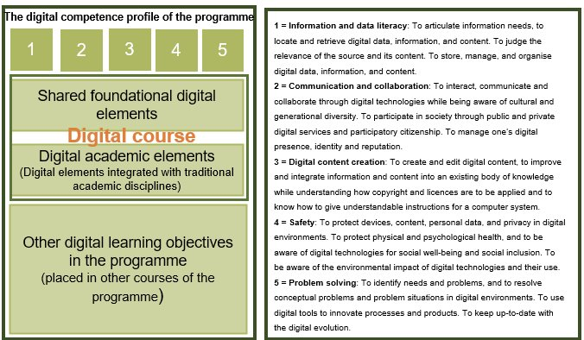
Første tanker

Slide 4
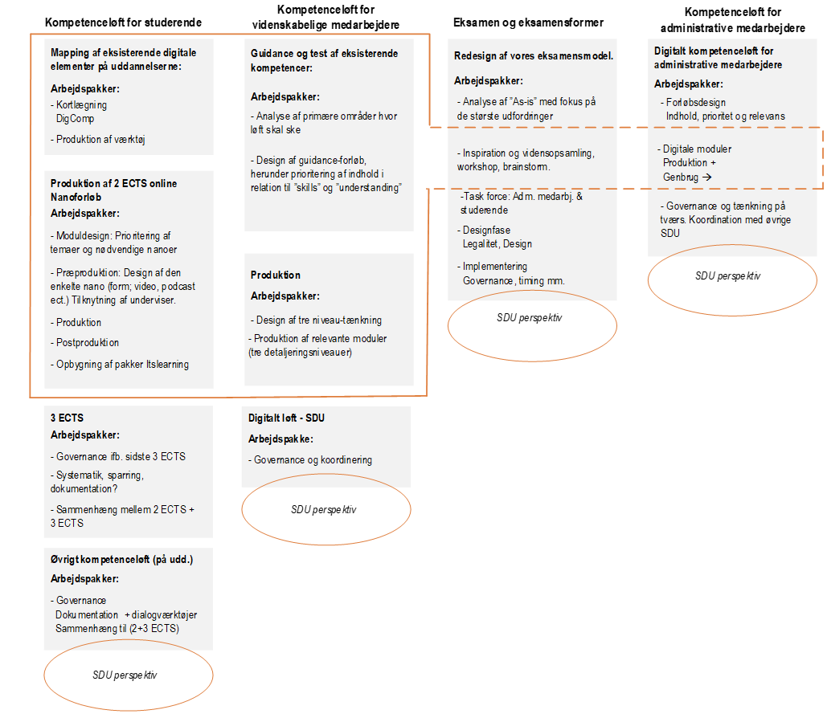

Slide 5
1.1 Browsing, searching and filtering data, information and digital content To articulate information needs , to search for data, information and content in digital environments, to access them and to navigate between them. To create and update personal search strategies. 1.2 Evaluating data, information and digital content To analyse, compare and critically evaluate the credibility and reliability of sources of data, information and digital content. 1.3 Managing data, information and digital content To organise, store and retrieve data, information, and content in digital environments. To organise and process them in a structured environment. | 2.1 Interacting through digital technologies To interact through a variety of digital technologies and to understand appropriate digital communication means for a given context. 2.2 Sharing through digital technologies To share data, information and digital content with others through appropriate digital technologies. To act as an intermediary, to know about referencing and attribution practices. 2.3 Engaging in citizenship through digital technologies To participate in society through the use of public and private digital services. To seek opportunities for self-empowerment and for participatory citizenship through appropriate digital technologies. 2.4 Collaborating through digital technologies To use digital tools and technologies for collaborative processes, and for co-construction and co-creation of resources and knowledge. 2.5 Netiquette To be aware of behavioral norms and know-how while using digital technologies and interacting in digital environments. To adapt communication strategies to the specific audience and to be aware of cultural and generational diversity in digital environments. 2.6 Managing digital identity To create and manage one or multiple digital identities, to be able to protect one's own reputation, to deal with the data that one produces through several digital tools, environments, and services. | 3.1 Developing digital content To create and edit digital content in different formats, to express oneself through digital means. 3.2 Integrating and re-elaborating digital content To modify, refine, improve, and integrate information and content into an existing body of knowledge to create new, original and relevant content and knowledge. 3.3 Copyright and licences To understand how copyright and licences apply to data, information, and digital content. 3.4 Programming To plan and develop a sequence of understandable instructions for a computing system to solve a given problem or perform a specific task | 4.1 Protecting devices To protect devices and digital content, and to understand risks and threats in digital environments. To know about safety and security measures and to have due regard to reliability and privacy. 4.2 Protecting personal data and privacy To protect personal data and privacy in digital environments. To understand how to use and share personally identifiable information while being able to protect oneself and others from damages. To understand that digital services use a “Privacy policy” to inform how personal data is used. 4.3 Protecting health and well-being To be able to avoid health-risks and threats to physical and psychological well-being while using digital technologies. To be able to protect oneself and others from possible dangers in digital environments (e.g. cyber bullying). To be aware of digital technologies for social well-being and social inclusion. 4.4 Protecting the environment To be aware of the environmental impact of digital technologies and their use. | 5.1 Solving technical problems To identify technical problems when operating devices and using digital environments, and to solve them (from trouble-shooting to solving more complex problems). 5.2 Identifying needs and technological responses To assess needs and to identify, evaluate, select and use digital tools and possible technological responses to solve them. To adjust and customise digital environments to personal needs (e.g. accessibility). 5.3 Creatively using digital technologies To use digital tools and technologies to create knowledge and to innovate processes and products. To engage individually and collectively in cognitive processing to understand and resolve conceptual problems and problem situations in digital environments. 5.4 Identifying digital competence gaps To understand where one’s own digital competence needs to be improved or updated. To be able to support others with their digital competence development. To seek opportunities for self-development and to keep up-to-date with the digital evolution
Notes:
Messages:
They are dependant on eachother!
Based on the meeting on February 5, we have identified: Very important, Partly Important, and Not that important (should you learn yourself or from secondary education)
Information and data literacy:
Communication and collaboration:
Digital content creation:
Safety:
Problem solving:

Slide 6
