Slide 1
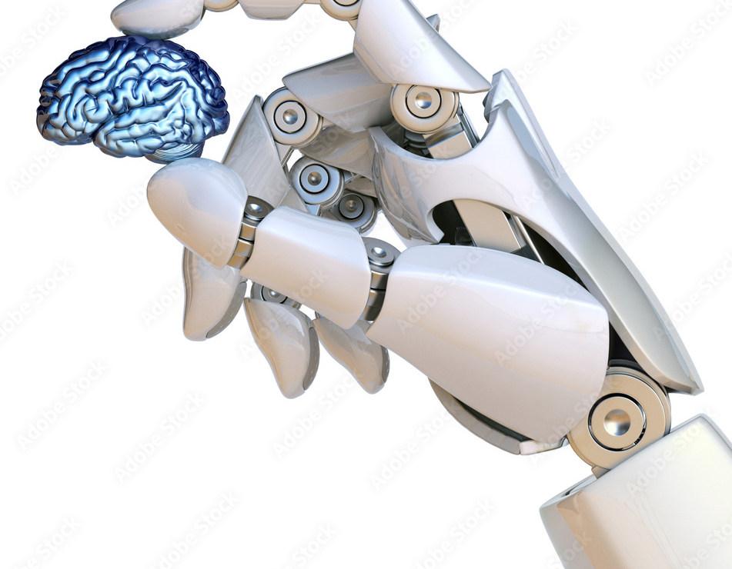
From Campus to Careers: AI’s Role at SDU and Beyond

Slide 2
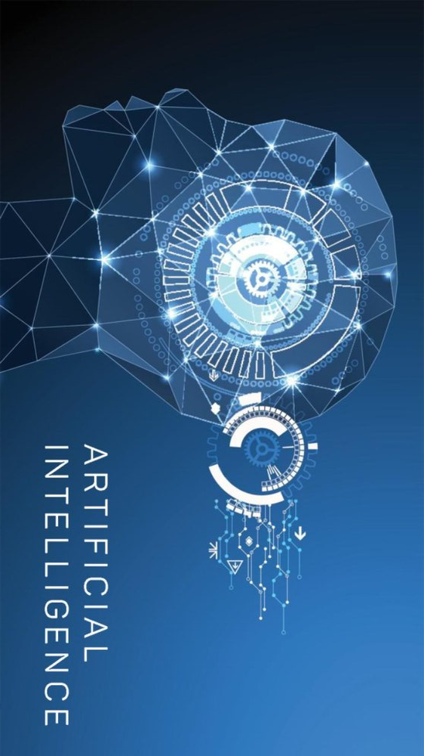
What is AI? AI stands for "artificial intelligence". AI refers to technologies and systems that are designed to perform tasks that traditionally require human intelligence, such as perception, learning, thinking, and decision-making.
Notes:
NEURAL Network
Sandsynlighed
Input defineres ved:
Tokenization: The input text is broken down into individual tokens, which can be words or subwords, depending on the language and context. This step allows the model to analyze and process the input more efficiently.
Embedding: Each token is then converted into a vector representation, or embedding, which is a numerical representation of the word or subword. These embeddings capture the meaning and relationships between words, enabling the model to understand the input.
Contextualization: The model processes the sequence of embeddings to understand the context and relationships between the tokens in the input. This is done using a series of layers known as transformers, which are designed to capture long-range dependencies and interactions between words.
Attention Mechanism: The transformer layers utilize a mechanism called self-attention, which helps the model assign different weights to different words in the input, based on their relevance and importance to the overall context. The attention mechanism calculates scores for each word pair, indicating how much one word should attend to another. These scores are then used to create a weighted combination of the embeddings, forming a new representation that highlights the most relevant tokens.
Decoding: Finally, the model generates a response based on the weighted input representations. It does this by predicting the most likely next token in the output sequence, given the context of the input and the generated tokens so far. This process is repeated until an end-of-sequence token is generated, or a maximum length is reached.
Post-processing: The generated tokens are then converted back into text, which forms the final response.
Query (Q): The query is a representation of the current token that the model is focusing on. It's used to calculate the attention scores for the token in relation to all other tokens in the sequence. Essentially, the query helps the model decide how much attention should be paid to other tokens when generating the representation for the current token.
Key (K): The key is a representation of all tokens in the input sequence that are used to compare against the query. The key helps the model determine the relevance of each token in the sequence, in relation to the current token (represented by the query). The comparison between the query and key is used to calculate the attention scores, which indicate how much each token should contribute to the final representation of the current token.
Value (V): The value is another representation of each token in the input sequence, which is used to create the weighted combination of embeddings. After calculating the attention scores between the query and key, these scores are used to weight the corresponding value vectors. The weighted values are then summed to produce the final representation of the current token.
175 milliarder parameter eller biases og 96 lag

Slide 3
About ChatGPT – GPT-3 and now 4
ChatGPT assistant is trained on a large amount of text data, including billions of words and phrases. It is difficult to determine the exact number of words, as the training and the amount of data is continuously updated and expanded. As an example, an earlier language model, GPT-2, which is a smaller version of GPT-3, is trained on a data volume of about 40 GB, equivalent to about 8 million websites, and contains over 1.5 billion parameters. GPT 3 was trained on a dataset of hundreds of gigabytes of text, which included books, articles, and websites. It consisted of around 45 terabytes of raw text data, which was then compressed to around 570 gigabytes for training purposes. The model had 175 billion parameters. GPT-4, is significantly exceeding the numbers of GPT-3. It's important to remember that the amount of data isn't the only factor that determines an AI model's effectiveness. An appropriate training process, an appropriate architecture for the model and careful fine-tuning are also essential to achieve the best results.
Notes:
Supervised Learning: In supervised learning, the AI model is trained on a labeled dataset, which contains both input data and the corresponding correct output. The model learns the relationship between inputs and outputs and makes predictions based on that understanding. Supervised learning is commonly used for tasks like image classification and sentiment analysis.
Example: A supervised learning model can be trained to identify whether an image contains a cat or a dog. The training dataset will consist of labeled images, where each image is marked as containing either a cat or a dog. The model learns to recognize features of cats and dogs and can then classify new, unlabeled images as containing a cat or a dog.
Unsupervised Learning: In unsupervised learning, the AI model is trained on an unlabeled dataset, which contains input data without any corresponding correct output. The model learns to identify patterns, structures, or relationships within the data, without being explicitly told what to look for. Unsupervised learning is often used for tasks like clustering and dimensionality reduction.
Example: An unsupervised learning model can be used to group customers based on their shopping habits. The training dataset consists of customer purchase histories without any pre-existing labels or categories. The model identifies patterns and relationships within the data and groups customers with similar shopping habits together, allowing for targeted marketing or personalized recommendations.
Reinforcement Learning: In reinforcement learning, an AI agent learns to make decisions by interacting with an environment and receiving feedback in the form of rewards or penalties. The agent seeks to maximize its cumulative reward over time by learning the optimal actions to take in different situations. Reinforcement learning is often used for tasks like robotics control, game playing, and navigation.
Example: A reinforcement learning agent can be trained to play a video game, such as Pac-Man. The agent receives positive rewards for collecting pellets and eating ghosts while avoiding negative rewards (penalties) for losing lives or being caught by ghosts. Over time, the agent learns to optimize its actions to maximize its score and successfully navigate the game environment.

Slide 4
AI at SDU - teaching
Significant role in teaching and exams – good and bad.
Focus on managing AI's role.
Embrace its significance while ensuring student integrity.
Students must produce their own work, not solely rely on AI.

Slide 5
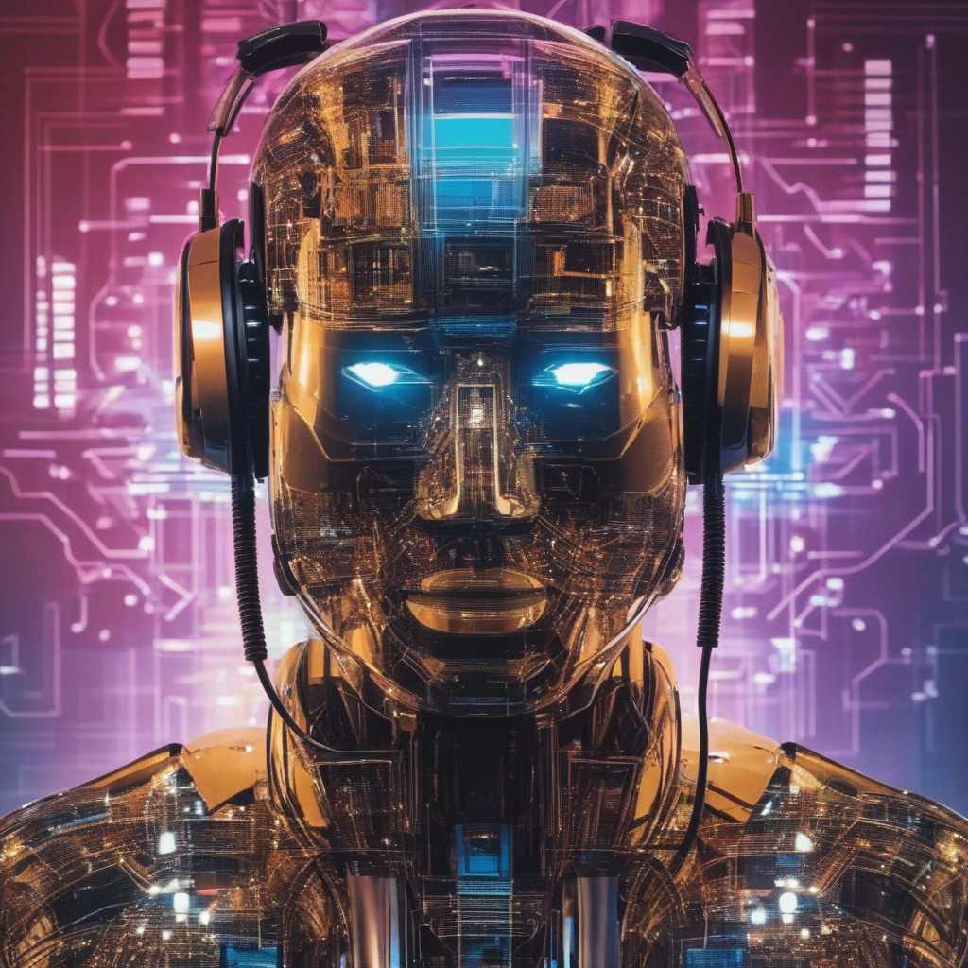
GENERATIVE AI in the engineering programmes at the Faculty of Engineering, SDU
Generative AI in teaching and learning
Generative AI, including ChatGPT, may be useful in connection with your learning, for example for
Reading over and giving feedback on text/language
Structuring ideas and content
Summing up large amounts of information
As with other sources or aids used in connection with assignments in your engineering programme, it is important that you follow the rules for good academic practice, so there can be no doubt as to who is the originator of the text. Thus, if you use e.g. ChatGPT in connection with an assignment, you must state where and how it was used. In certain courses or for certain assignments, your teacher may ask you not to use generative AI / ChatGPT in cases where the use thereof may be harmful to the learning process.
Generative AI / ChatGPT and confidentiality
Any information which you enter into e.g. ChatGPT is not treated confidentially, and generative AI may share the information which you have entered, with others. This particularly calls for attention if your work includes collaboration with businesses and/or research. It is your responsibility to only enter information which is public or can be made public. SDU cannot be held responsible for your use of generative AI.
For data treatment reasons, ChatGPT is not centrally approved by SDU, so your teacher cannot require you to use it in connection with a course. But it is ok to recommend it.
Generative AI and exams: Written on-campus exams, home assignments and projects
The use of generative AI in connection with written on-campus exams at the Faculty of Engineering is prohibited. This also applies to written on-campus exams with all aids allowed.
The use of generative AI in connection with home assignments and projects, including final projects, at the Faculty of Engineering is allowed, if you follow good academic practice as described above.
Using generative AI in defiance of the above will be considered cheating.

Slide 6
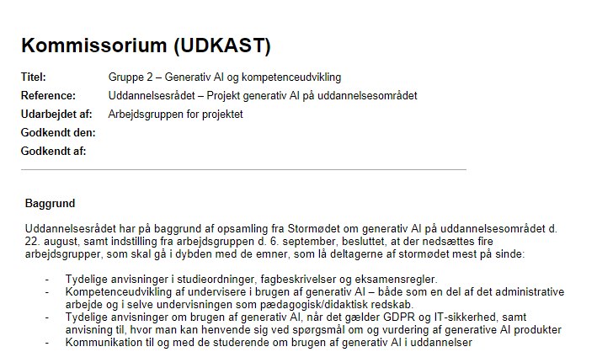
Mandate on Generative AI - Exploring its application in academic curricula and examinations
Mandate on Generative AI and Professional Development (VIP)
Mandate on Generative AI in the context of GDPR and IT Security
Mandate on Generative AI - Communication with and for the students

Slide 7
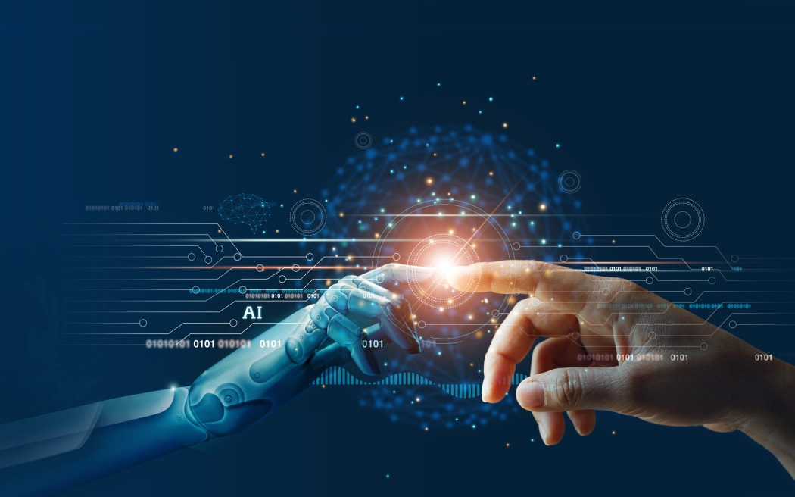
Ways AI might help students
ASSIGNING AI: SEVEN APPROACHES FOR STUDENTS WITH PROMPTS (Dr. Ethan Mollick & Dr. Lilach Mollick)
Wharton School of the University of Pennsylvania & Wharton Interactive
AI as Mentor: Providing Feedback
AI as Tutor: Providing Direct Instruction
AI as Coach: Increasing Metacognition
AI as Teammate: Increasing Collaborative Intelligence
AI as Student: The power of teaching others
AI as Simulator: Creating Opportunities for Practice
AI as Tool
Explain AI to students
Set clear guidelines for AI use
Encourage students to be critical of AI output
Use AI as a supplement to, not a replacement for, human instruction
Notes:
I artiklen "Assigning AI: Seven Approaches for Students with Prompts" fra 2023 diskuterer Lilich Mollick og andre forskere syv forskellige måder at bruge kunstig intelligens (AI) i undervisningen på. Forfatterne argumenterer for, at AI kan være et nyttigt værktøj til at hjælpe elever med at lære, men at det er vigtigt at være opmærksom på de potentielle risici.
De syv tilgange, som forskerne beskriver, er følgende:
AI-tutor
En AI-tutor kan bruges til at give eleverne individuelle vejledning og feedback på deres arbejde. Dette kan være nyttigt til at hjælpe elever med at identificere og løse fejl i deres arbejde, eller til at give dem nye perspektiver på deres læring.
AI-coach
En AI-coach kan bruges til at hjælpe elever med at udvikle deres metakognitive evner, såsom evnen til at reflektere over deres eget læringsforløb. Dette kan gøres ved at hjælpe eleverne med at spore deres fremskridt, identificere deres styrker og svagheder, og udvikle strategier for at forbedre deres læring.
AI-mentor
En AI-mentor kan bruges til at give eleverne et perspektiv fra en erfaren professionel inden for et givent område. Dette kan være nyttigt til at hjælpe elever med at udvikle deres kritiske sans og forståelse af komplekse koncepter.
AI-teammate
En AI-teammate kan bruges til at hjælpe elever med at samarbejde og løse problemer sammen. Dette kan være nyttigt til at hjælpe elever med at udvikle deres sociale og kommunikationsevner, og til at lære at arbejde effektivt i teams.
AI-tool
En AI-tool kan bruges til at hjælpe elever med at udføre opgaver, som kan være tidskrævende eller kedelige. Dette kan frigive tid til eleverne, så de kan fokusere på mere kreative eller problembaserede opgaver.
AI-simulator
En AI-simulator kan bruges til at give eleverne en sikker og kontrolleret platform til at øve sig på nye færdigheder eller koncepter. Dette kan være nyttigt til at hjælpe elever med at reducere risikoen for fejl, og til at forberede dem på virkelige-verdens situationer.
AI-student
En AI-student kan bruges til at hjælpe lærerne med at vurdere elevernes præstationer. Dette kan gøres ved at få AI-en til at udføre opgaver, som ligner dem, som eleverne bliver bedt om at udføre.
For hver tilgang diskuterer forskerne de potentielle fordele og risici ved at bruge AI i undervisningen. De anerkender, at AI kan være et kraftfuldt værktøj til at hjælpe elever med at lære, men de understreger også, at det er vigtigt at bruge AI på en ansvarlig og etisk måde.
For at hjælpe elever med at få mest muligt ud af AI-baseret læring anviser forskerne, at lærere bør gøre følgende:
Forklar for eleverne, hvordan AI virker
Det er vigtigt, at eleverne forstår, hvordan AI fungerer, og at de er opmærksomme på de potentielle risici. Lærere kan gøre dette ved at give eleverne en introduktion til AI, og ved at diskutere de forskellige måder, hvorpå AI kan bruges i undervisningen.
Sæt klare retningslinjer for, hvordan AI skal bruges
Lærere bør sætte klare retningslinjer for, hvordan AI skal bruges i undervisningen. Disse retningslinjer bør omfatte regler for, hvordan AI-systemer skal bruges til at give feedback, og hvordan AI-systemer skal bruges til at vurdere elevernes præstationer.
Opmuntre elever til at være kritiske over for AI-systemernes output
Eleverne bør opmuntres til at være kritiske over for AI-systemernes output. Eleverne bør lære at vurdere, om AI-systemernes output er nøjagtigt og relevant, og om det kan bruges til at støtte deres læring.
Brug AI som et supplement til, ikke som et erstatning for, menneskelig undervisning
AI er et kraftfuldt værktøj, men det er ikke en erstatning for menneskelig undervisning. Lærere bør bruge AI som et supplement til deres undervisning, og de bør være tilgængelige for at hjælpe eleverne med at forstå og bruge
share

Slide 8
AI and research
Mushtaq Bilal - https://twitter.com/mushtaqbilalphd?lang=da
Use AI for Structure and Not Content
Outsource Academic Labor to AI But Not Thinking
Treat AI as a Research Assistant Not a Supervisor
Don’t Over-Rely on AI and Don’t Forget to Use You Common Sense
ChatPDF is an AI-powered app that will make reading journal articles easier and faster.
Don't use ChatGPT for academic research. It creates fake citations to papers that don't even exist. Instead, use Scite Assistant — an AI-powered app designed for researchers.

Slide 9
Competences and AI of the future
Data analysis: With the huge amount of data that AI generates and uses, having data analysis skills is essential to be able to understand how to use the data in a meaningful way. It is also important to be able to identify and analyze relevant data sources to train and improve AI systems. Creative thinking: Although AI can help solve complex problems, some challenges still require creative thinking and innovation. Humans need to be able to think outside the box and find new ways to solve problems that AI can't handle. Collaboration: Since AI is often used in teams and contexts with other technologies and systems, it is important to have strong collaboration skills. This includes the ability to communicate clearly, work in teams, and understand how different technologies and systems interact. Adaptivity: Technologies and AI systems will continue to evolve and change, and it is important to be able to adapt to these changes and learn new skills and knowledge. Ethical thinking: AI can have a major impact on society and people's lives, and it is important to have a deeper understanding of ethics and fairness to ensure that AI systems are used in a responsible and ethically responsible manner. Critical thinking: The ability to harness the potential of AI in the future requires critical thinking. Critical thinking is the ability to analyze, assess, and critique information and ideas in a systematic and objective way. It is a necessary skill to make informed decisions and to understand and assess the opportunities and challenges associated with AI.
Prompt Engineering – the ability to communicate with AI, giving meaningful commands for meaningful output

Slide 10
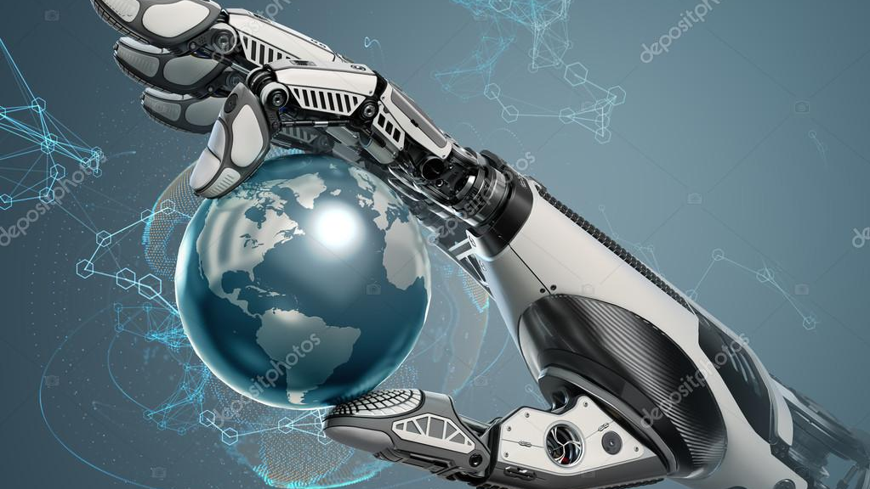
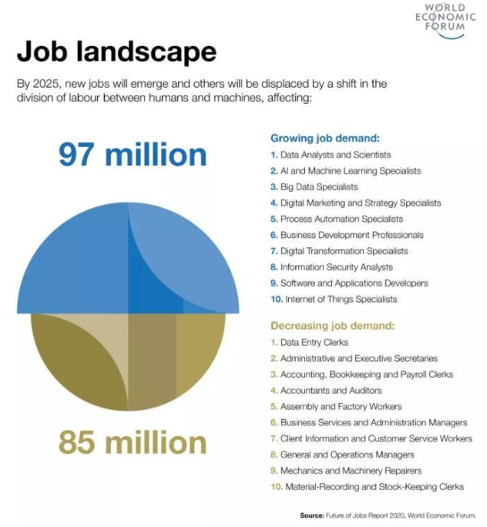
The Future Labor Market
“But beyond this, we shall endeavour to spread the bread thin on the butter-to make what work there is still to be done to be as widely shared as possible. Three-hour shifts or a fifteen-hour week may put off the problem for a great while. For three hours a day is quite enough to satisfy the old Adam in most of us!” John Maynard Keynes, “Economic Possibilities for our Grandchildren (1930)
Less people will have to work in the traditional sense and people will be less willing to do jobs they don't like. People won’t have to work to survive, and we will have to pay more for less desirable jobs, or automate them, which seems great all around. Sam Altman – CoFounder and CEO at OpenAI on X (formerly Twitter) (2021)

